Slide 1
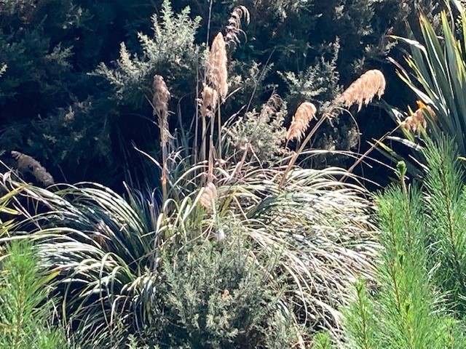
Life on Big Stone Road
Notes:
Andrea McMillan, resident of Big Stone Road.
Just reporting as a mere local, who will be impacted by the noise, dust, smell, dirt, traffic, birds, pests, etc.
Enjoy life in rural Dunedin for the space, the views, the accessibility to the local environment to enjoy the beach, and horse riding in the location.
We, as a household, collect and manage our own water and waste. We have planted many natives and improved the native bush habitat on our property, all to be undone by the DCC plans for Smooth Hill.
While we went through the standard purchasing due diligence, there was no mention on the LIM of the proposed smooth hill site.
While we have been invited to provide submissions on the plans, this is not consultation – consultation starts at the beginning of the journey, not when the plans are finalized and consent is sought.
I have two key points in this short presentation:
To relay the personal impact as a citizen of Dunedin, living close to the site
to question the lack of a social impact assessment by the DCC to international best practice standards.

Slide 2
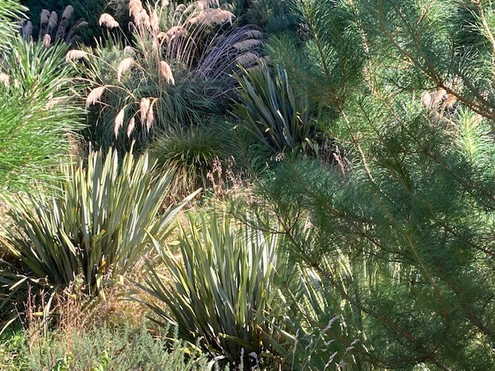
The stream
Notes:
Life by the stream.
During the various phases of this proposal, I have personally heard many references to the stream as ‘dead’ and of no value, hardly worth worrying about. There are highly qualified people here and who have already submitted feedback on the importance of the Otokia creek and wetlands. All I know, as a local enjoying the environment, that the stream is a delightful place to be, the banks have been planted out in natives 5 m either side, the bird life is fantastic. The stream is by no means ‘dead’, stagnant, or unpleasant - it is a thriving, peaceful environment that we have enjoyed as a family.

Slide 3
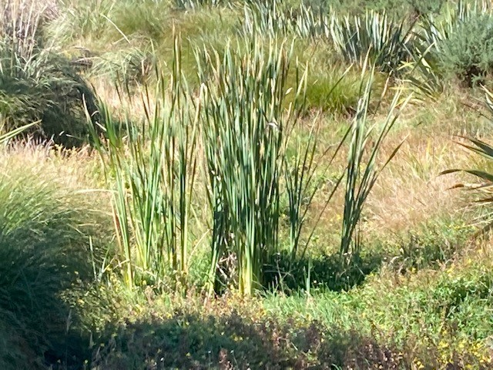

Social Impact Assessment
NZ Association for Impact Assessment
  Impact assessment methods in relevant areas of public and private sector decision making, to protect social, cultural and environmental values.
Social Impact Assessment
  Way of life – lifestyles, work, interactions and recreation
  Culture
  Community
  Political and governance systems
  Fears and aspirations
  Personal and property rights
Notes:
Social impact assessments are expected best practice. The NZ Association for impact assessment provides information on the various types of assessments, and we see examples of many assessments in this application. The social impact assessment, however, appears to me to be woefully inadequate. The NZAIA identifies a social impact assessment should consider the noted bullet points. You will note that the way of life is at the top of the list – including lifestyles and recreation – requiring protection.

Slide 4
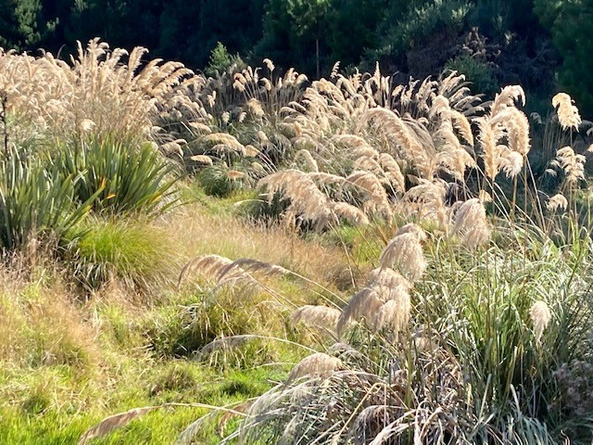
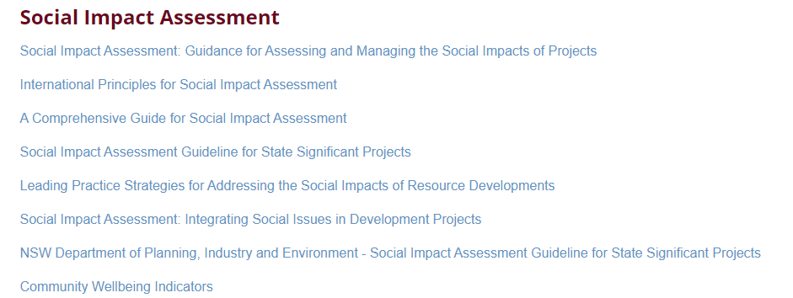
A Social Impact Assessment should:
Identify stakeholders, groups and communities impacted
Collect baseline data covering key social issues of the impacted communities
https://www.nzaia.org.nz/communityengagement.html
Notes:
The international best practice guidance is readily available on the site, including details on community and stakeholder engagement. The description of this best practice advice, is to start at the beginning, as a part of the planning process. Early, effective, and well targeted stakeholder engagement, designed to promote social acceptance of the project, to support smoother construction and operation processes. Poor quality or inadequate engagement is identified as likely to result in greater fear, anxiety and opposition towards a project. For me, there has been no engagement with me as a direct stakeholder, rather the opportunity to oppose or otherwise, after the planning process.

Slide 5
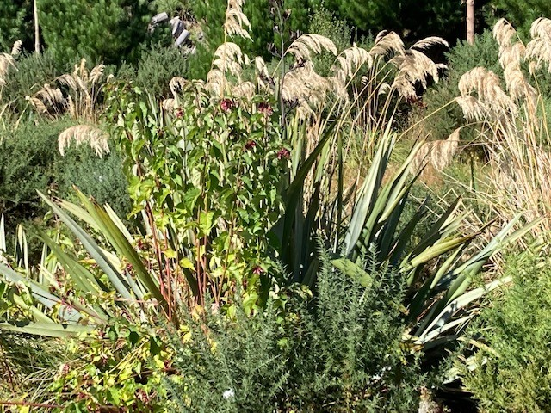
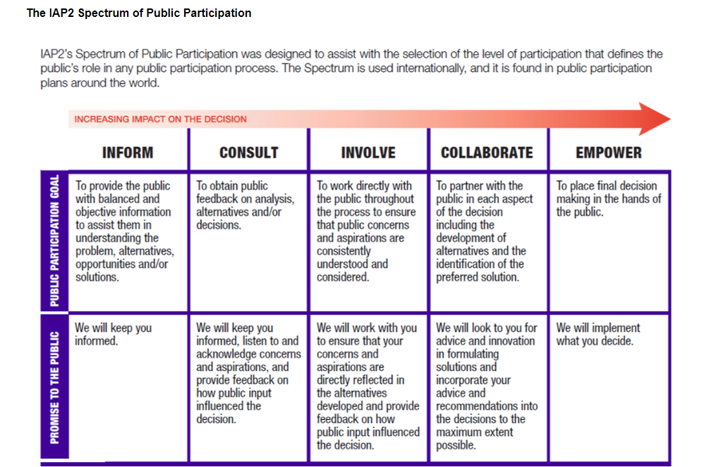
https://www.nzaia.org.nz/communityengagement.html
Notes:
This feels like a ‘fait au complet’ situation, where my needs or aspirations have not been heard or even considered as relevant. In terms of the recommended spectrum of public participation, the only step that seems to have been applied is the ‘informed’ step, and that we are consulting on the final plan and project, without the opportunity to truly consult, involve, collaborate, yet alone empower.

Slide 6
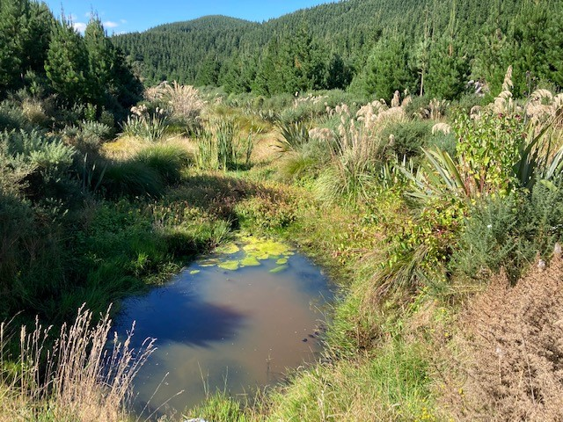
Did the DCC complete a social impact assessment?
Not from my perspective
  Geological, economic, water, air, ecological, archaeological, cultural, transport, acoustic, environmental
  Social impact assessment is severely lacking and not to an international recognized standard
  Been ‘informed’, not consulted
  Consider the social impact of a significant air incident or pollution event
    Loss of social licence and trust
    Clean up costs
Notes:
The DCC approach, to me, is not to the best practice social impact assessment – again this fait au complet approach. While I might be dismissed as only a very small, insignificant part of the process, consider the impact of an environmental or, perish the thought, a significant aviation event – the social impact of such events goes way beyond the injured individuals, to the much wider community, which needs evaluation and considered consultation.

