Slide 1
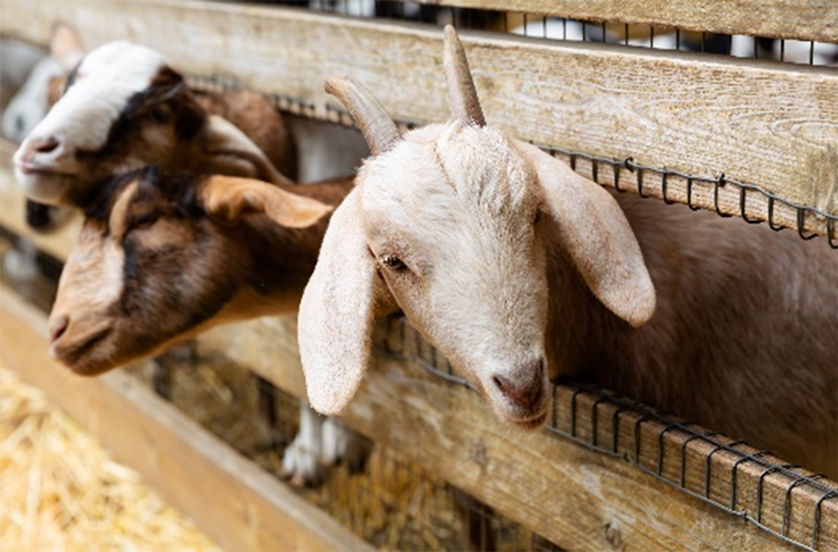
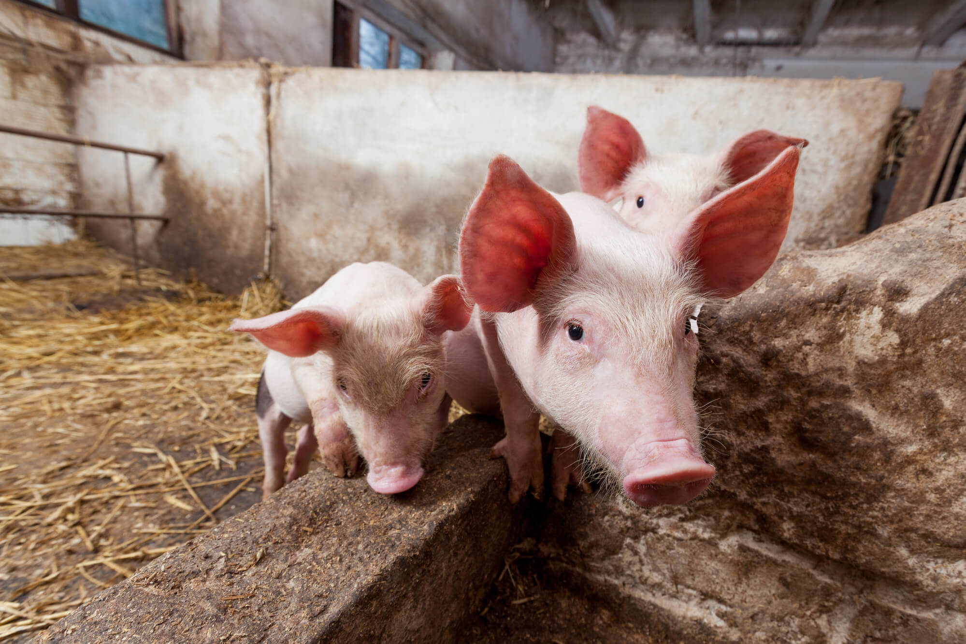
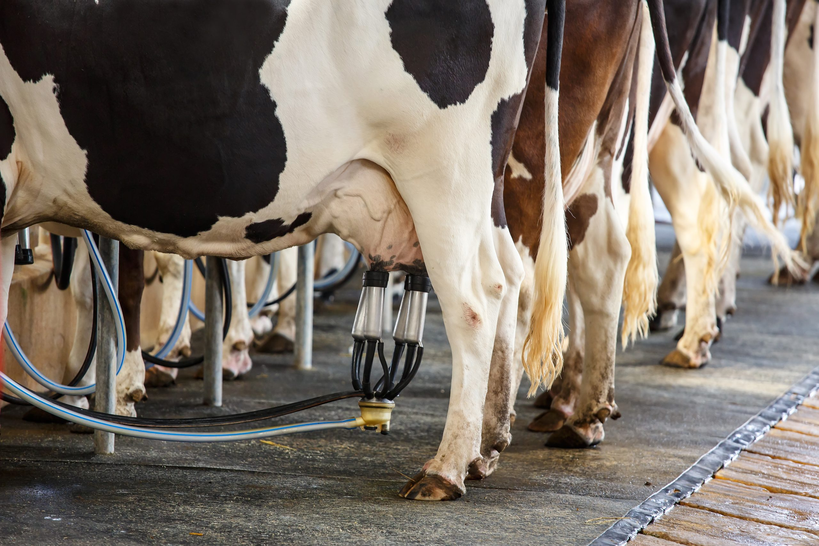
ORC Consents and Compliance
Animal Effluent Rules
Regional Plan Water
July 2023

Slide 2
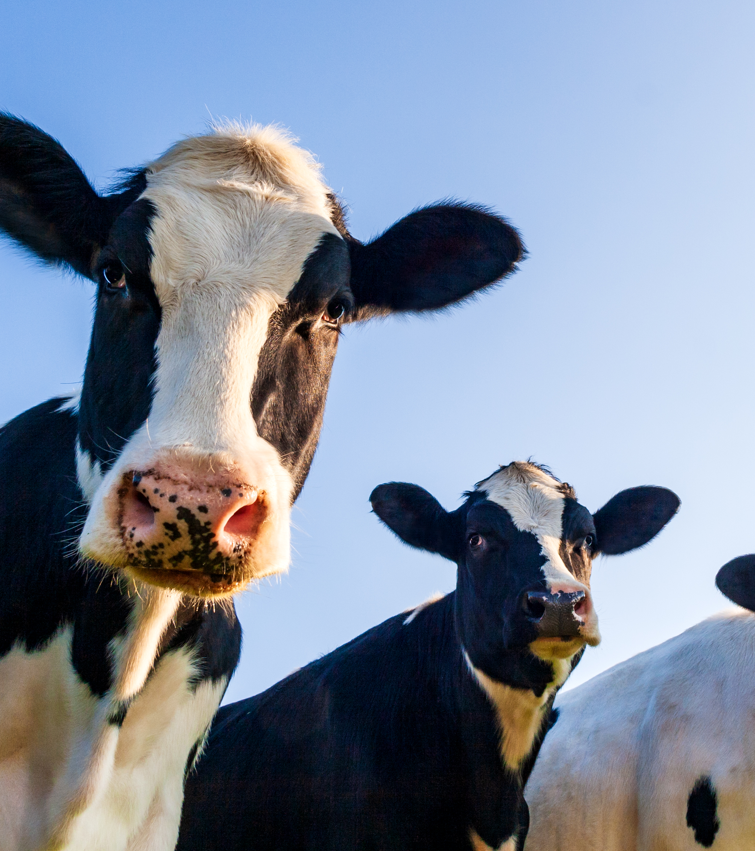
What we will cover
The rules about effluent storage and discharge
Scenarios
Compliance approach
Dairy monitoring programme
Questions

Slide 3
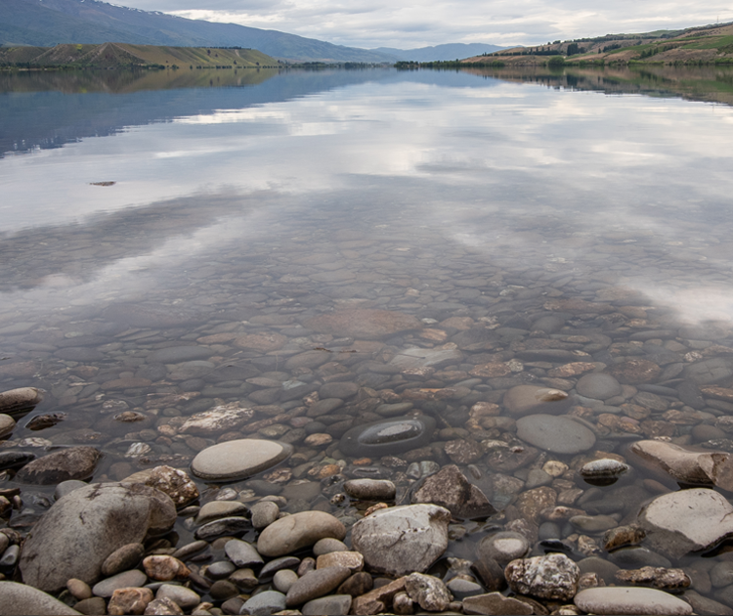
Why?
Needed rules in our plan focusing on effluent management for some time
New National Direction (NPS-FM) heavily focusing on water quality

Slide 4
Background to Plan Change 8
Plan Change notified
Environment Court
Mediation, including with industry partners
Decision
Formal adoption by Council
Notes:
Central Government introduced a new NPS-FM which heavily focused on water quality. As a result of this we needed to make some changes to the plan which is where these rules were introduced. The rules went through a plan change process where they were mediated on by a number of industry partners. It has now been formally adopted by Council and is finalised in the Water Plan.

Slide 5
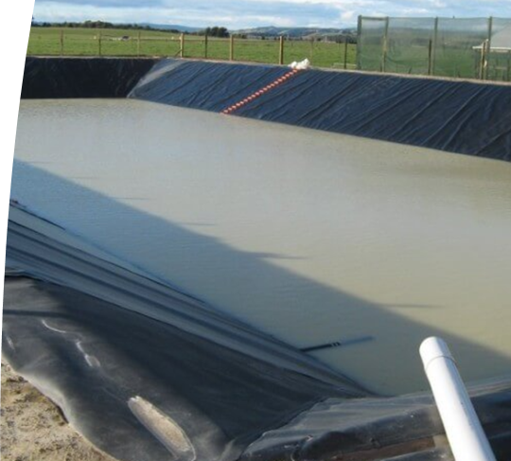
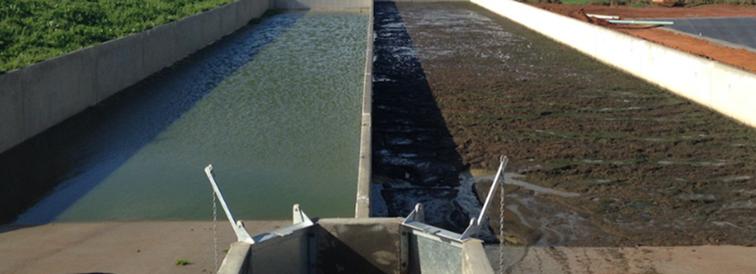
What consents you will need
Land use consent for storage
Current storage:
  may be permitted OR
  temporarily permitted
New storage
Discharge permit
Land
Air (in certain circumstances)
Notes:
You will potentially need a land use consent and a discharge permit associated with your system.
Land Use consent is required for storage of effluent from your pond, clip tank etc.
Accessories of ponds are not considered storage in the definition (e.g. stone trap, weeping wall, pump chamber etc) but there is a separate rule for those
A discharge permit is required to discharge effluent to land in most situations, apart from small scale discharges (less than 35m3 year). The timing of when this consent is needed is dependent on the land use rule that is triggered.
An air discharge permit may be required for the pond location and spray irrigation depending on distances to other properties, roads etc. With good management this can be avoided.

Slide 6
Existing structures
It is sized at the 90% volume of the DESC | √
In the last five years a SQP has certified it as having no visible holes, cracks or defects | √
Meets the pond drop test criteria | √
Management plan (schedule 21) | √
Constructed before 25 March 2020 then you MAY NOT need consent, but you need to meet all the criteria.
If you do not meet this, then you are temporarily permitted
Upgrading pond = new structure
Notes:
Mike to present

Slide 7
Temporarily permitted structures - when do I need to apply?
Using the storage calculation method in the plan work out how many days storage you have
How many days you have using the method in the plan relates to when you need to apply for consent
Days of storage ​ | Date that consent needs to be applied by based on existing use rights
0 – 10 ​ | 4 June 2023
11 – 40 ​ | 4 December 2024
41+ ​ | 4 December 2025
Notes:
The method in the plan is to stagger the applications and focuses on the higher risk ones first, also allows pro active people to apply now
Mike to do

Slide 8
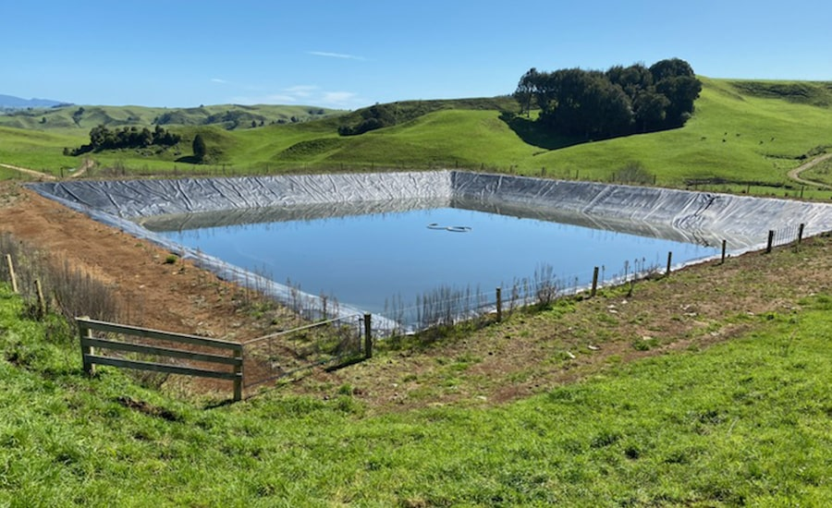
New Structures
Using land for the construction, use and maintenance of a new structure needs consent
Focusing on location, management plan, design of pond to ensure pond will avoid adverse effects on the environment
Apply for discharge permit at the same time

Slide 9
Components of an animal effluent system
This is your sludge bed, weeping wall or sump etc
It will be permitted if:
  the volume is less than 35,000 litres; AND
  It has no holes, visible cracks or defects; AND
  It is not located within 20m of specific features.
If volume is over 35,000 litres may still be permitted but needs to be certified by SQEP in last 5 years.
Notes:
The volume is more than 35,000 litres; AND
A suitably qualified person under Schedule 20 has, in the last 5 years, certified as having no cracks, holes or defects that would allow effluent to leak; AND
It is not located within 20m of any lake, river, Regionally Significant Wetland, bore or soak hole or water supply used for humans.
If the combined volume of the animal effluent system exceeds a total of 35,000 litres people will also need to prepare a management plan under Schedule 21.
If people can’t meet any of the above, then they will need to apply for consent.

Slide 10
Rule of thumb - do I need consent?
Structure | Consent?
sludge bed or weeping wall | Generally will be permitted
Build a new pond or tank now (including upgrades) | Consent needed
Existing structure | Some permitted*
 | Some temporarily permitted, but will need to put new storage in

Slide 11
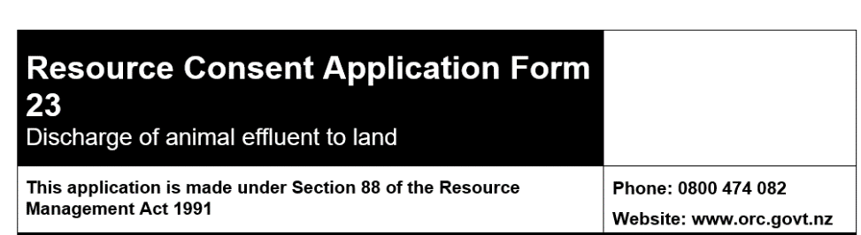
Discharge of effluent to land
When you apply for a land use consent you will need a discharge permit. You can apply for these at the same time.
If you do not need a land use consent you will need to apply for a discharge permit. This is required now.
Notes:
Permitted for as long as your LUC is permitted unless discharging within 20 m of the property boundary
Less than 35m3 per year

Slide 12
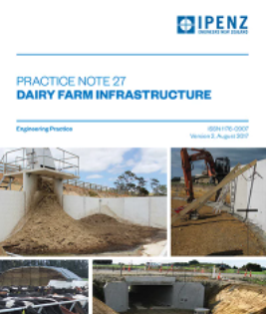
Suitably Qualified Person
Running the DESC
1
Creating storage plans
2
Checking for structural integrity
3
Figuring out how many days storage you have
4
Notes:
Certain requirements where you need a SQEP. Do it once and do it right so strongly encourage using the right people. You might need a different SQEP to do the effluent storage calculator vs designing the animal effluent system but it could be the same person if they meet the criteria
In terms of the Application, we have made our forms as straight forward as possible to help with . Otherwise you may wish to seek planning advice.

Slide 13
Management Plans
Schedule 21 sets out what you need
Need this for your discharge and land use
Key questions:
What if I already have a management plan?
Who can help me?
Notes:
(a)Prepared by the owner or their agent;
(b)Reviewed at least once every 12 months; and
(c)Provided to the ORC upon request.
Needs basic info showing key info of farm showing location of pond, where you are discharging, watercourses, bores etc as well as contingency measures if things go wrong

Slide 14
Scenario time
I have done the calculation and I have 10 days storage – what next?
I think my existing pond/tank is permitted – do I need to do anything?
My pond was built after March 2020 – what happens here?
My pond is permitted, do I still need a discharge permit?
Notes:
You need to apply now for both discharge and LUC
It always helps to check with our public enquiries team if you are unsure. Note you may still require a discharge permit for land application.
You will need to apply for a LUC and DP now. Please contact our public enquiries team for more info on this
Yes, unless small scale. Application date may vary depending on pond.

Slide 15
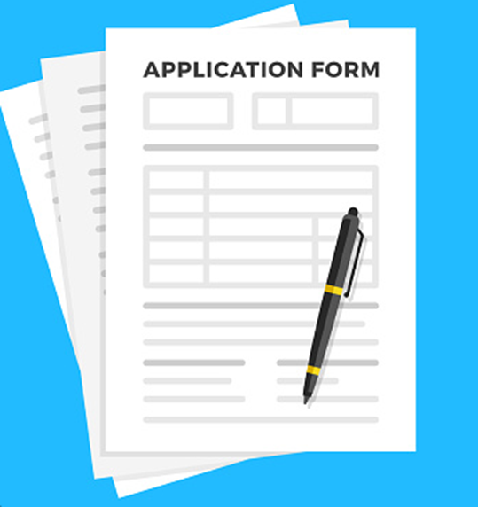
What information goes in my application?
Plans for your storage
Dairy Effluent Storage Calculation using the DESC
Policy and effects assessment
Management Plan
Notes:
We have tried to make the application forms as user friendly as possible like the IWG process – trying to keep things simple. Have done alot of the assessment for you so you can tick what applies rather than reading through a plan full of policies to see what applies.

Slide 16
Consent conditions – land use
Ongoing use and maintenance
Construction related
Management Plan
Notes:
Set backs from rivers, bores etc
Managment Plan
Ensuring built properly
Annual visual inspections to check for cracks etc

Slide 17
Consent conditions – discharge
Where, when and how
VOLUME
Management Plan
Exclusions
Notes:
Maximum volume to be discharge
Where, when (application rate, set back distances etc)
Management Plan
Effluent is valuable when used properly so just putting conditions on to make sure it is used correctly.

Slide 18
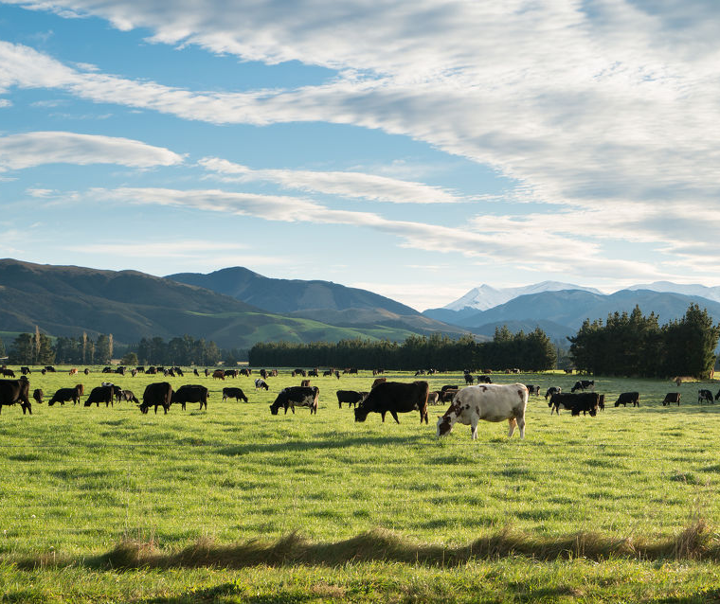
What should I be doing now?
Good time to think about:
  If you need consent:
  Have a chat to us
  Start preparing your application
  For the future:
  Pond drop tests
  Get someone to do a DESC
  What storage on farm may look like for you
  Getting someone to do a visual inspection of your storage
  Talking to a trusted advisor and Council

Slide 19
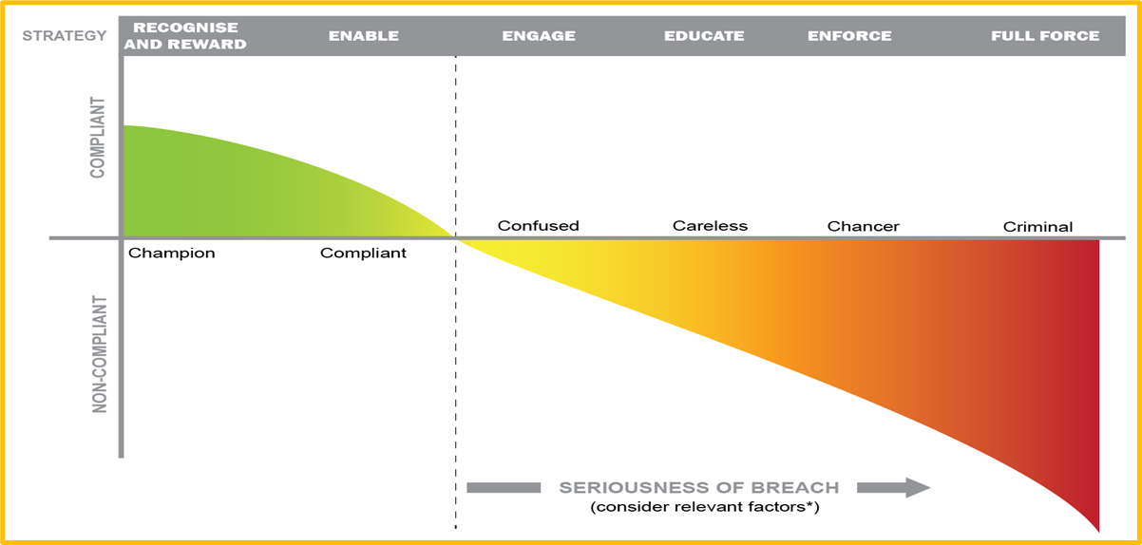
Approach to compliance
ORC staff will work with you to understand the rules and how they will effect your farm
An education first approach will be taken with a focus on achieving compliance
Gross discharges will not be acceptable
Additional time will be allocated to on-site meetings to ensure you have access to advice
If you’re unsure please contact ORC and someone will be available to assist

Slide 20
Dairy monitoring programme
Permitted activity dairy programme continues for 2023-24 season
  Farm landfills, offal pits, silage (Waste Plan)
  Compliance with current effluent rules
  Request information on compliance with new rules
  On-site audit/assessment of compliance with consent conditions
Consent monitoring – chargeable activities
  Assessing information supplied as part of consent conditions (eg, management plans)
  Preparation of consent audit reports
  Follow-up from consent non-compliance
Reactive monitoring to pollution complaints – 24/7 pollution hotline

Slide 21
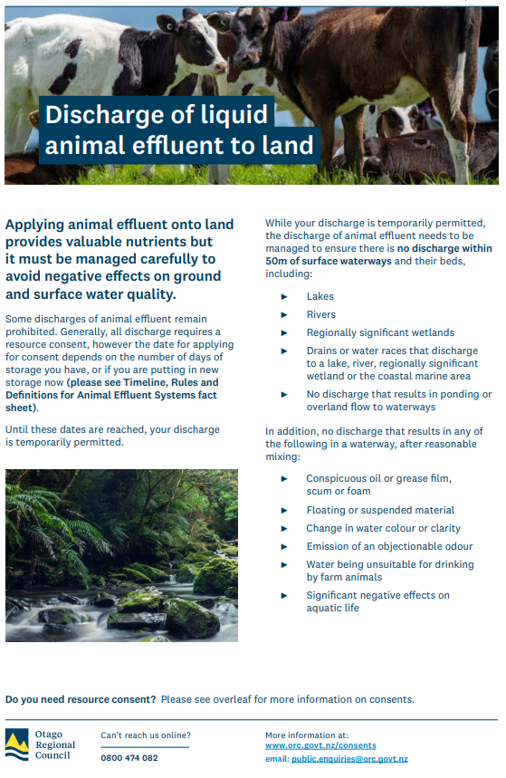
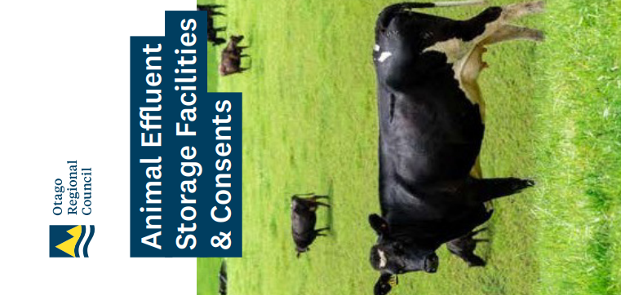
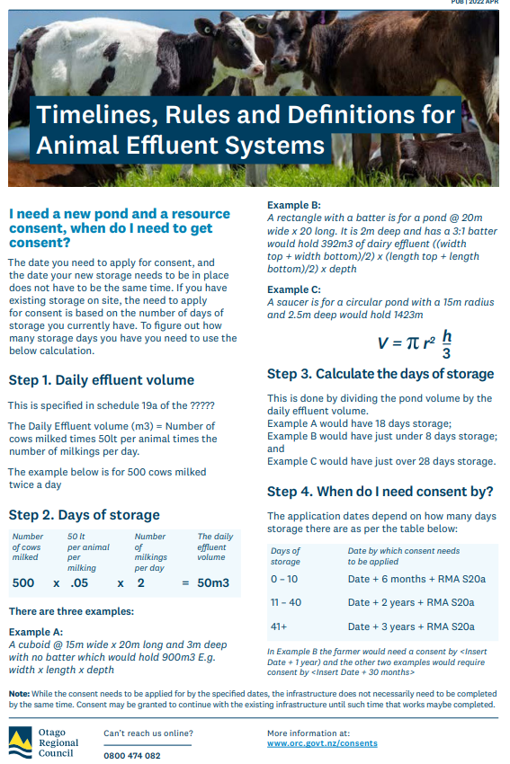
How we will help
Resources
  Application forms
  Factsheets
Advice:
  Consent questions (0800 474 082)
  Good management
  Catchment Advisors and Compliance Teams
Field days or workshop sessions
How can we help?

Slide 22
Questions

