Slide 1
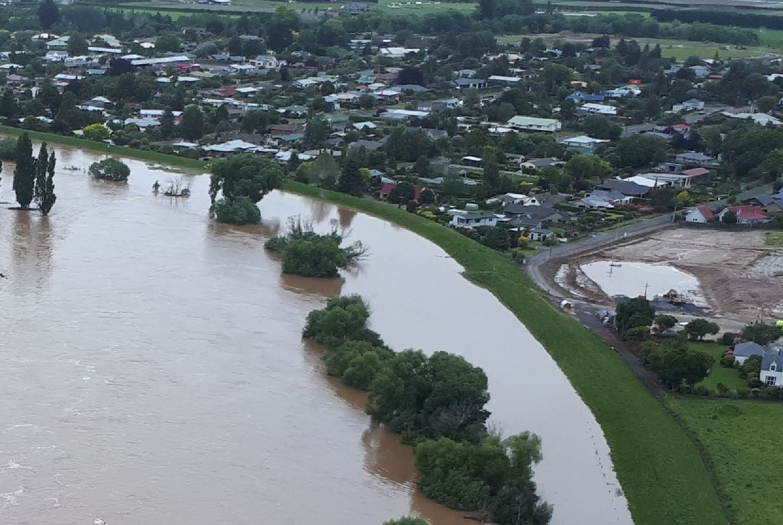
Lower Taieri Floodbank Risk Assessment
8th February 2024 – Otago Regional Council Safety & Resilience Committee
Outram, November 2018

Slide 2
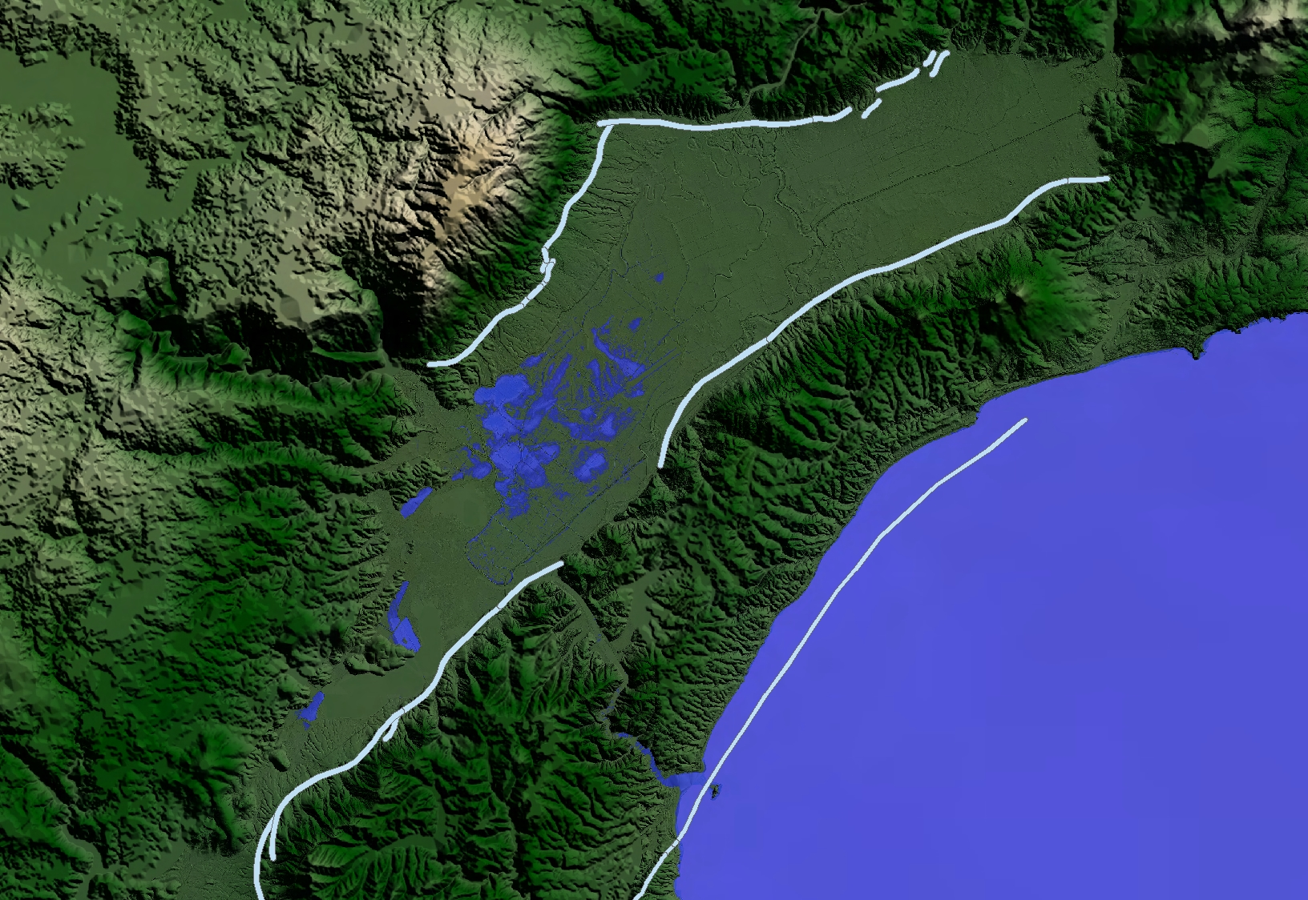
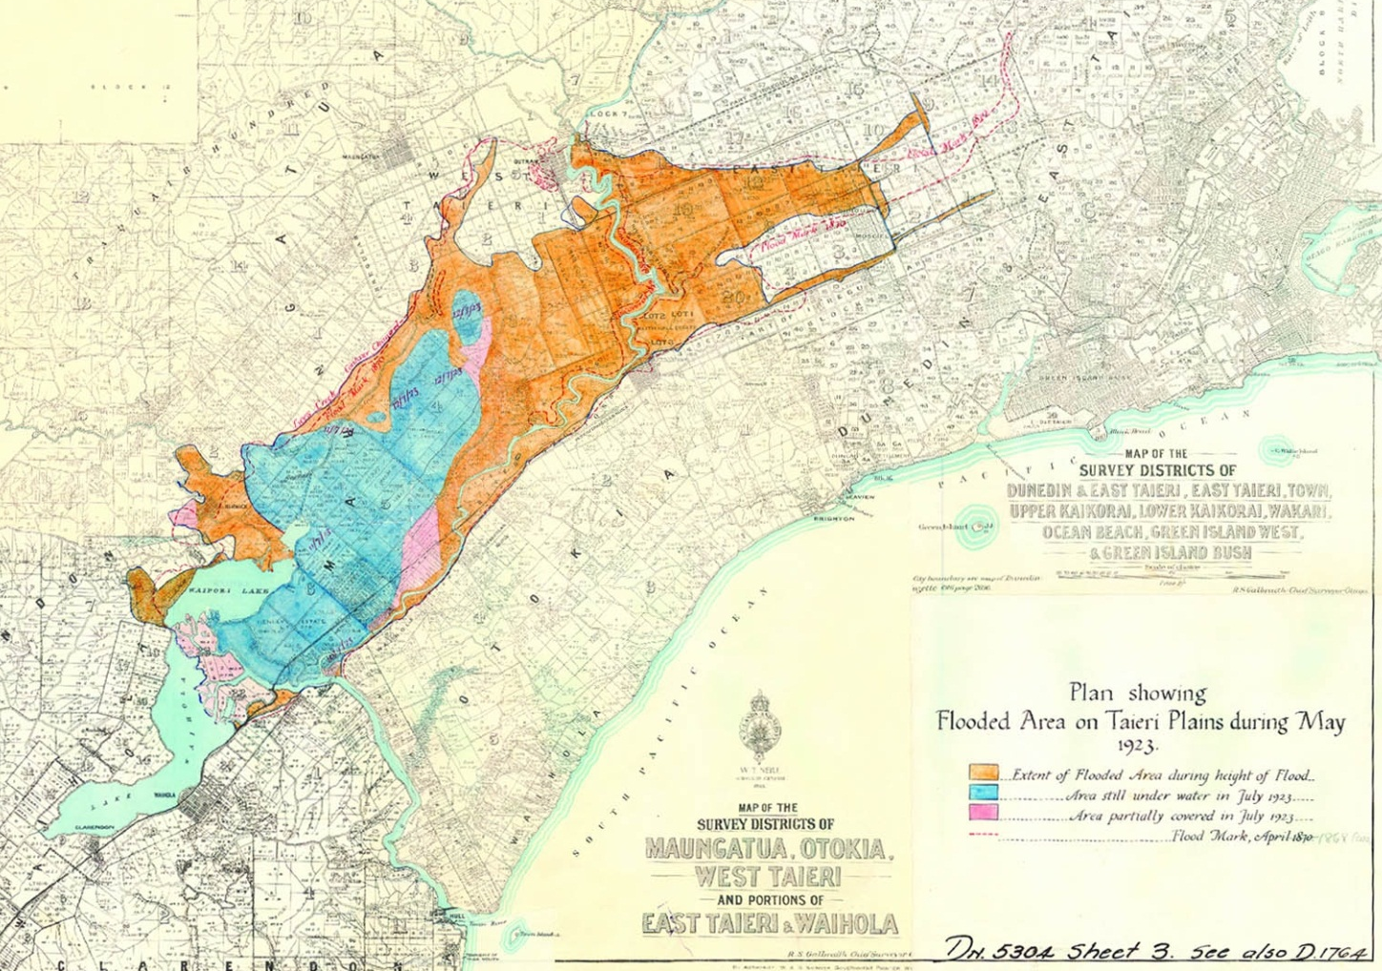

NATURAL HAZARDS ON THE TAIERI PLAIN
Peak flow: 1750m³/s
Topography of the Taieri Plain, areas below mean sea level (shaded blue) and fault lines (indicative)
May 1923 flood extent
Notes:
Remind about NH info on Taieri
Not new FH on Taieri
Area of the plain topography sitting below sea level.

Slide 3
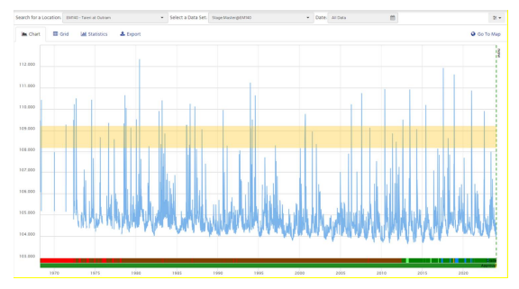
RECORDS AT OUTRAM
1980
2017
Outram
Taieri River Stage at Outram whole of record (1968-2024) with berm level super imposed (orange shaded area), indicating when river channel capacity is exceeded.
Notes:
Remind about Flood Hazard info on Taieri
Not new Flood Hazard on Taieri
Noting that we have tested the scheme as part of this risk assessment to 3000m3/s for the Taieri. This is slightly greater than the largest flood on record (being 1980) and the current design LoS of 2500m3/s.
This is to stress the scheme to identify areas of risk and allow a conservative approach

Slide 4
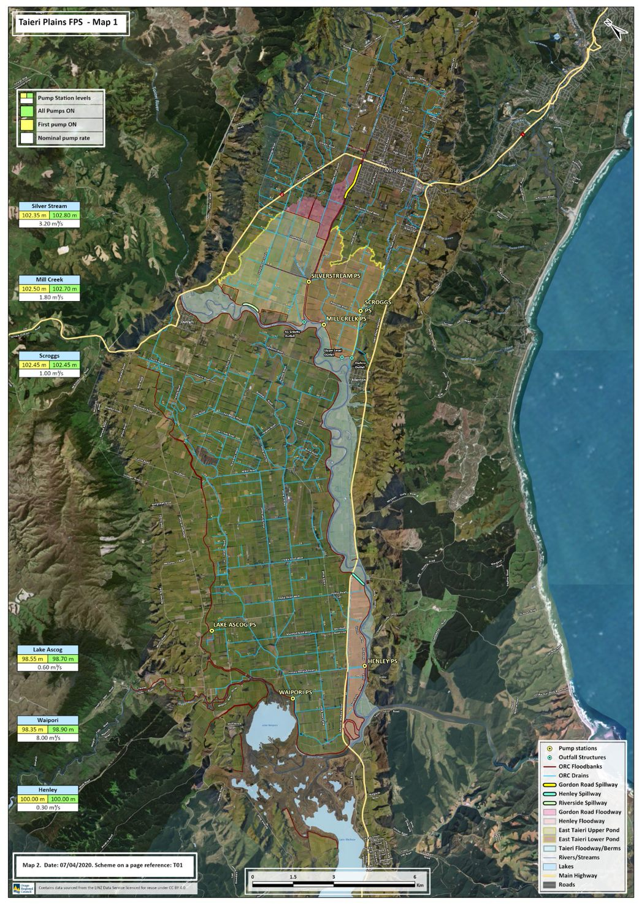
LOWER TAIERI FLOOD PROTECTION SCHEME
The Lower Taieri Plain has a long history of flooding, and development of drainage and flood protection works goes back to the early 1900s.
The Lower Taieri Flood Control Scheme provides flood protection to an area of approximately 18,000 ha of the Taieri Plain (109 km of floodbanks).
The scheme provides important protection to what is predominantly a farming area, along with the townships of Mosgiel, Outram, Momona, and the Dunedin Airport.
Notes:
A reminder of the scheme.
Covers a large area reliant on floodbanks and pumping.
Protects large areas of farmland, townships and critical infrastructure (e.g. Airport)

Slide 5
This is included as Appendix C of Lower Taieri Risk Assessment paper
Notes:
This has been included here and as an appendix to the paper to demonstrate the complexity and layers of work involved in the wider programme.
It is an internal brainstorming and planning document used by ORC staff to guide projects.
What is important to note here is where we are currently in the “Identifying what our scheme does now phase” and to show where this work will ultimately lead us into identifying how safe we want to be with the scheme and how we get there… pathways forward for the scheme.

Slide 6
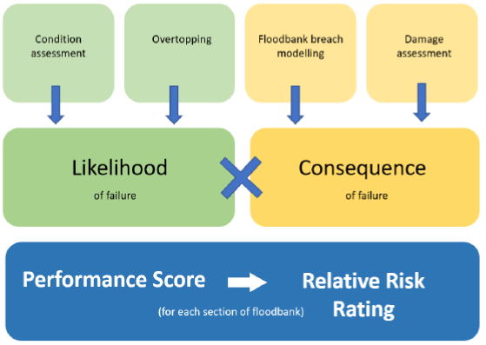
FLOODBANK RISK ASSESSMENT
Assessed* all floodbanks in scheme
  Risk: likelihood x consequence of failure
  Likelihood of failure (3 failure modes):
  Field condition
  Intrinsic strength
  Capacity
  Consequence
  Social
  Environmental
  Economic factors
  Ratings based on high-level floodbank breach 2D hydraulic modelling
RMF spreadsheet tool then provided an overall risk rating for each floodbank section
  *Generally followed NZ River Managers Forum (RMF) Code of Practice document ‘Flood Protection Assets Performance Assessment Code of Practice’, March 2015.
Notes:
Floodbank sections:
field condition assessment 2017/18, soon after the July 2017 flood event. (mid-points)
Field Condition: field condition assessment 2017/18
Intrinsic strength: combination of both quantitative geotechnical analysis and qualitative evaluation incorporating the results of the 2017/2018 field condition assessment.
Overtopping: quantitative water level review, field observation data and engineering judgement. (comparing flood levels modelled by ORC (~3,000 m3/s event) to the foodbank crest levels.)
quantitative water level review was undertaken by comparing modelled flood levels (ORC (~3,000 m3/s event)) to the floodbank crest levels.
ORC 2D model 2020 and crest level 2021LiDAR
Breach modelling: 2D hydraulic model developed by T+T. Zomorodi 2020 theoretical equations to estimate the peak discharge (Qpeak), dimensions etc
Consequence categories: social, environmental and property flood inundation
PAR, road rail, airport, power, Environment, Property damage,

Slide 7
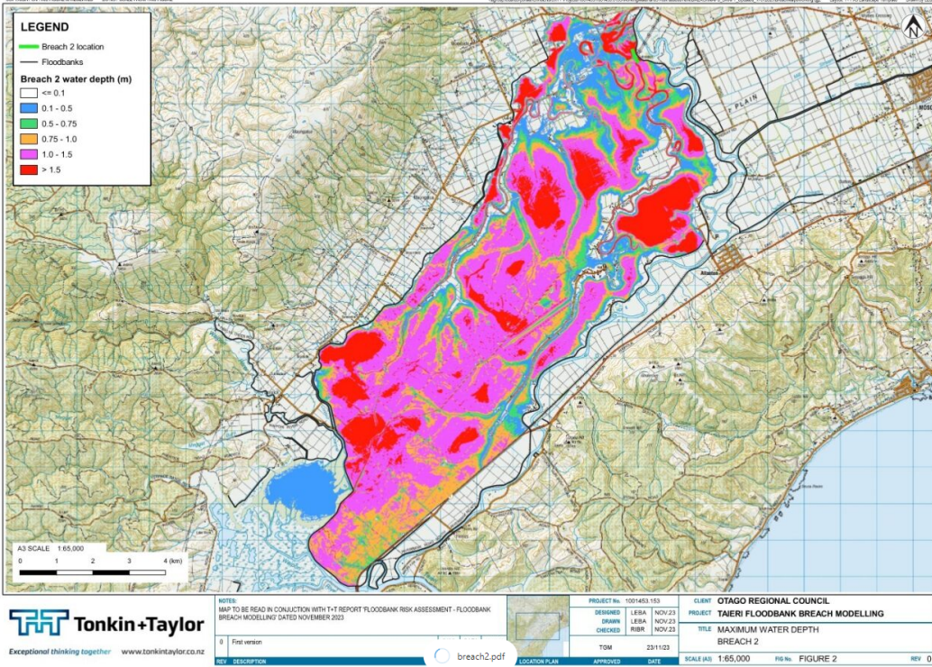
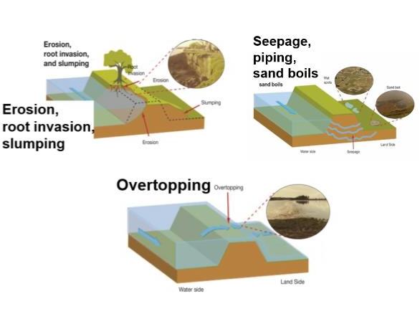
Notes:
Risk is a combination of these factors… consequence (area and what is within this area) and likelihood (different methods of failure)
Breach scenario location 2: Taieri true right bank, directly downstream of Outram
Contributing factors to extreme risk sites –
Site 1 – There is little to no berm along this section of bank meaning the river runs up to the toe of the bank. The land adjacent to the floodbank (landward side) is lower that the river level. This situation creates an increased risk of piping within the floodbank. There is also a tree growing close to the toe of the floodbank elevating the risk further.
Site 2 – The floodbank level at this location tappers down to allow the floodbank to tie into the access area for the bridge on Henley – Berwick Rd. This creates and increase risk of overtopping at this location.

Slide 8
FLOODBANK RISK RATING SUMMARY

Slide 9
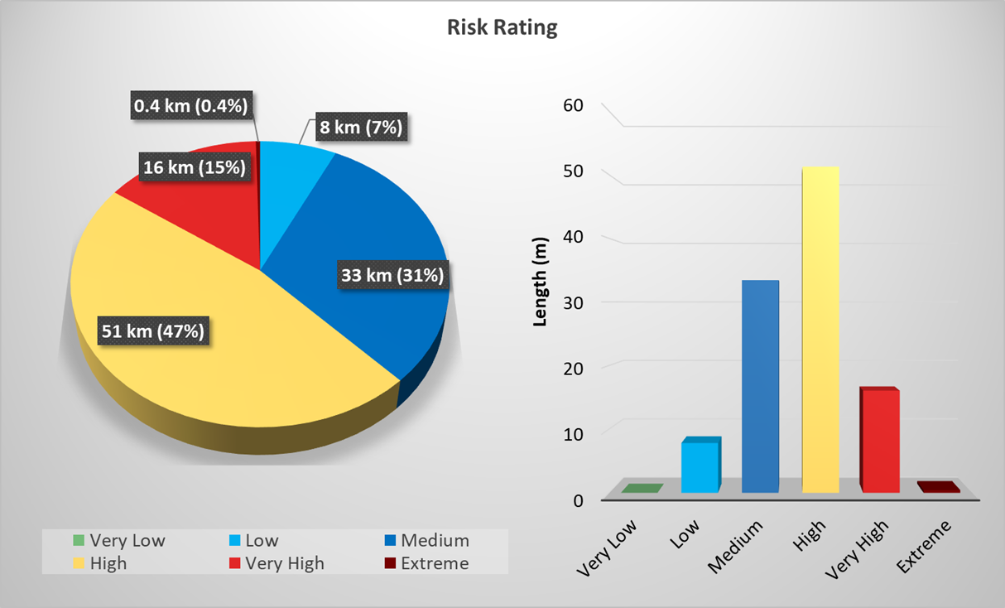
FLOODBANK RISK ASSESSMENT – Risk Rating
Notes:
Risk rating significantly impacted by consequence component. PAR, buildings and airport
Majority of risks fall within “Medium” and “High” the two midrange categories of the relative scale we have used.

Slide 10
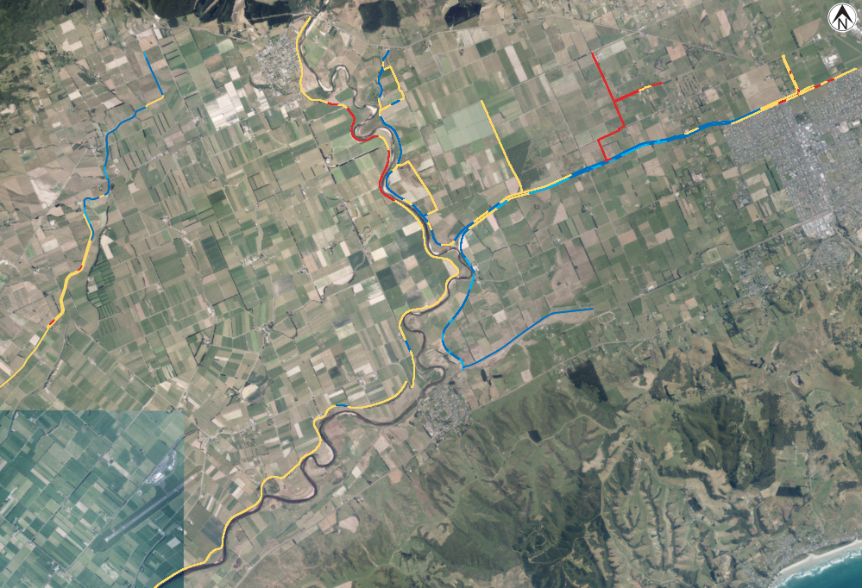
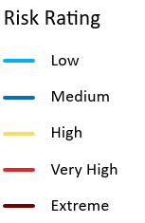
FLOODBANK SECTION RATING
Relative Risk Rating – East Taieri
Notes:
Visual representation of where these risk categories lie within the plain - East Taieri:
Cutoff bank – overtoppng/capacity
True right bank of Taieri -
Small locations along True left bank SS -

Slide 11
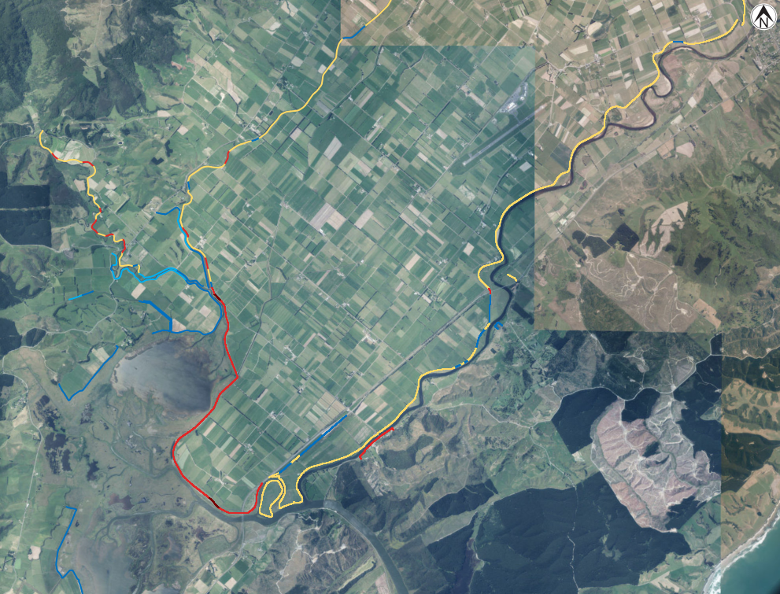
FLOODBANK SECTION RATING
Risk Rating - West
Notes:
Visual representation of where these risk categories lie within the plain - West Taieri:
Waipori downstream of contour channel
Henley - overtopping

Slide 12
WHAT DOES THIS MEAN / WHAT NEXT?
Results from the T+T risk assessment do not significantly change our understanding of risk to the area, although it does consolidate this information and visually demonstrate known areas of concern.
We’re sharing this report to keep the public up to date on our wider programme of asset management and resilience work for the Lower Taieri Flood Protection Scheme.
This report provides a relative assessment of risk, identifying critical sections to prioritise where we investigate further and build resilience.
We will account for findings in our infrastructure strategy and asset management programs
  Each of the identified risks will be assessed further (Identifying drivers and what can be done to reduce it)
The information in this report will support the next stages of works “How safe do we want to be?” and “How do we close the gap?”
Notes:
Some risks can be mitigated through engineering works and/or investigations, however many cannot.
For some risks mitigation measures through infrastructure management may not be possible. In these instances, consequence is the main driver of risk and while infrastructure solutions may not work other measures may be needed.

Slide 13
IMMEDIATE ACTIONS/WORK PROGRAMMES
Investigation and planning is already underway to address the two sections of floodbank identified as extreme risk.
An investigation is planned for all remaining sections of floodbanks, triaged based on severity of their risk rating. This will involve reviewing the drivers of the likelihood of failure ratings and what appropriate risk mitigation measures can be effectively implemented.
These measures will be factored into current Annual Plan (FY2023/2024) and prioritised with current planned works.
Notes:
Contributing factors to extreme risk sites –
Site 1 – There is little to no berm along this section of bank meaning the river runs up to the toe of the bank. The land adjacent to the floodbank (landward side) is lower that the river level. This situation creates an increased risk of piping within the floodbank. There is also a tree growing close to the toe of the floodbank elevating the risk further.
Site 2 – The floodbank level at this location tappers down to allow the floodbank to tie into the access area for the bridge on Henley – Berwick Rd. This creates and increase risk of overtopping at this location.

Slide 14
COMMUNICATION PLAN
Before Committee Meeting
Email to stakeholders sent week of 29 January. Report included (embargoed) along with invitation to meet in person should they wish.
  Dunedin City Council
  Dunedin International Airport
  Aukaha
  Waka Kotahi
  Future Development Strategy team through ORC Project Manager
Media release
Post Committee Meeting
Presentation to Mosgiel Taieri Community Board (8 February)
Public information sessions to be held – date and venue TBC
Social media – using simple, clear language.
Other stakeholders to be advised of report, and invited to attend information sessions
  Property Owners – noting there will be some landowners who will need to be expressly contacted.
  Transpower
  Ministry of Education
  Metservice
  Emergency Services
  DoC and Fish and Game

Slide 15
End of presentation – thank you

Slide 16
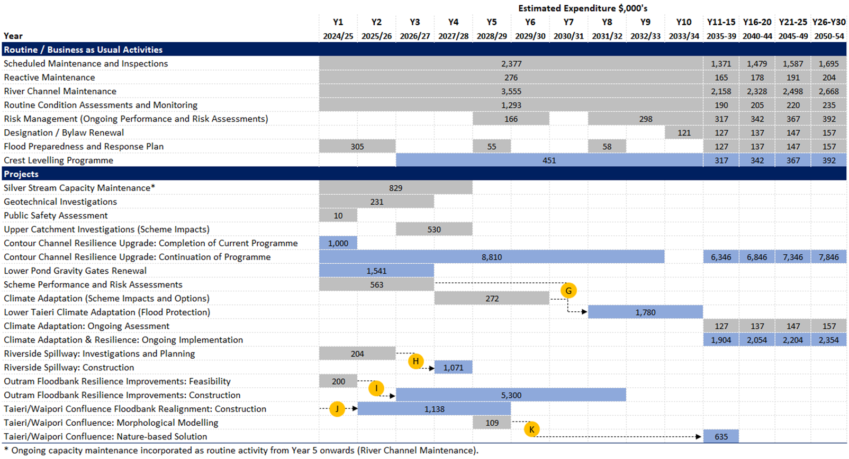
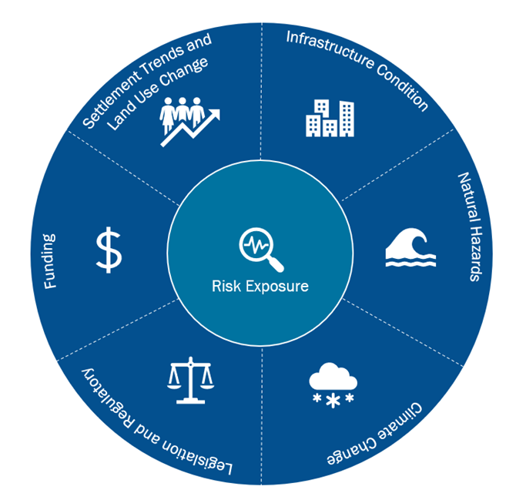
FUTURE LTP, ON-GOING RESLIENCE WORK
Significant Issues, Infrastructure Strategy 2024 - 2054

Slide 17
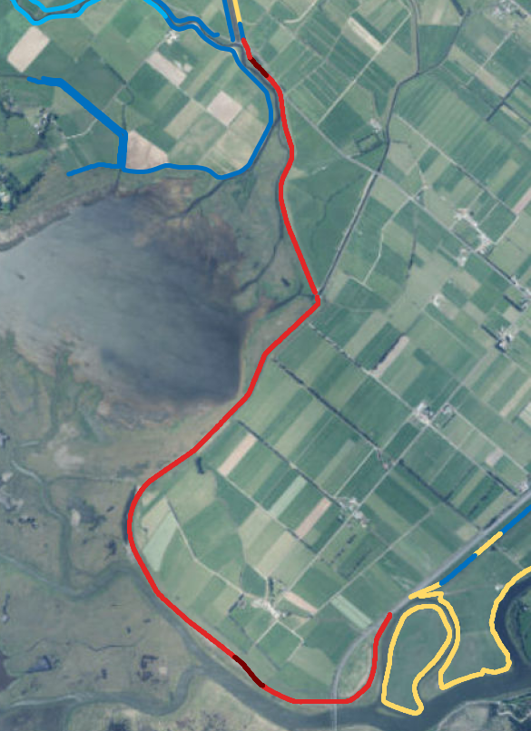
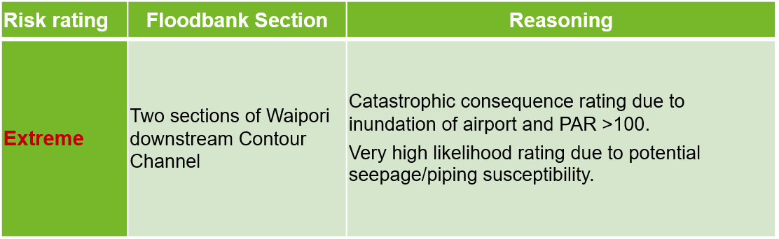
Results: Summary

Slide 18
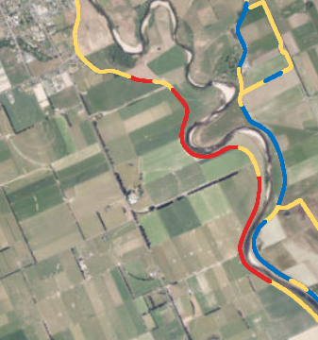
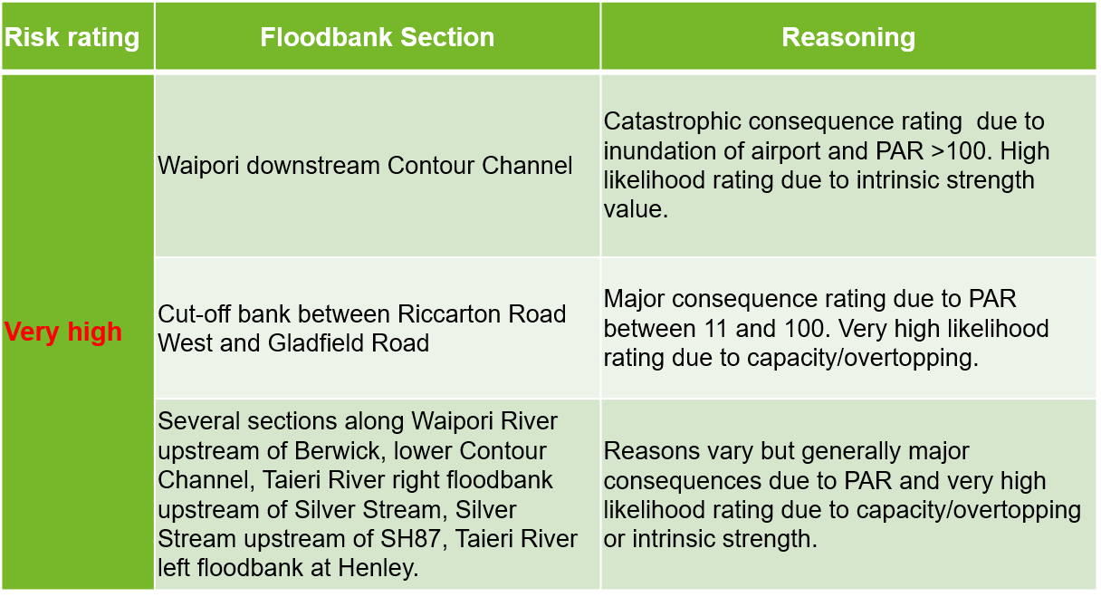
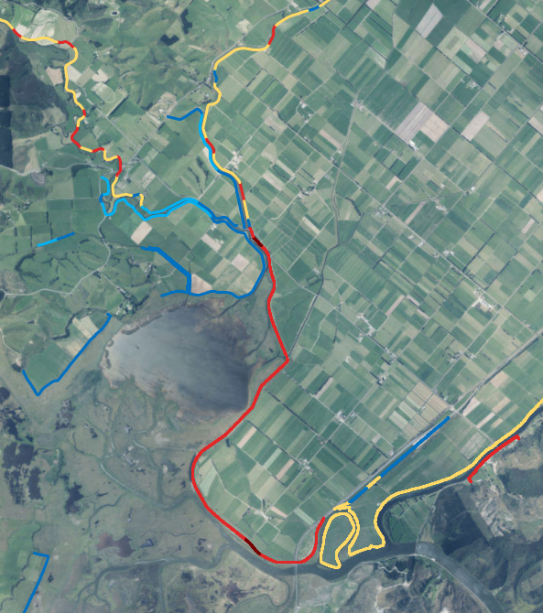
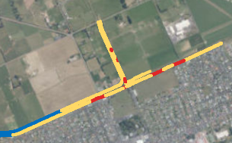
Results: Summary

Slide 19
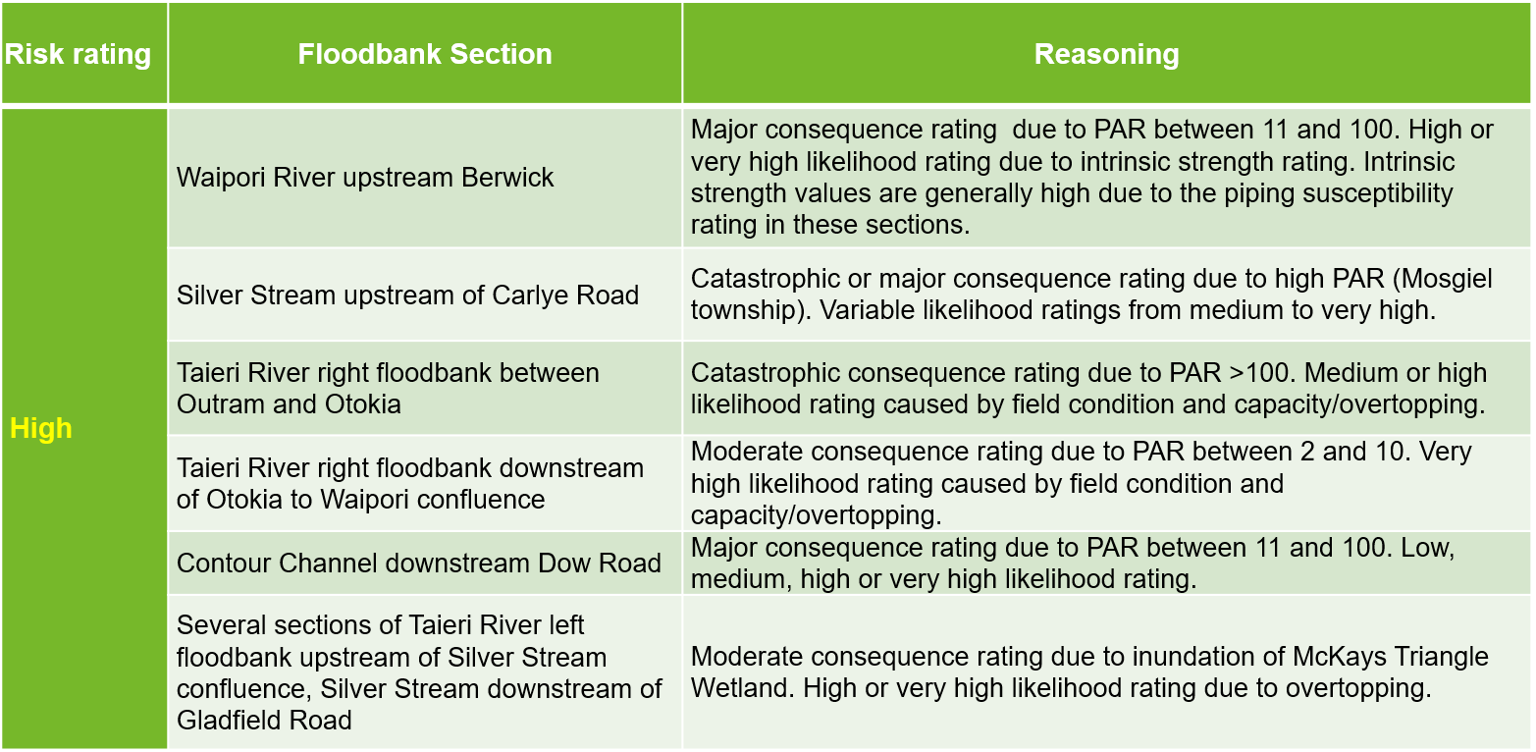
Results: Summary

Slide 20
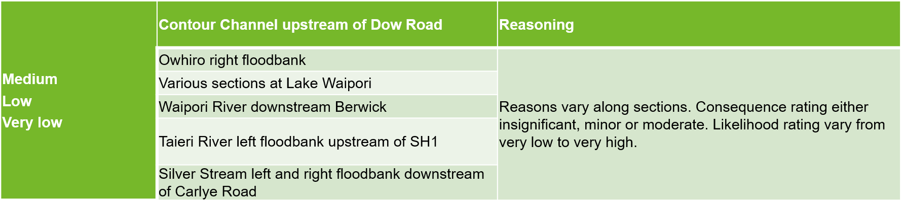
Results: Summary

Slide 21
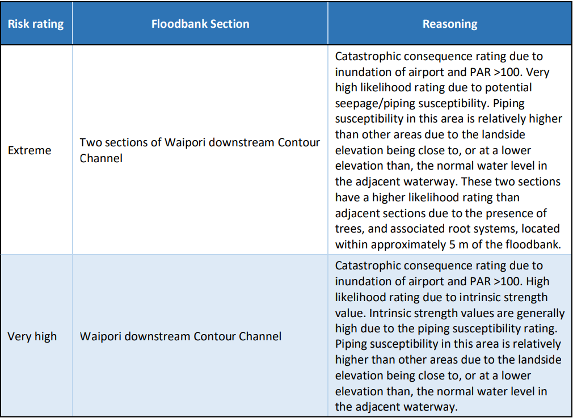
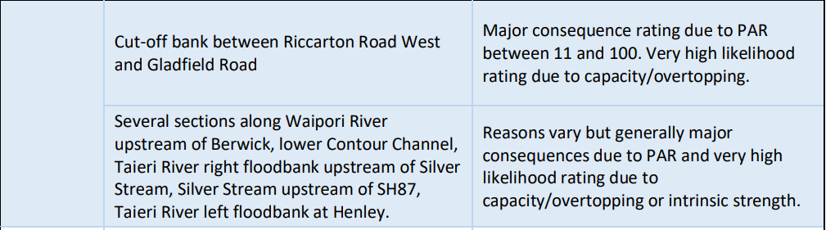
FLOODBANK RISK ASSESSMENT
General reasoning for risk rating

Slide 22
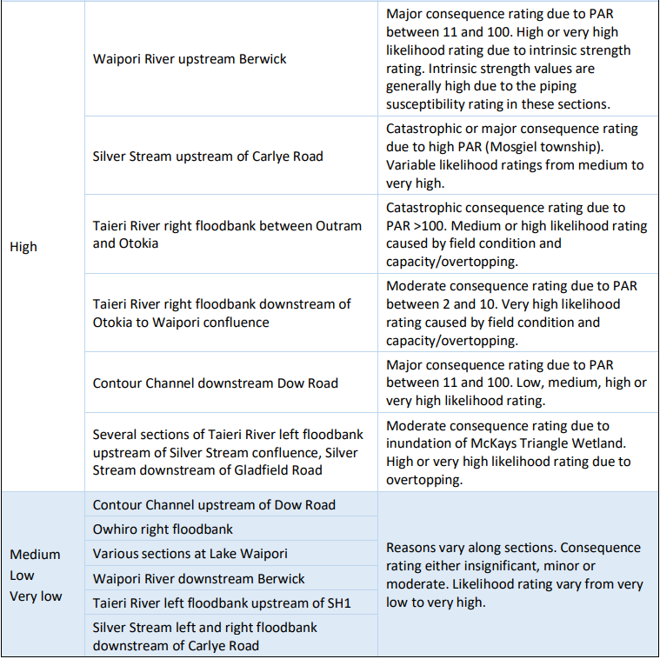
FLOODBANK RISK ASSESSMENT
General reasoning for risk rating

Slide 23
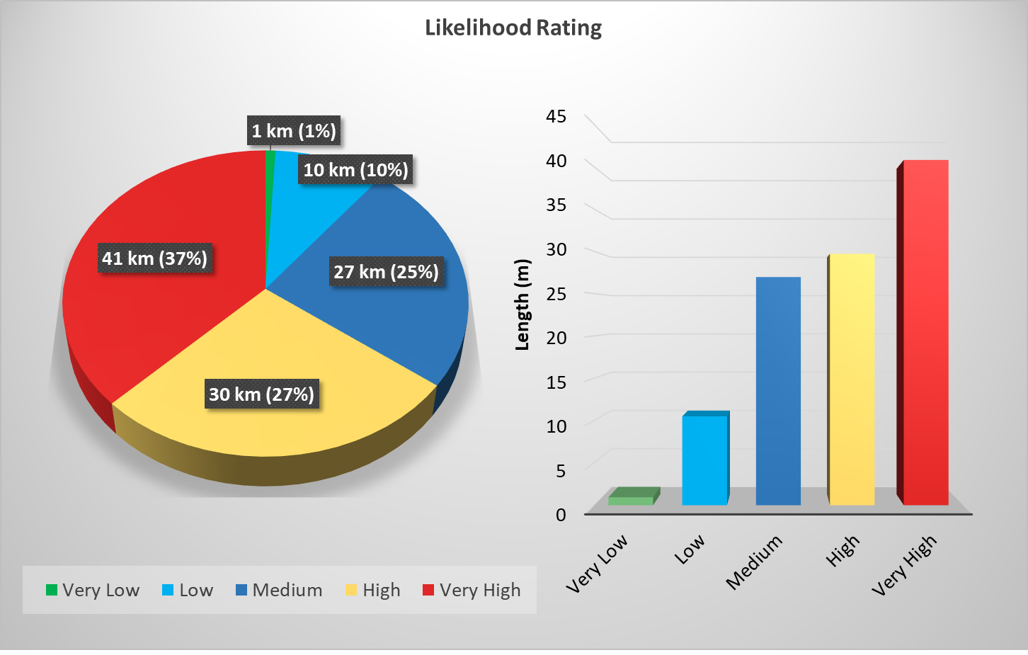
FLOODBANK RISK ASSESSMENT – Likelihood

Slide 24
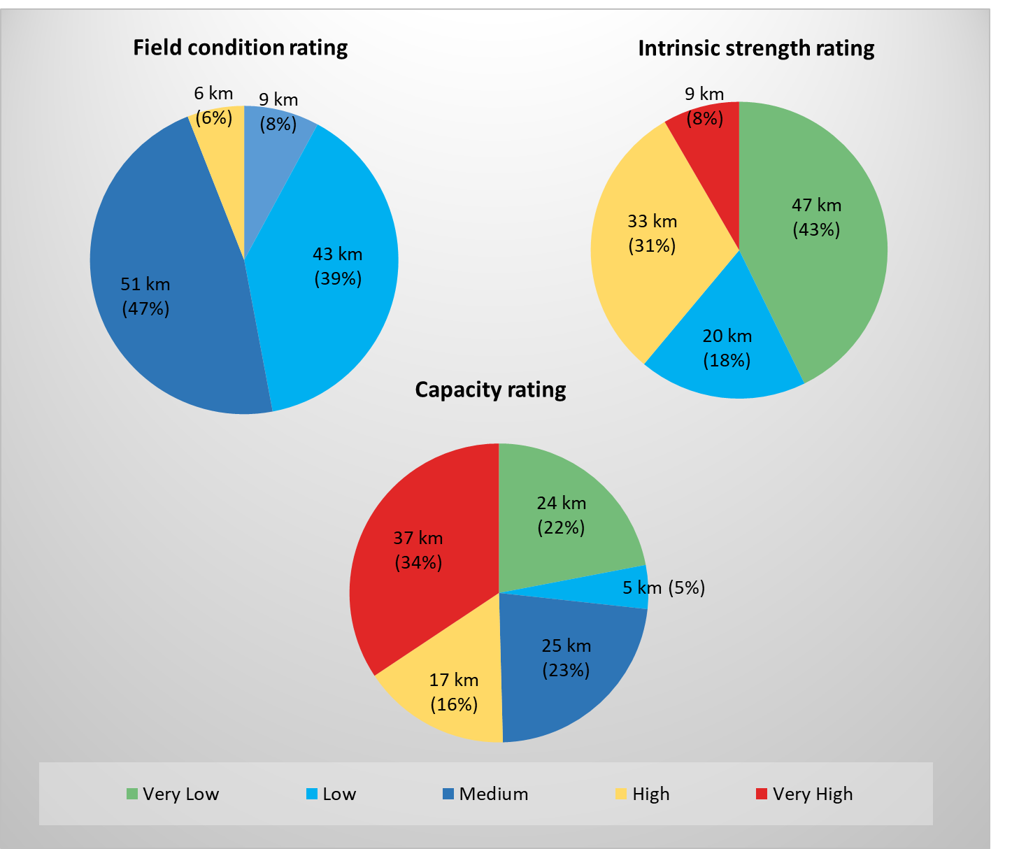
FLOODBANK RISK ASSESSMENT – Likelihood breakdown

Slide 25
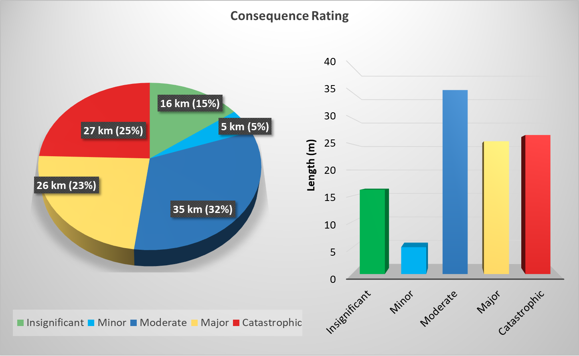
FLOODBANK RISK ASSESSMENT – Consequence

Slide 26
BREACH MODELLING
High-level floodbank breach modelling to estimate the flooded extent and water depth resulting from a hypothetical floodbank breach.
Informed the damage cost assessment for each of the consequence of failure categories
15 representative locations (floodbanks with a history of susceptibility and to broadly cover the scheme area) point source.

