Slide 1



Supporting the vision of a World Class Network of integrated Trails across Otago
Connecting Communities and Inspiring Adventures
One of the top walking and cycling destinations in the World

Slide 2
Thankyou
For the ORC’s and the regions council’s support of the Otago Trails submissions to fill the gaps in the Otago Trails Network in the Active Transport section of the Otago Southland Regional Land Transport Plan
Thank you for continuing to work with the Taieri Trails and Coastal Community Cycleway Connection to support the development of shared trails under the umbrella of the Dunedin Tracks Network Trust
Thank you for preparing the report Nov 2020 re opportunities to support Regional Trails
Thankyou for the staff input and report today 9.4 Taieri Trails on Foodbanks

Slide 3
We support
Option 3 ORC enables development of SUP’s on suitable flood assets and takes ownership for trail maintenance.
The recommendation to develop guidance for construction standards
Staff continue working with the Taieri Trails Group and Clutha District Council to finalise their proposals for council consideration
A partnership model – enabling trails to be built by Trusts
- enabling outside funding
We commend the reinstatement of the Taieri Liaison Group as a mechanism for communication
We recommend increased financial support for filling the gaps in the network over the 9 year plan

Slide 4
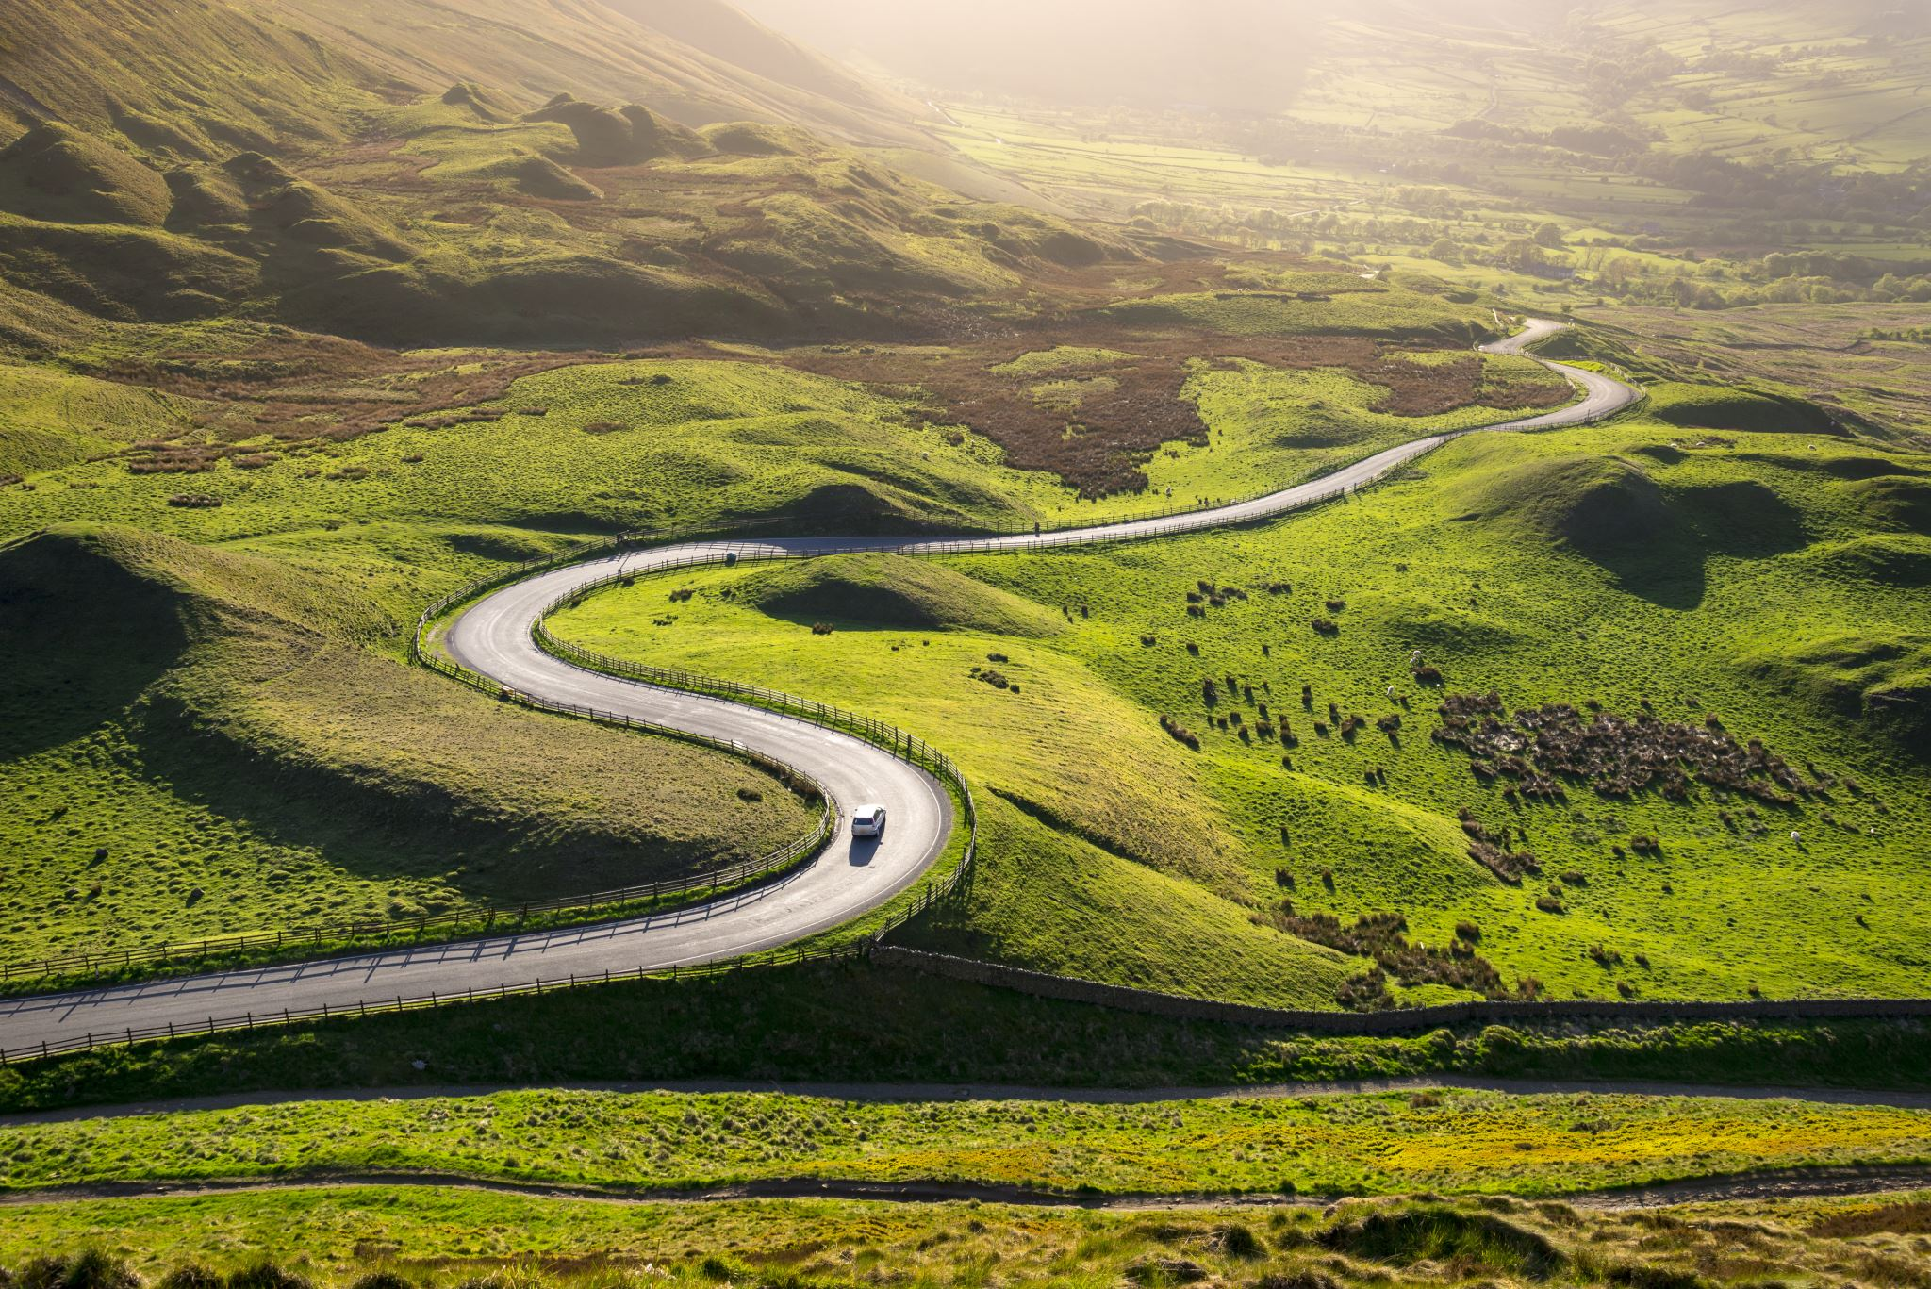
Dunedin Tracks and Trails
Enabling the use of flood banks for shared trails supports the Otago Southland Regional Land Transport Plan: active transport – filling the gaps in the great rides.

Slide 5
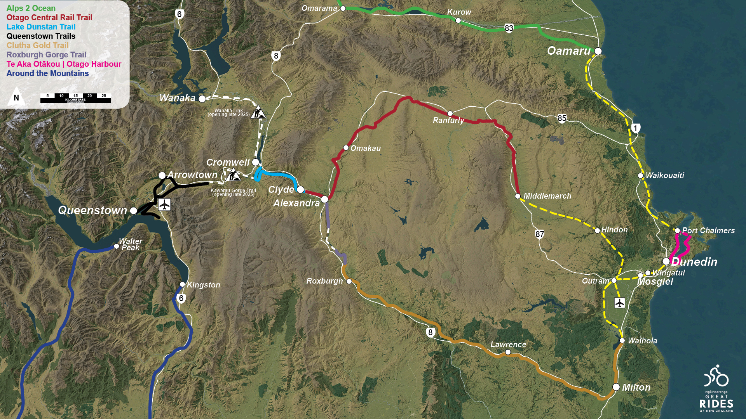

Slide 6
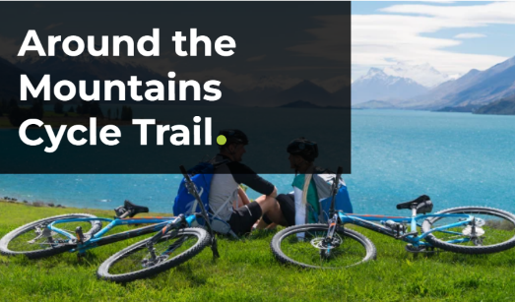
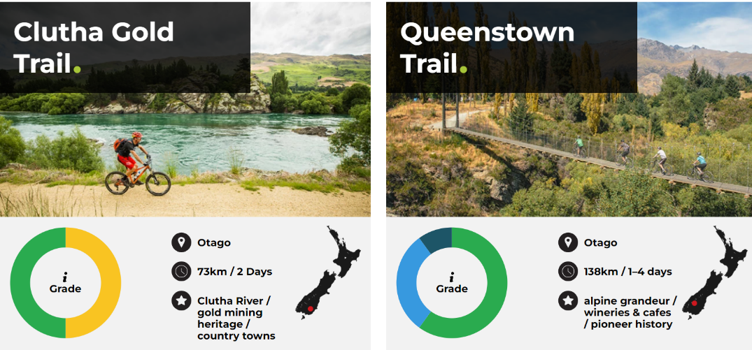
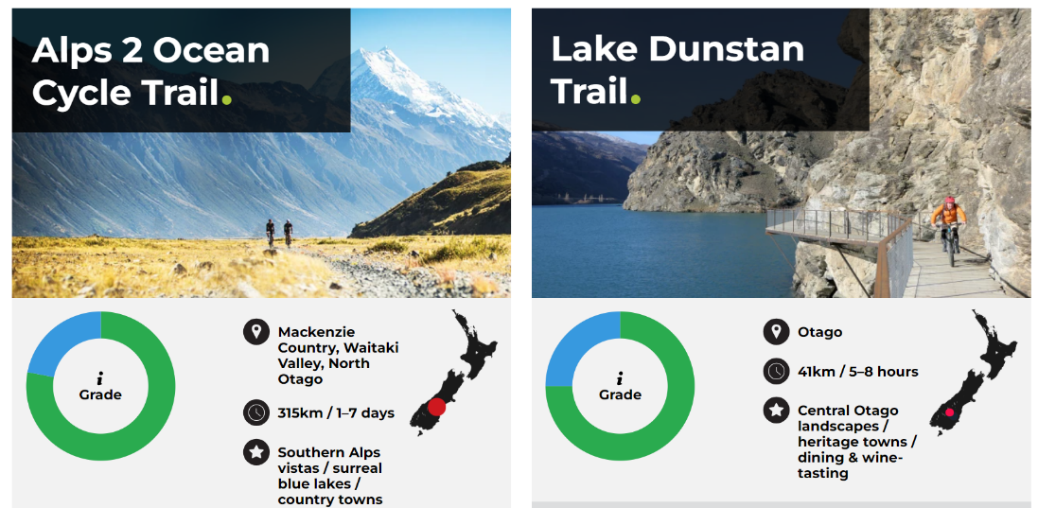




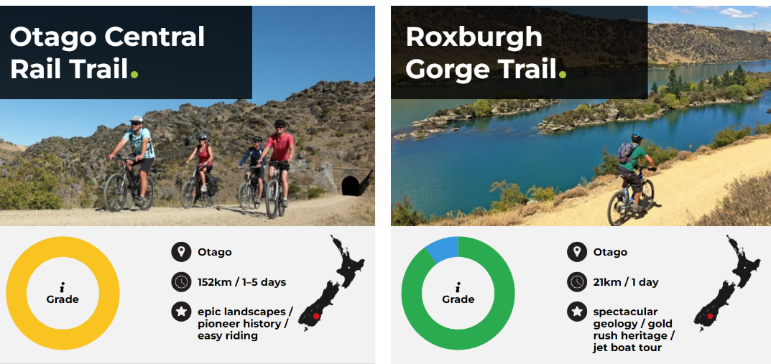




What does success look like?
An off-road trail network across Otago, connecting major centres to our rural communities and townships
Thriving and resilient communities, with new and enhanced economic and employment opportunities
New opportunities for tourism, adventure, fun and exploration
Access to safe, affordable and low-carbon transport choices
Protecting and valuing biodiversity and our natural environment
Celebrating the stories of our region by showcasing our cultural and historical identity
Enabling healthy and active lifestyles and improved wellbeing
Through collaboration we have the opportunity to leave a legacy for future generations, to deliver a connected network of trails and enhance our reputation as a world class cycling destination.
The vision for
Otago’s Trail Network
Connecting
the Great Rides
of the region
The missing links:
Oamaru to Dunedin – 113km
Mosgiel to Waihola – 28km
Wingatui to Middlemarch – 60km
Roxburgh to Alexandra - 13km
Kawarau Gorge – 32km (under construction)
Cromwell to Wanaka – 54km
Filling these gaps will create a 1037km connected cycle trail network, making it the longest trail network in the Southern Hemisphere
Developed and supported by:

Slide 7
Dunedin Tracks and Trails
The Otago Trails Trust’s are supportive of the Otago Trails vision of connecting the Great Rides of the Otago Region

Slide 8
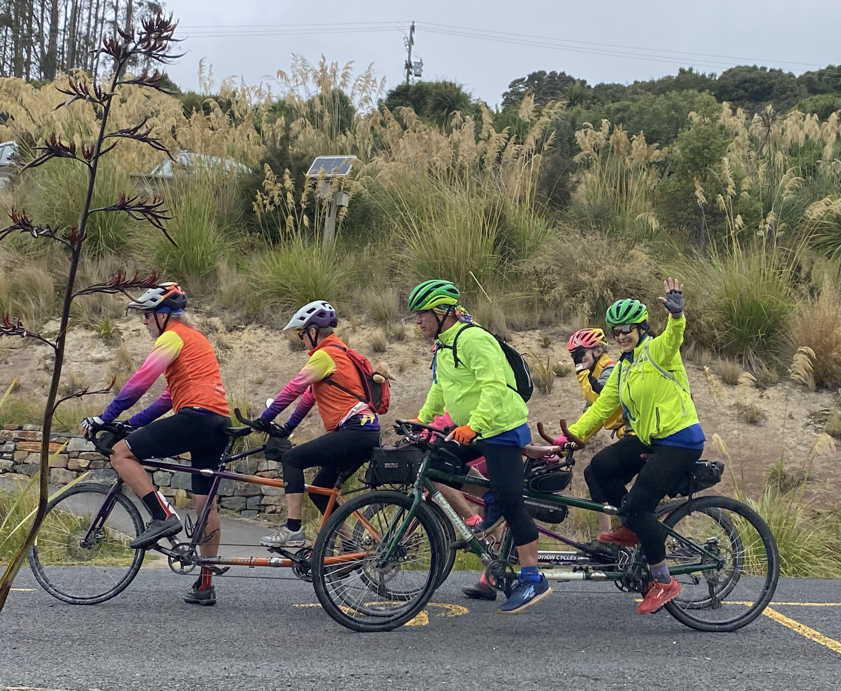
The Why?

Slide 9
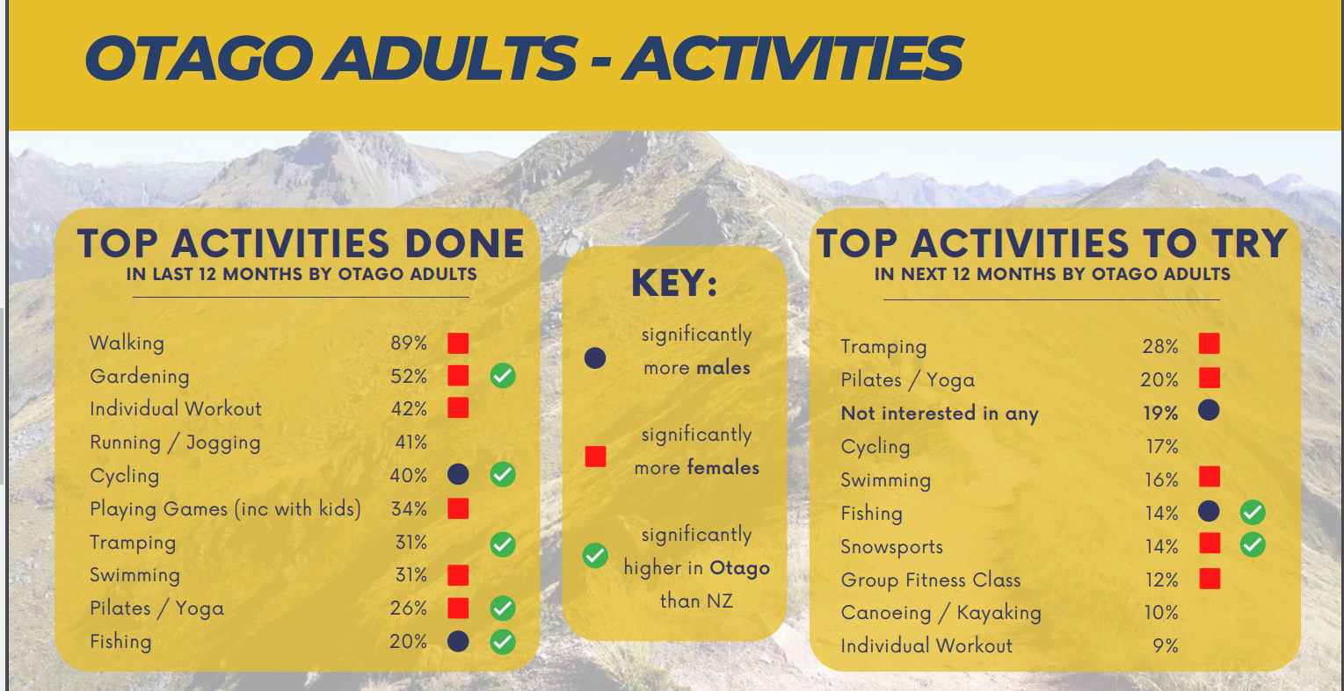
The why?

Slide 10
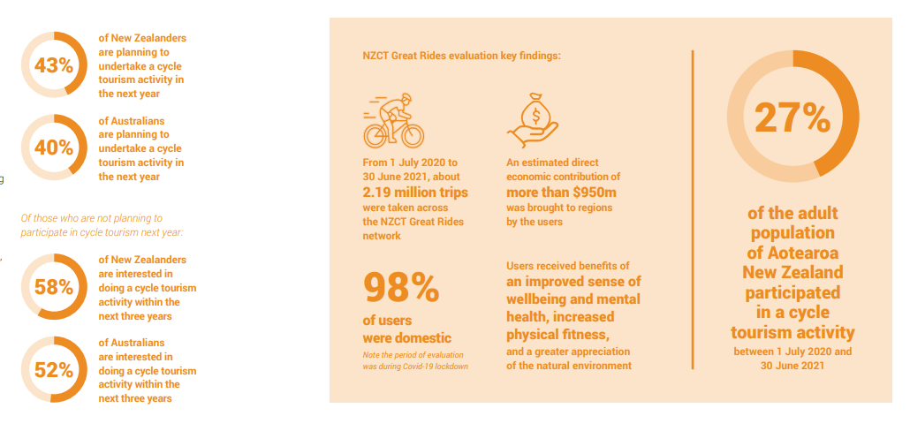

Slide 11
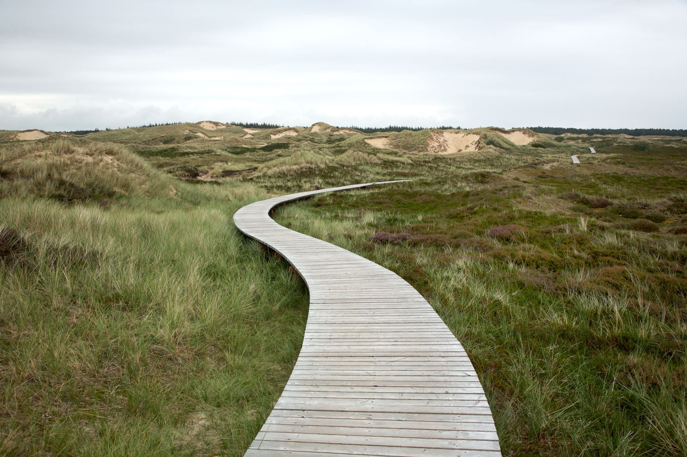
Dunedin Tracks and Trails
The opportunity for health and wellbeing, fun and adventure
The opportunity to experience our outstanding landscapes/nature
Access to safe low carbon and affordable recreational and transport choices – locally and across the region
Otago a World Class Network of linked up Great Rides for local, regional, domestic and international Tourism
The opportunity to tell our stories
A visitor economy that benefits the whole region , economically, socially, culturally, physically, mentally, environmentally and spiritually
An outstanding place to Live, Work and Play

Slide 12
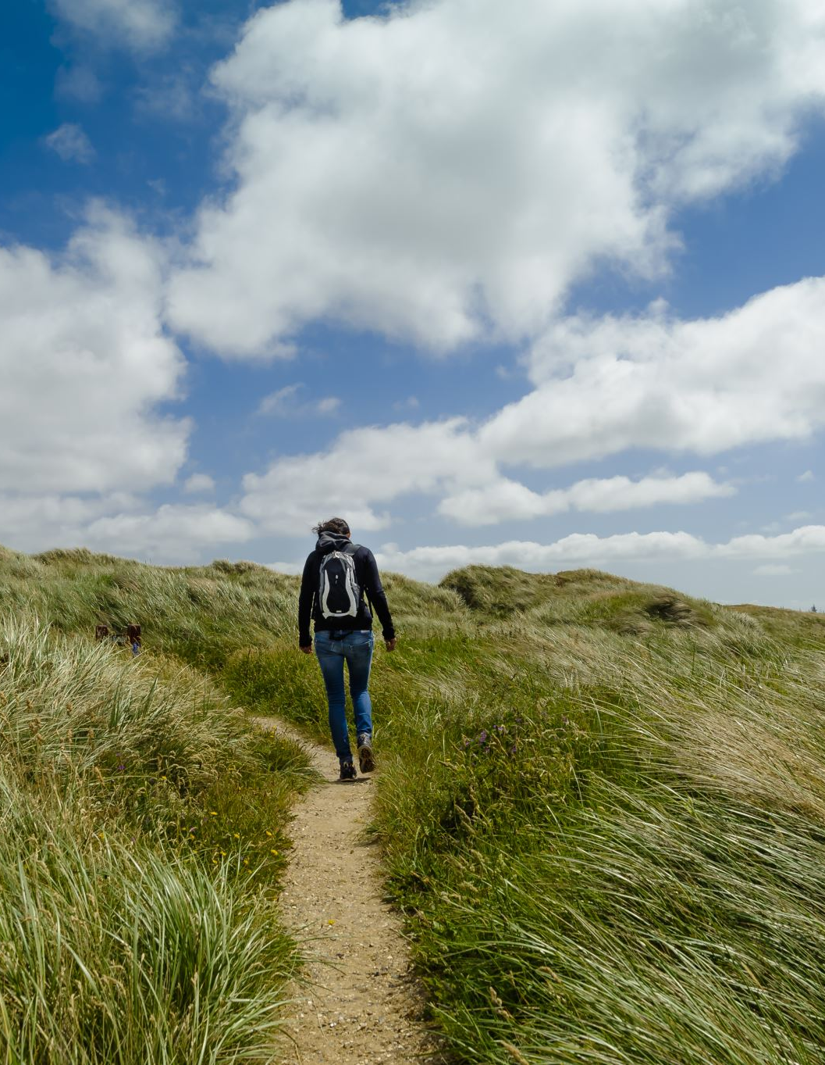
Where Dunedin Tracks Network Trust is at:
Supporting two trails – Taieri Trails and the Coastal Community Cycleway
Strategic Plan
Physical work started on Section 5a on Coastal Community Cycleway Connection
Taieri Trail landowner support for Section 1
Made numerous submissions to ORC/DCC
Working with Otago’s Trails Trusts on the Otago Trails Vision
Raised in excess of $200,000k in 2024

Slide 13
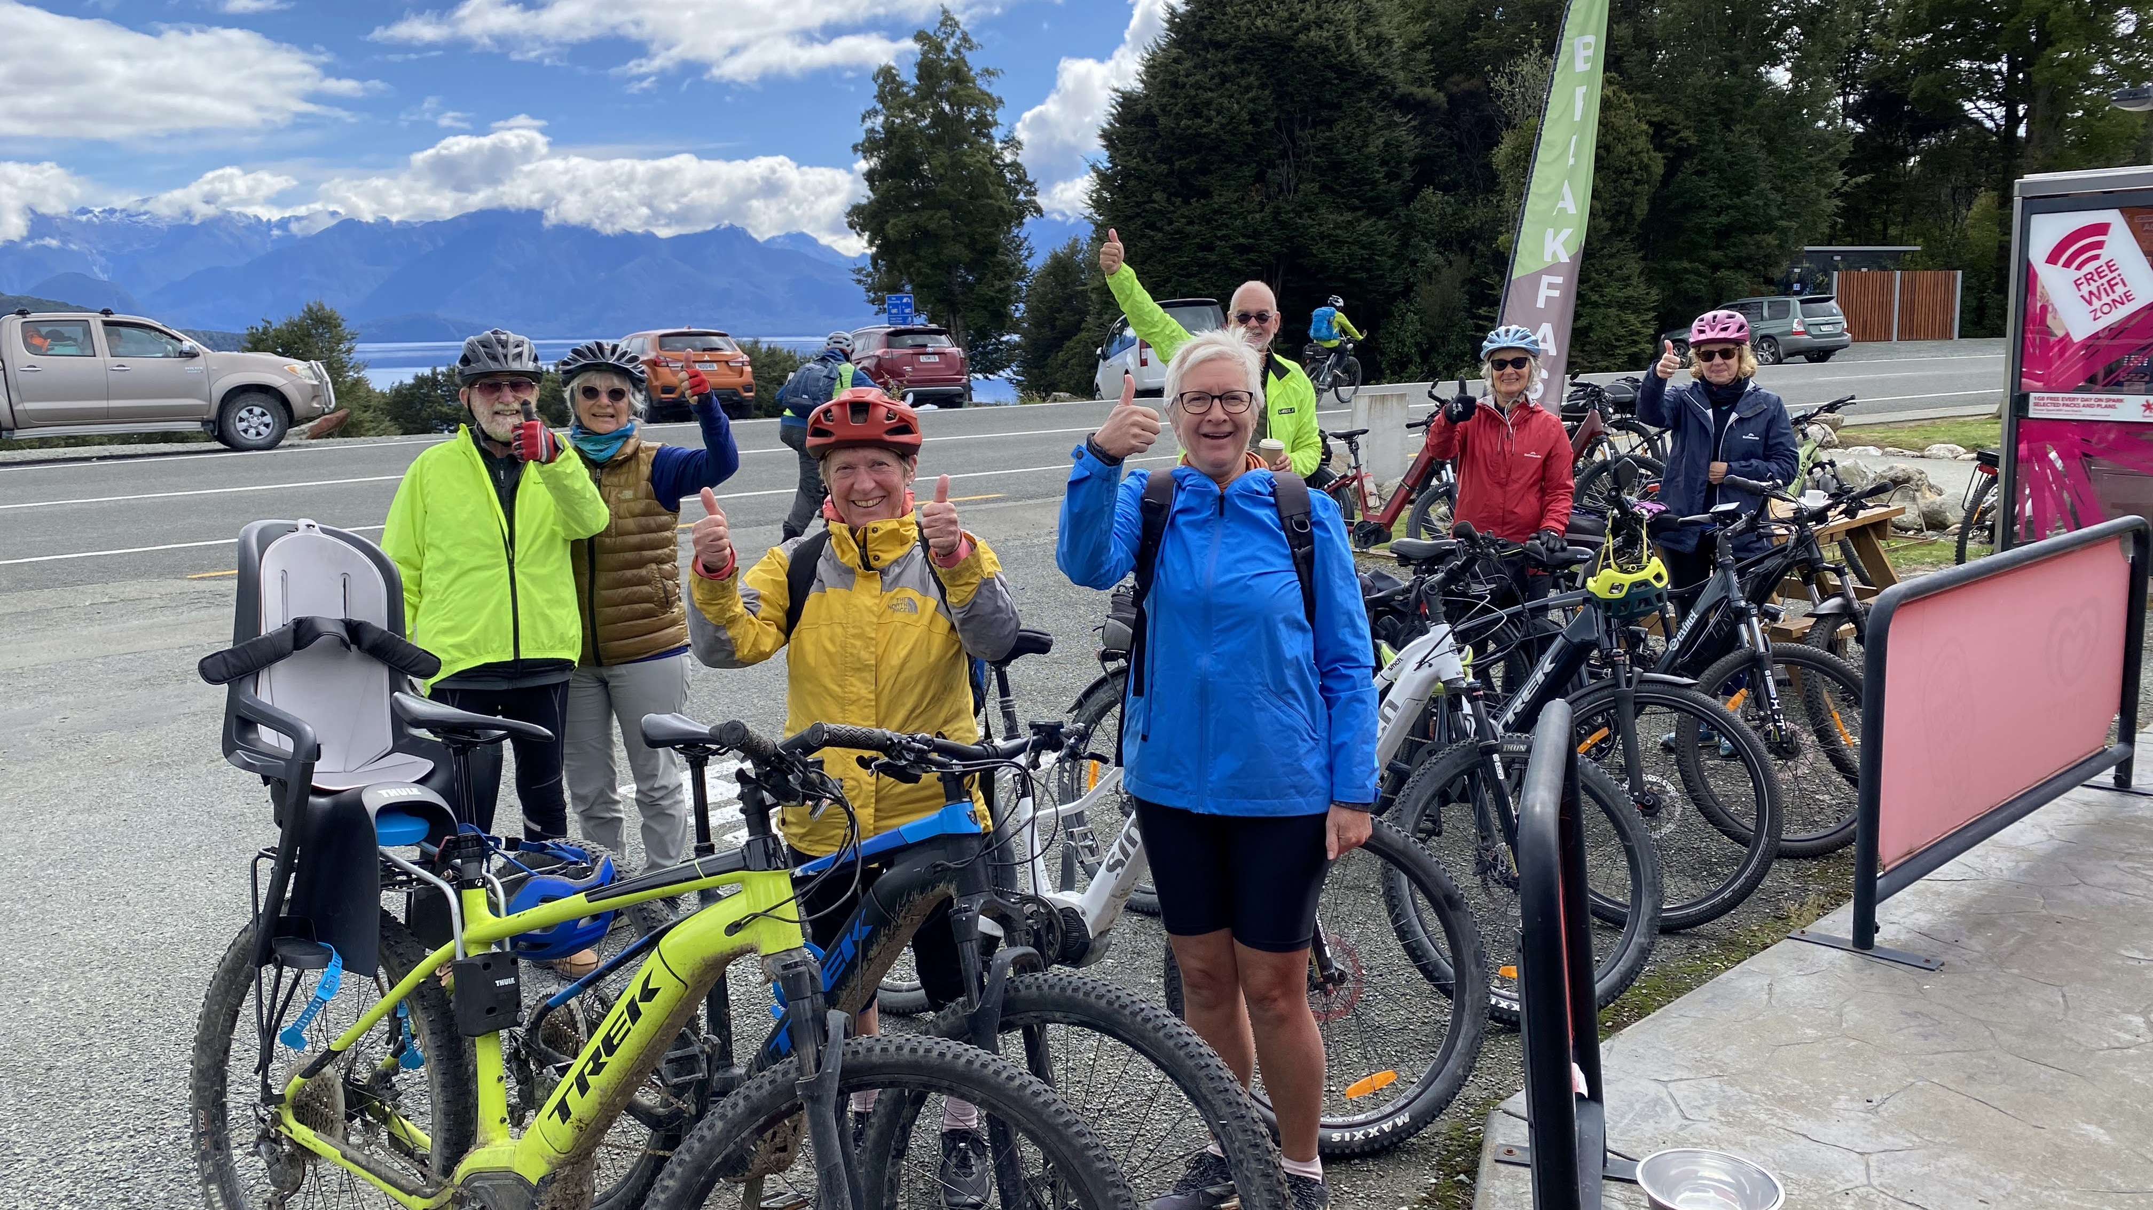
Thankyou Questions ?
TT

