Slide 1
Draft Concept
Manuherikia Catchment Plan
Manuherikia Catchment Group
Presented to Manuherikia Reference Group 19 November 2019

Slide 2
Overarching approach
Holistic approach to issues and values – not just flow management
Give effect to National Policy Statement
Management at values-based scale or at values-based locations
Notes:
While current NPS will be given effect to, the proposal will also be mindful of central government freshwater proposals.
Management at values-based scale or at values-based locations can be at specific reaches, tributaries or on a catchment wide level.

Slide 3
Flow management proposal:
Three management zones:
  Falls Dam Management Zone
  Manuherikia River Management Zone
  Ida Valley Management Zone (includes both the Ida Burn and Pool Burn catchments)

Slide 4
Four-tiered approach available within each zone
Mainstem Minimum Flows
Tributary Residual Flows
Individual Residual Flows
Reference Points
Notes:
Mainstem Minimum Flows
regulatory via plan
Tributary Residual Flows
residual flows at mouth of tributaries
regulatory via consent
maintain aquatic habitat
allow for local catchment sharing and main stem sharing
Individual Residual Flows
both mainstem and tributary
regulatory via consent
Reference Points
non-regulatory
would assist with management of flows, especially with rationing and releases from Falls Dam

Slide 5
Site | Management Tier
Falls Dam Discharge | Residual Flow
Dunstan Creek at Beattie Road | Tributary Residual Flow
Manuherikia River D/S Dunstan Creek confluence | Reference site
Pool Burn at Cob Cottage | Reference site
Lauder Creek at Rail Trail | Tributary Residual Flow
Thomsons Creek | Tributary Residual Flow
Manuherikia at Ophir | Minimum flow site and Reference site
Chatto Creek at Confluence | Tributary Residual Flow
Manor Burn | Tributary Residual Flow
Manuherikia River at Campground | Minimum flow site and Reference site
Notes:
Notes on specific purpose of sites:
Falls Dam Discharge
Residual Flow to maintain aquatic habitat below Falls Dam to Dunstan Creek Confluence.
Manuherikia River D/S Dunstan Creek confluence
Reference site - managing releases from Falls Dam
Pool Burn at Cob Cottage
Reference site for separating Manuherikia and Pool Burn Management Zones. Not clear yet whether this would be a regulatory site
Manuherikia at Ophir
Minimum flow site and Reference site- managing releases from Falls Dam
Manuherikia River at Campground
Minimum flow site and Reference site- managing releases from Falls Dam

Slide 6
Approach to assessing allocation
Start with effects / values
Analyse use of water
Assess impact of any proposed flow limits
Stored water versus run-of-river water
Depending on results of above assessments, re-assess flow limits and allocation levels
Notes:
Explanation:
Understand issues and effects that need to be addressed in catchment
Analyse use of water on both a catchment and management zone basis including:
maximum recorded and instantaneous rates
stored water versus run-of-the river water
Efficiency of use and distribution
Assess impact of any proposed flow limits on
addressing issues and effects – how much then does an allocation limit need to achieve?
surety of supply
Consider implications of separating out stored water from run-of-river water – should stored water be ‘primary allocation’ or a separate class of allocation.
Depending on results of above assessments, re-assess flow limits and allocation levels, acknowledging that one affects the other (e.g. flow limit impacts on allocation via surety of supply).

Slide 7
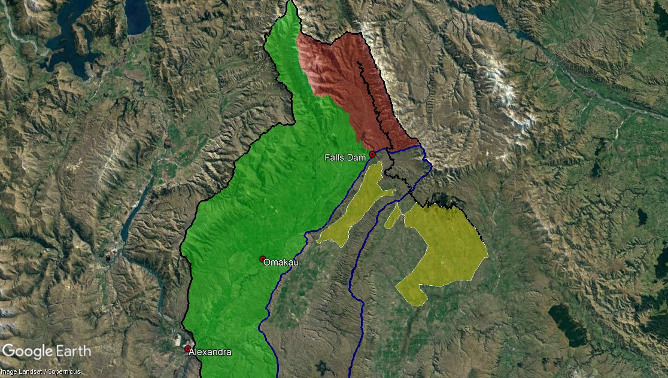
Management
Zones
Falls Dam Management Zone
Hawkdun Idaburn Race
Manuherikia River Management Zone
Area irrigated with water from Falls Dam Management Zone
Ida Valley Management Zone

Slide 8
Falls Dam Management Zone
Abstractions above Falls Dam
Command area is outside of this zone
Minimal link to effects below Falls Dam
Primary allocation limit and consent conditions, such as residual flows.
Notes:
Includes all abstractions above Falls Dam
All the water taken from within the Falls Dam Management Zone is used outside the zone, either in the Ida Valley Management Zone or in the neighbouring Taieri Catchment
For practical purposes these abstractions do not impact on flow management (and thus the values) below Falls Dam.
Management of the effects of abstractions above Falls Dam proposed to be achieved by a primary allocation limit and consent conditions, such as residual flows.

Slide 9
Manuherikia River Management Zone
Manuherikia catchment below Falls Dam
Ophir and Campground as minimum flow sites
  flow management sites – dam discharges and water sharing
  effects on mainstem
Notes:
Includes Manuherikia catchment below Falls Dam
Two main stem minimum flow sites are proposed at Ophir and Campground.
These two sites also act as flow management sites for water delivery from Falls Dam and water sharing.
These minimum flow sites can manage the effects of abstraction within the Manuherikia River Management Zone on the mainstem.

Slide 10
Ida Valley Management Zone
Pool Burn and Ida Burn not linked to minimum flows in Manuherikia
Reference flow site at Cobb Cottage
Specific conditions to address effects within catchment, including residual flow conditions
Notes:
Exclude the Pool Burn and Ida Burn catchments from any minimum flow limit set in the Manuherikia Management Zone
Hydrology shows lack of contribution to minimum flow in Manuherikia during low flows
Set a reference flow site at Cobb Cottage, to isolate the Ida and Pool Burn Catchments from the Manuherikia Catchment for flow management, water rationing and water augmentation.
Manage ecological values in the Ida and Pool Burn catchments via take specific conditions such as residual flow conditions

Slide 11
Water quality
Issues
Elevated levels of sediment and phosphorous
Elevated levels of bacteria and nitrogen from a number of sources
Notes:
Issues:
The river can look dirty due to elevated levels of sediment, and sediment can result in elevated levels of phosphorous.
The river can have elevated levels of bacteria and nitrogen from a number of sources including agricultural land use practices, human wastewater discharges and river birds.

Slide 12
Water quality
Responses
Changes to land use practices
Address wastewater discharges
Understand impact of river birds and manage
Riparian planting
Notes:
Responses:
Changes to land use practices including:
irrigation practices e.g overland flow
stock exclusion
riparian management and planting in identified areas
Improved management of human wastewater discharges
Improved understanding and recognition of contribution of river birds to water quality issues
Riparian planting to reduce sediment inputs from Maori and Muddy Creeks

Slide 13
Habitat management (where separate for quantity and quality)
Issues
Vehicle access in river
Indigenous species at risk due to predation by salmonids
Habitat, amenity and access limited or spoiled by weed plants
Notes:
Issues
Vehicle access in river can damage habitat and fish species
Indigenous species at risk due to predation by salmonids
Habitat, amenity and access limited or spoiled by weed plants

Slide 14
Habitat management (where separate for quantity and quality)
Responses
Limit or prevent driving in riverbed.
Protection of indigenous species from salmonids – including barriers, flow management.
Remove and manage willows, manage weeds on dry riverbed.
Notes:
Protection of indigenous species from salmonids could include barriers, flow management in appropriate places.

