Slide 1

Science Programme
Workshop 2
September 2026

Slide 2
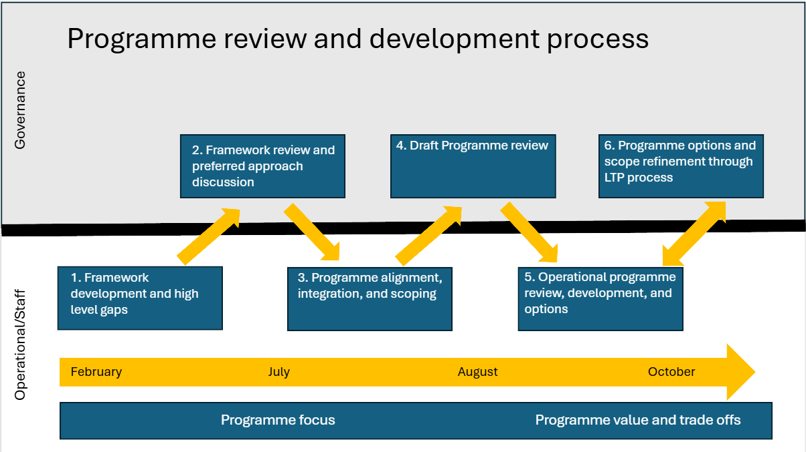
Context
Context
Takeaways
Scoping/Objective setting process
Example Programmes
Notes:
We are in box four today.
Here today to talk about take aways from our last discussion (step 2)
Work we’ve done considering objectives and programme scopes, based on feedback from box two, and what a programme that address those would look like
Seeking feedback on whether this is the sort of objective set you’d like to see the programme assess against
Notably not the last time we’ll discuss this. We’ll take the feedback away and revise, assess how well the programme stacks up, and then we’ll work together through the LTP process further revising and developing the objectives and programmes to meet them

Slide 3
Takeaways
Context
Takeaways
Scoping/Objective setting process
Example Programmes
*Disclaimer
Notes:
Worth reviewing anticipated needs. These set some high level principles about what the programme should look like and tell us at a high level what you want from the programme.

Slide 4
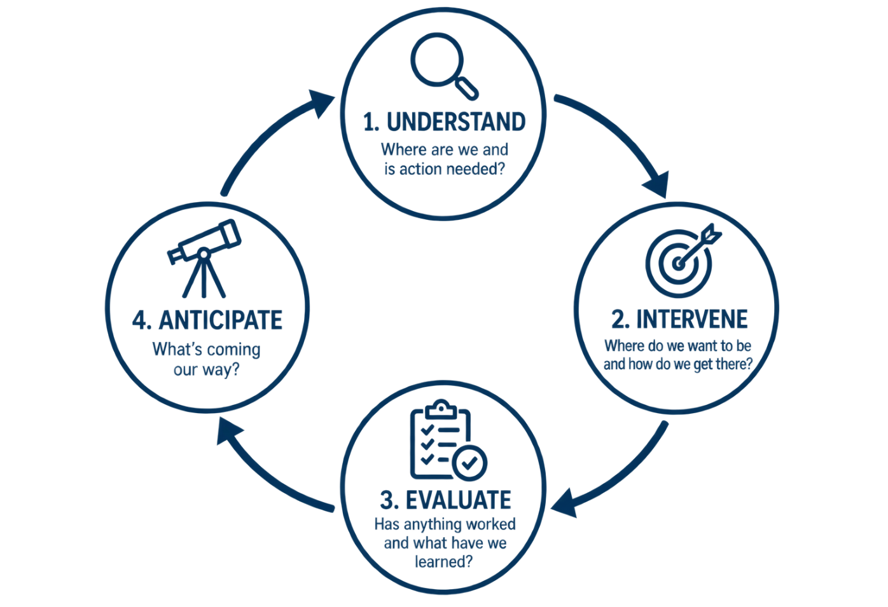
Context
Context
Takeaways
Scoping/Objective setting process
Example Programmes
Previous Workshop
History
Anticipated programme needs
Legislative requirements
  Large amount of discretion in "requirements"
Need for clear objectives
National framework
Information expectation scenarios and feedback
Notes:
Prior workshop covers some history of the programme from the last review through to now.
This included some discussion what we thought you may want from a programme based on what we’ve been hearing from you and communities
We discussed legislative requirements and that, while they are numerous, they often leave a lot of discretion in how we implement or meet them. Ultimately, the level of effort required is driven by how much information you want when making decisions.
That means to review the science programme its useful to develop some clear objectives about what you want from the programme
We introduced a nationally developed framework which aims to give us a starting point and framework for the discussion
And then we ran through some scenarios and discussed how much understanding you might like to have when making a decision in that situation.

Slide 5
Takeaways
Context
Takeaways
Scoping/Objective setting process
Example Programmes
◎
Anticipated Needs
Value for investment
Meet the needs and expectations of Otago's communities
Suitable under multiple policy settings
Integrate across land, air, water, coast, and biodiversity
Focused on aspects and areas ORC can directly influence
Robust science to support limit setting and regulatory processes
Notes:
Worth reviewing anticipated needs. These set some high level principles about what the programme should look like and tell us at a high level what you want from the programme.

Slide 6
Takeaways
Context
Takeaways
Scoping/Objective setting process
Example Programmes
Scenario Feedback
More information in areas with higher risk of a resource management issue
More information on issues which are specific to ORC
Support the full environmental management cycle
More information where community groups are active
Equally interested in regulatory and non-regulatory effectiveness
Desire to partner with other groups if possible
Notes:
We’ve also taken the menti meter information scenario feedback and summarised it here. This includes some more direction on where you’d like to see more information, the type of information you want and generally how you want us to go about meeting your anticipated needs

Slide 7
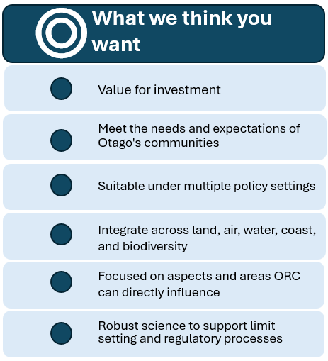
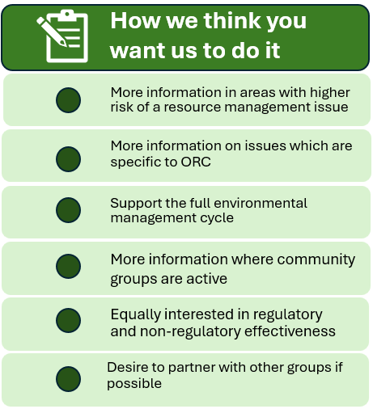
Takeaways-
Context
Takeaways
Scoping/Objective setting process
Example Programmes
◎
(Scenario Feedback)
Notes:
Together, they give a pretty good idea of general principles for “what you need” from a science programme and how the programme should structure things to provide for those needs.
Probably worth DISCUSSION here.

Slide 8
Questions / Discussion

Slide 9
Objective Setting/Scope Development Process
Context
Takeaways
Scoping/Objective setting process
Example Programmes
Notes:
So, we’ve taken the feedback, general principles, legislative requirements, etc. and gone and developed what the science programme that addresses those, for approximately current operation budget, would look like.

Slide 10
Objective Setting/Scope Development Process
Example Programmes:
Grouped by high-level management levers
Developed in line with the “what” and “how”
Context
Takeaways
Scoping/Objective setting process
Example Programmes
◎
(Scenario Feedback)
Notes:
To do so, we’ve had to group the programmes in a that makes assessing whether they are meetings the objectives. So, we’ve grouped by the high-level management lever we are trying to influence
Pulled together an example programme looking to comprehensively inform management of each lever.
Developed in-line with the “what and how”-
integrate across domain,
aim at answering all four questions for the management cycle,
provide more information in high risk areas,
look to provide information about whether actions are working where communities are active in managing/remedying and issue
Partner with communities, industry groups, and other agencies where possible
Aim to provide robust science

Slide 11

Scoping/Objective setting process- Management Levers
Context
Takeaways
Scoping/Objective setting process
Example Programmes
CONTAMINANTS
ABSTRACTION
◎
HABITAT LOSS
PESTS/INVASIVES
(Scenario Feedback)
Physical destruction
Vegetation loss
Drainage
Fish passage
Instream works
Wood Burners/ industrial emissions
Land use and practice
Waste disposal
Water take
Storage and damming
Irrigation
Water conveyance
Pest species
Invasive species
Exotic species
Notes:
At a high level, regional council controls 4 management levers. This include Abstraction/flow alteration, contaminants of land, air, and water, habitat loss/physical disturbance and pests/invasive species.

Slide 12
Scoping/Objective setting process- Management Levers
Context
Takeaways
Scoping/Objective setting process
Example Programmes
Why Structure this way?
Facilitate integration
Full management cycle
Similar response mechanisms
◎
(Scenario Feedback)
Notes:
Structuring this way is useful as it allows us to evaluate cross domain links, so making sure that if an issue is contaminants in the estuary/coast, we’ve got the necessary information from upstream rivers and land use to understand what, where and why we have the issue.
It also let’s us look around the full management cycle. So, evaluate whether we have the necessary programmes to determine how we might manage things differently if we have a degrading trend and then making sure we will evaluate whether the communities actions to manage things differently have worked.
The different group shave similar management response mechanisms. Abstraction deals in allocative mechanisms, the diffuse and point source aspect of contaminants means they are often best dealt with through a combination of practice rules, non-reg and consenting, and habitat loss/physical disturbance is often best dealt with the rules around where activities can occur.

Slide 13
Objective Setting/Scope Development Process
Context
Takeaways
Scoping/Objective setting process
Example Programmes
Example Programmes:
Grouped by high-level management levers
Developed in line with the “what” and “how”
◎
(Scenario Feedback)
Notes:
Example programme looking to comprehensively inform management of each lever.
Developed in-line with the “what and how”-
integrate across domain,
aim at answering all four questions for the management cycle,
provide more information in high risk areas,
look to provide information about whether actions are working where communities are active in managing/remedying and issue
Partner with communities, industry groups, and other agencies where possible
Aim to provide robust science

Slide 14
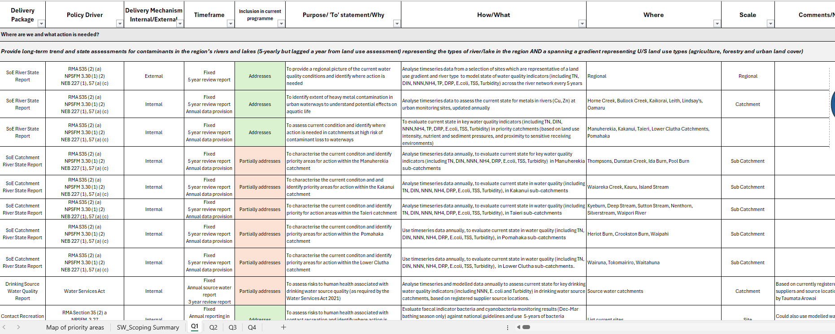
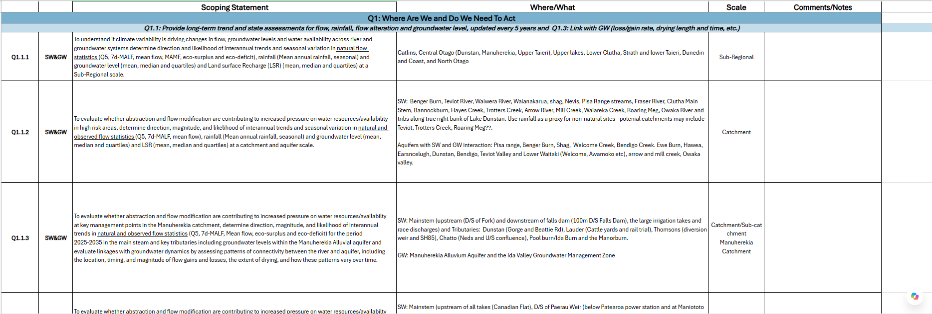
Over 500 objectives/scopes within the programme
Notes:
The process to develop the objectives above has serious detail but it is difficult, if not impossible, to cover all of it across all programmes
The draft examples which follow aim to provide an over view of what the programme should provide based on the “what” and “how” for each management lever.
More of this detail will be visible through the LTP process
The detail is present to help evaluate whether we’d need to and how we’d refine monitoring etc. so isn’t fully needed until we enter the operational review part.

Slide 15
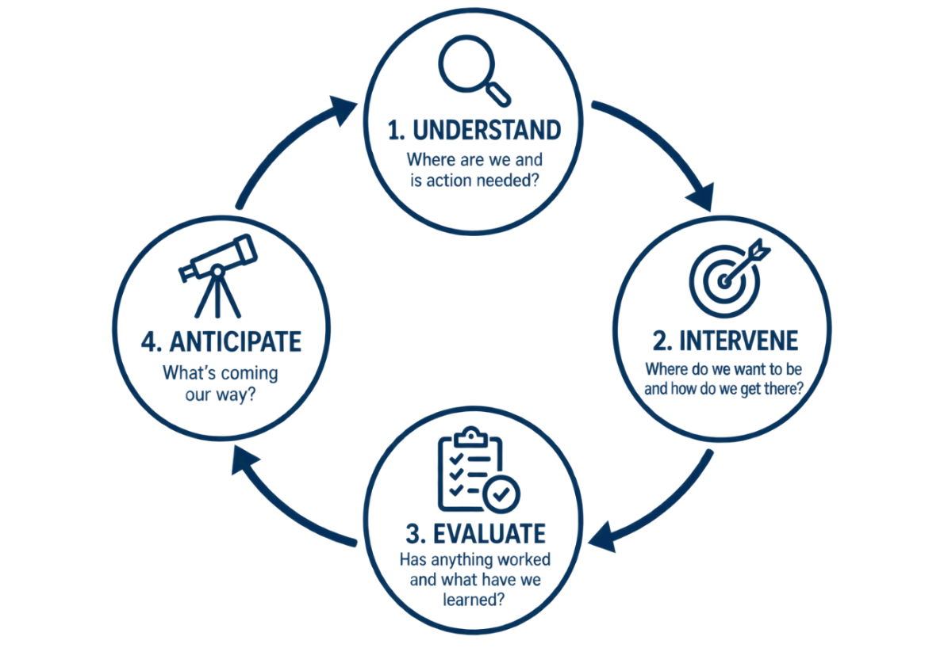
Example Programmes- Slide Structure
◎
Overview
Where are we and is action needed?
Where do we want to be and how do we get there?
Has anything worked and what have we learned?
What’s coming our way
Alignment with priority action
(Scenario Feedback)
Delivered in partnership with community/industry groups or community data
Current programme fully delivers
Minor tweaks required
Major change / doesn’t attempt

Slide 16
Water Abstraction
& Flow Alteration
Notes:
Cover off more specific details – tangible examples.
More specificality for catchments. E.g Manuherekia and storage etc. taieri (rock and pillar) land cover changes (tussock changes)
E.g add example; tracing abstraction from rovers down to estuary – like the kakanui.
Don’t use the word “protect” – triggering use manage instead of protect.

Slide 17
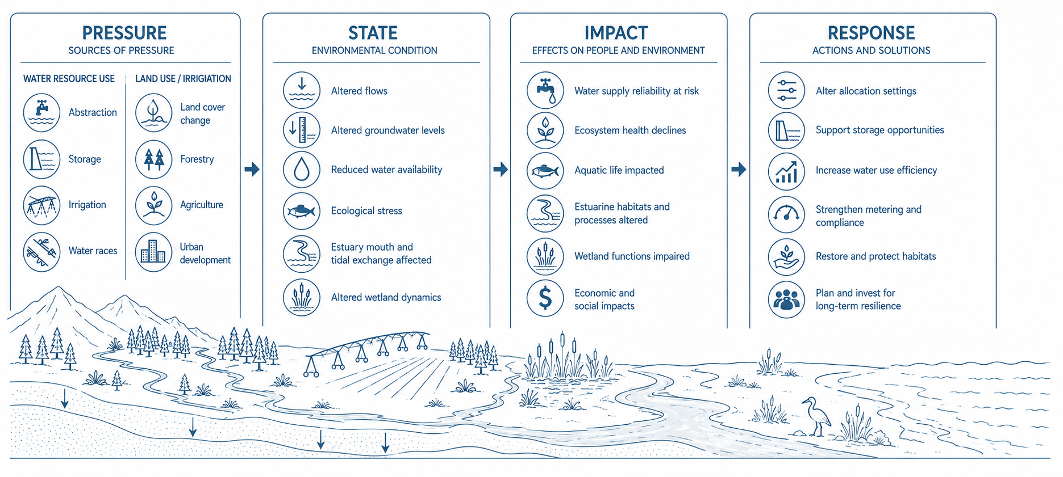
Example Programmes: Abstraction and Flow Alteration
Overview
Where are we and is action needed?
Where do we want to be and how do we get there?
Has anything worked and what have we learned?
What’s coming our way

Slide 18
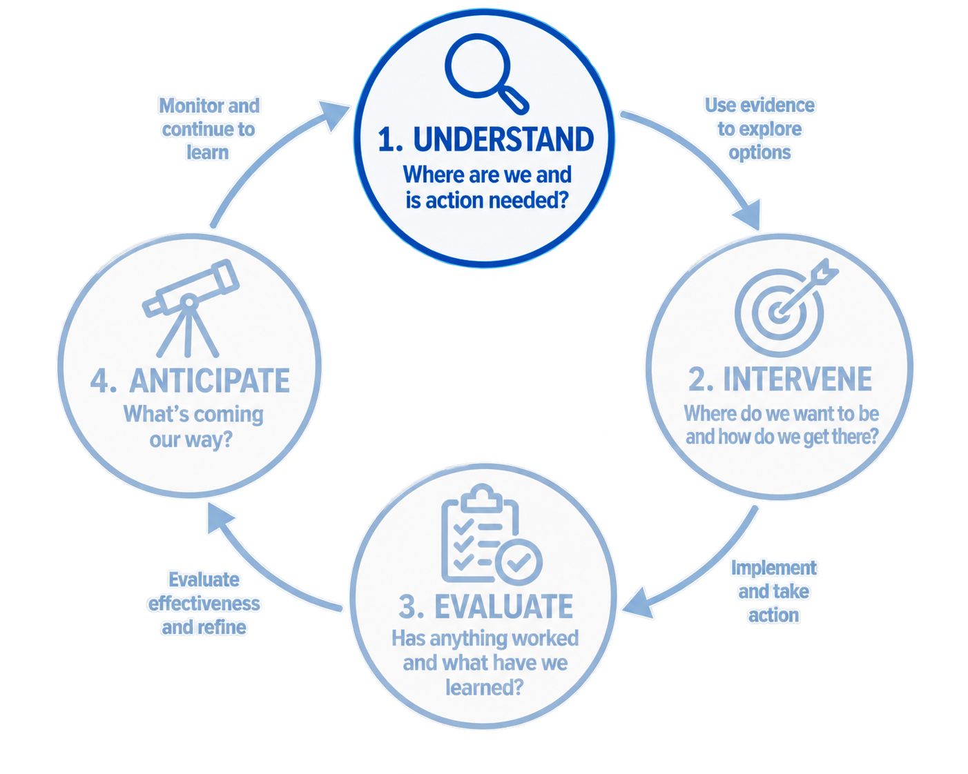
Example Programmes: Abstraction and Flow Alteration
Overview
Where are we and is action needed?
Where do we want to be and how do we get there?
Has anything worked and what have we learned?
What’s coming our way
Notes:
This is the first major part of the programme.
The question here is: what is the current state of the system, what pressures are acting on it, and where are the risks?

Slide 19
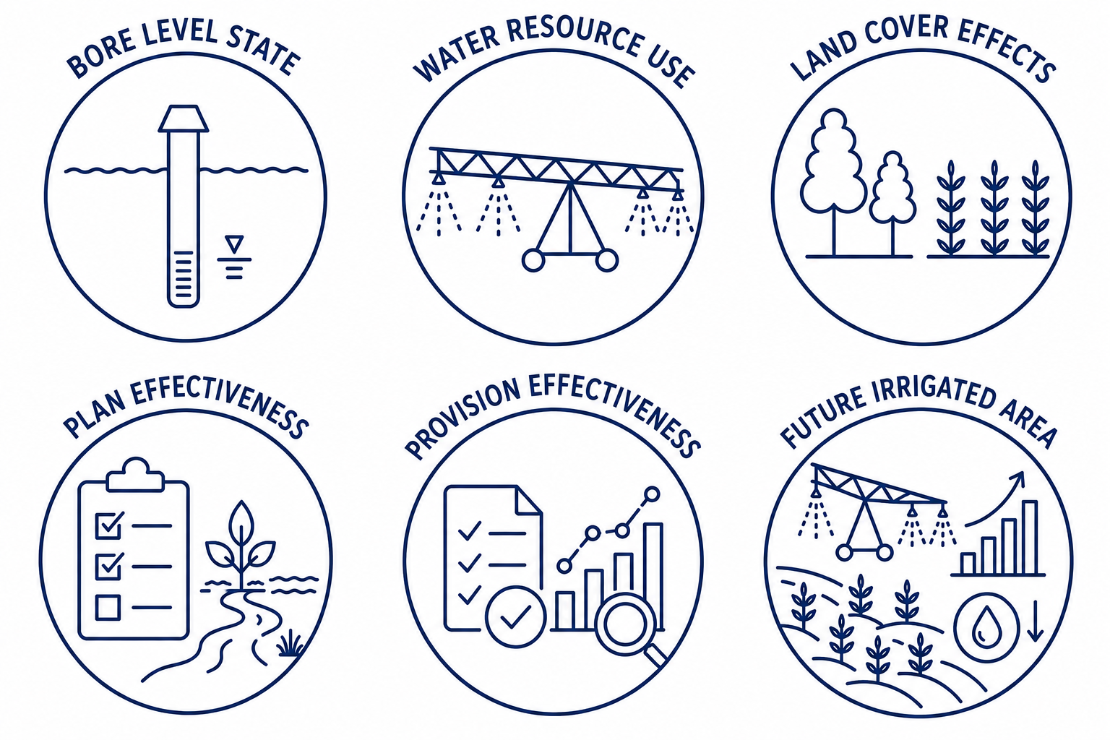
RESOURCE USE, THREATS AND PRESSURES
Overview
Where are we and is action needed?
Where do we want to be and how do we get there?
Has anything worked and what have we learned?
What’s coming our way
Water use accounting to understand change in water resource including changes to allocation, abstraction, irrigated area, demand and water availability through time
  Higher spatial resolution in high pressure areas
  Converted to live dashboards to aid in management in high pressure areas
Impact of water race losses on water availability and groundwater recharge
Water losses associated with willows and forestry
Impact of land cover on water yield, soil moisture, evapotranspiration and recharge
Soil moisture balance model for recharge quantification, and as a proxy for irrigation demand
Wetland connectivity and buffering
RMA 30(1)(fa), NPSFM 3.29, NEB 223 and 57(3(b))
Notes:
This question is where we look to understand to what degree flows in Otago are altered by abstraction, damming and diversion. This includes use of water for agricultural, industrial, domestic and power creation. This is often termed water accounting.
Resolution: Pressure Based​
In our water accounts, we’d look to provide more resolution- such as sub-catchment level outputs, where pressure is higher (such as Taieri, Manuherekia, Lindis, Kakanui) and catchment level accounts where pressure is lower (Arrow, Cardrona, Shag, Pomahaka). Operationally this would mean more effort into understanding water take data, and how it relates to water use, in higher pressure catchments and converting the understanding through to being available for use at any point. In other catchments, irrigated demand may be used as a proxy.
How would the current programme change?​
Better understanding of how demand/use is changing over time through irrigated area and water use as historically ORC has not tracked this.​
Live dashboards would be developed for areas which don’t have them (Taieri, Lindis, Cardrona, and others- already exist in the Manuherekia). These help catchments manage water but also track allocation pressure. ​
Expand accounts to better incorporate how different land uses are using water, such as forestry, willows, and leakage from water races. ​
Partnerships​
Irrigation companies and industry bodies when developing and providing water accounts.
Irrigation companies when investigating “losses” from water races and whether those have positive environmental impacts in groundwater and wetland ecosystems
Forestry industry when investigating how plantations impact water losses​
​
Driver
Water accounting plays an important role when allocating resources, which is a regional council responsibility under both the RMA (30(1)(fa)) and NEB (223, 57(3(b))). More explicitly, water accounting has been a requirement under multiple iterations of the NPSFM (3.29).
Alignment with Councillor Priority Actions: ​
SRA4- Improve accessibility of environmental and natural hazard information, including consideration of property-level visibility and integration of relevant external data sources where practicable:
Creation of accounting dashboards to help community groups better manage water​
SRA5- Ensure irrigation, water storage and hydro opportunities are appropriately enabled, including addressing any unintended regulatory or organisational barriers:
provides base information to evaluate current and alternative allocation settings​
SPA3- Identify and address barriers to good practice water use in the non-regulatory space, including working with water users, communities and sector expertise to support improved outcome:
provides accounting dashboards to facilitate water management by catchment groups​
EDA7- Support landowner collaboration and environmental and flood resilience initiatives where these contribute to improved catchment outcomes:
accounting dashboards to facilitate water management by catchment groups. Info will also support any storage considerations undertaken by regional council or catchments themselves.
CPA1 Identify where Council effort and resources can achieve the greatest improvement in freshwater outcomes, informed by existing science, catchment planning and community priorities and CPA2 Identify priority locations for targeted resource investment across river and lake systems, and report to Council on where effort will achieve the greatest environmental benefit, including consideration of areas such as Waihola, Tomahawk Lagoon, Dunstan, Lake Hayes and the Manuherekia:
Feeds into CPA1 and 2 by providing base information about the pressure on water resources and where issues may be present. ​

Slide 20
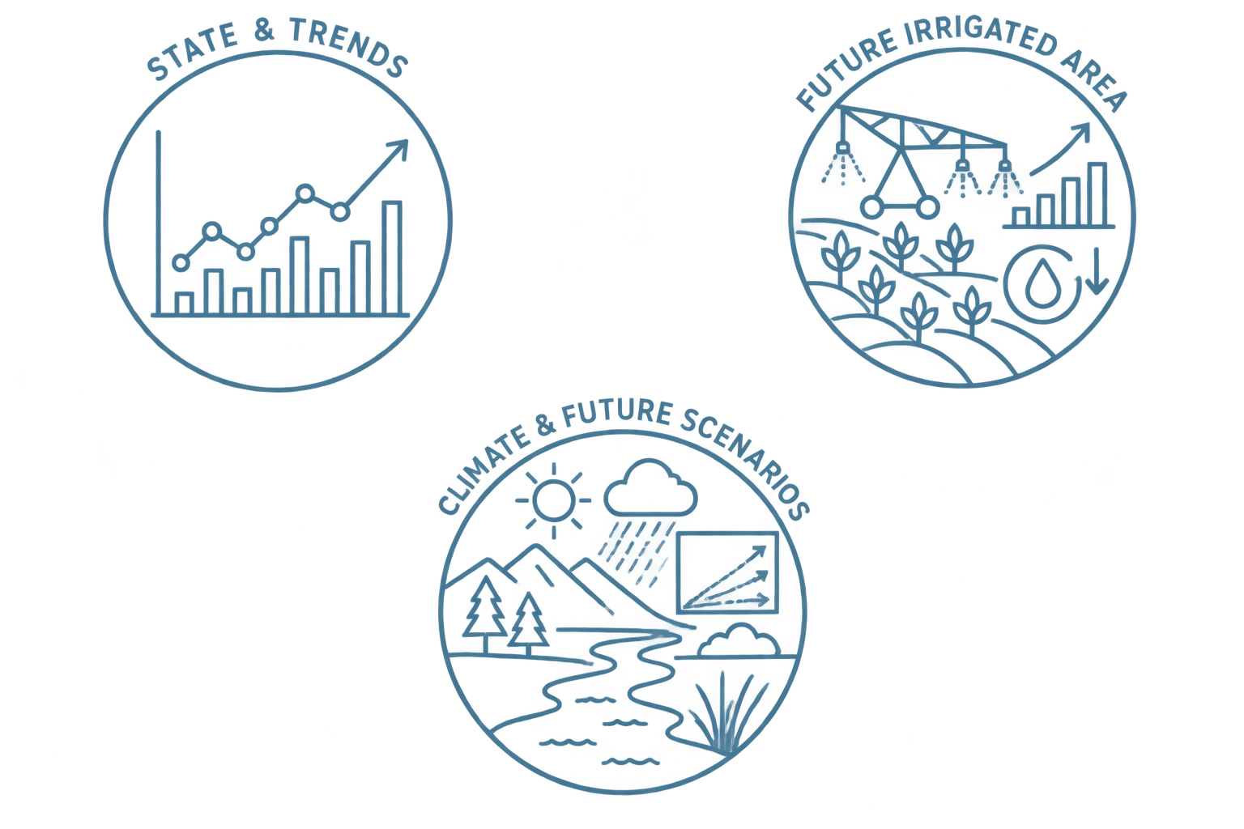
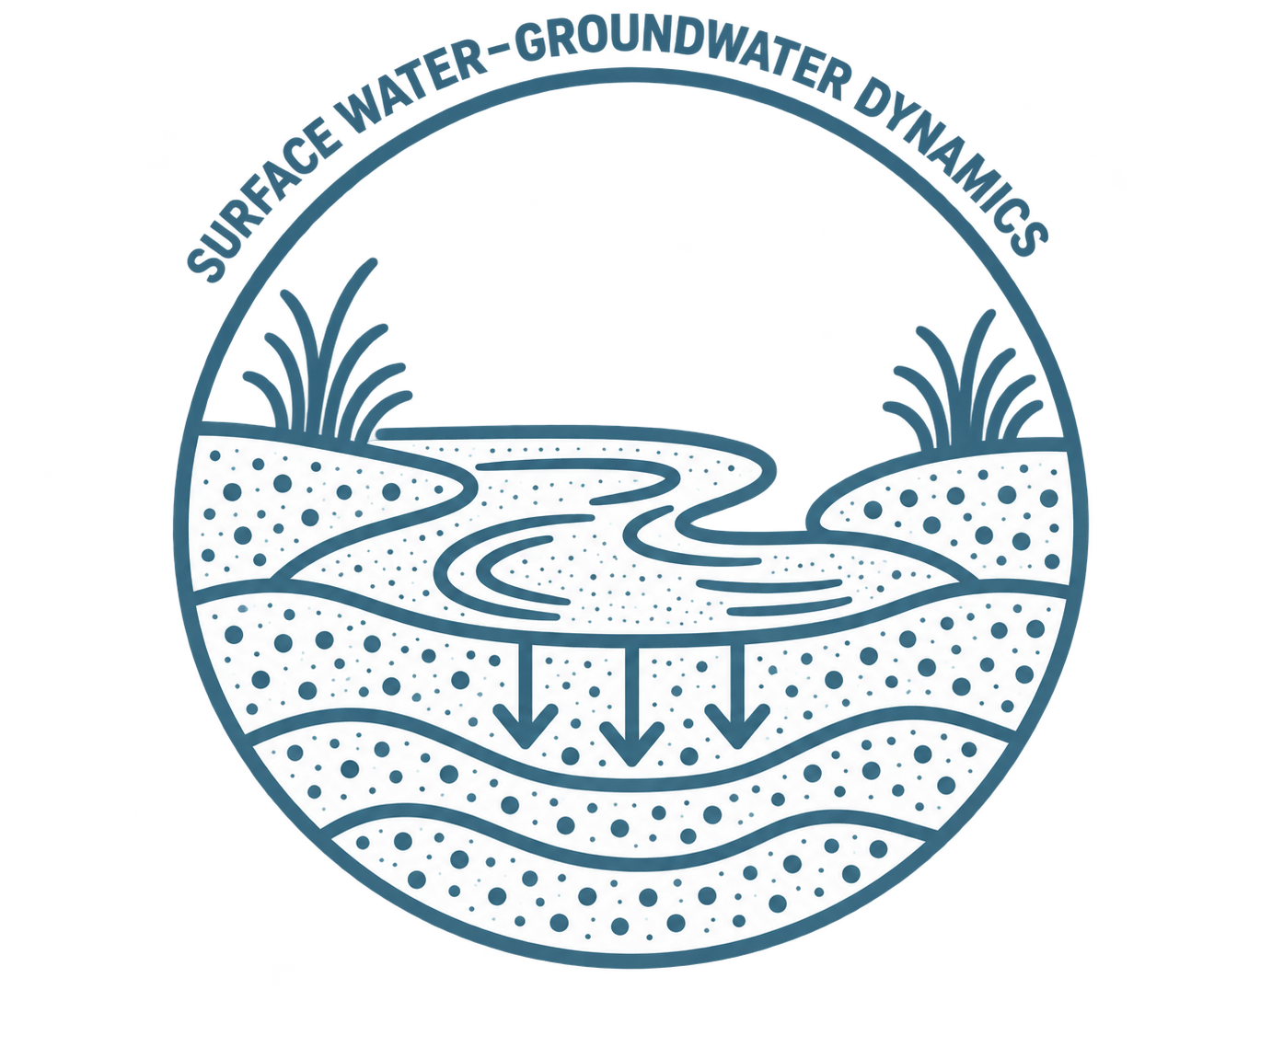
STATE OF ENVIRONMENT
Overview
Where are we and is action needed?
Where do we want to be and how do we get there?
Has anything worked and what have we learned?
What’s coming our way
Impact of climate variability
Impact of abstraction on water availability/reliability
Abstraction impacts on ecological physical habitat
How abstraction influences estuary mouth dynamics
Wetland and dryland ecosystems extent
Temporal and spatial drying patterns
Quantification of loss and gain rates into water balance models
Identify groundwater level threshold for groundwater use reliability for high pressure aquifers
RMA 35(2)(a)​, NEB 222(bd), 224(2), 57(1)(a),(c),(f), and 55(3)
Notes:
This question is where we look to understand fundamental state and trends in rainfall, natural flow, which provide an indication of climate variability, and how that compares to sites with upstream flow alteration through damming, diversion, and abstraction. ​We also look to understand how flow alteration may be impacting on ecological values and interactions with groundwater/aquifers which can lead to drying reaches or depletion of aquifers resulting in water not being available for bores​
Resolution: Pressure Based
In our state of environment, we’d again look to provide more resolution- such as sub-catchment level outputs, where pressure is higher (such as Taieri, Manuherekia, Lindis, Kakanui) and catchment level accounts where pressure is lower (Arrow, Cardrona, Shag, Pomahaka). Operationally, this may mean re-prioritization of flow sites toward high pressure catchments, and movement of sites within catchments, and altering of the groundwater monitoring programme to better understand surface water interactions.
How would the current programme change?​
Investigating state and trend in flows which provides an indication of whether use and/or climate are leading to reduced water availability for both the environment and water users. ORC has not previously done this which limits ORC’s ability understand water quantity resources through time.
The programme would also look to maintain an active understanding across the full region rather periodically (often >10 years) publishing reports on individual catchments and then leaving them. We will still investigate and publish reports on a catchment lever. However, once the understanding is developed it would be actively maintained through semi-automated processing. ​
Better integrating groundwater to understand whether drying reaches are natural and how abstraction influences drying, loss and gain rates, aquifer recharge, and bore reliability​
Linking impacts through to estuary closure and wetland and dryland ecosystem extent​
Partnerships​
Bore owners when determining bore locations, and bore head security checks and education. (Check my well - online website)
Drivers​
State of environment monitoring helps determine how flows are changing and whether we need to alter management approaches, whether that’s regulatory allocation settings, or non-regulatory rostering/water management. State of environment monitoring is required under the RMA (35(2)(a)) and NEB (222(bd); 224(2); 57(1(a), (c), (f); 55(3)). Water quantity also has requirements under the NPSFM.​
Alignment with Councillor Priority Actions: ​
SRA5- Ensure irrigation, water storage and hydro opportunities are appropriately enabled, including addressing any unintended regulatory or organisational barriers:
provides base information on water quantity state and water availability​
EDA7- Support landowner collaboration and environmental and flood resilience initiatives where these contribute to improved catchment outcomes:
understanding vulnerability of different bores to abstraction levels​
CPA1 Identify where Council effort and resources can achieve the greatest improvement in freshwater outcomes, informed by existing science, catchment planning and community priorities and CPA2 Identify priority locations for targeted resource investment across river and lake systems, and report to Council on where effort will achieve the greatest environmental benefit, including consideration of areas such as Waihola, Tomahawk Lagoon, Dunstan, Lake Hayes and the Manuherekia:
Feeds into CPA1 and 2 by providing base information about the pressure on water resources and where issues may be present. ​ ​

Slide 21
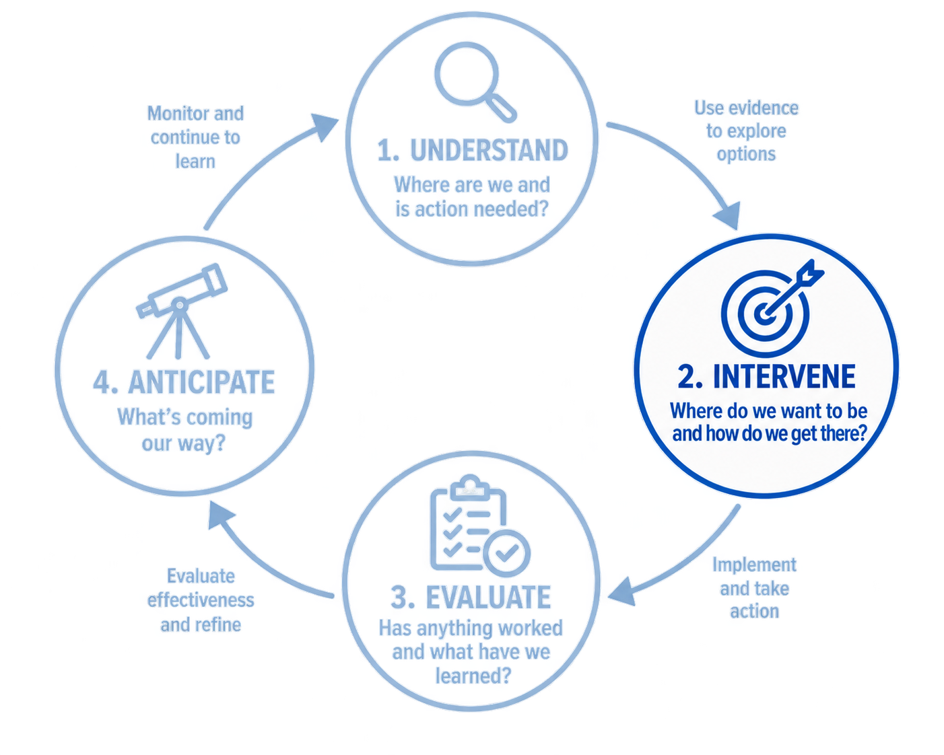
Programme Focus and Key Questions
Overview
Where are we and is action needed?
Where do we want to be and how do we get there?
Has anything worked and what have we learned?
What’s coming our way
Notes:
Once we understand the current state and the pressures, the next question is: what can we do about it?

Slide 22
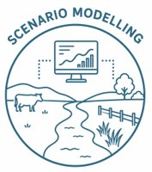
SCENARIO MODELLING AND DECISION SUPPORT TOOLS
Overview
Where are we and is action needed?
Where do we want to be and how do we get there?
Has anything worked and what have we learned?
What’s coming our way
Impact of alternative land cover, environmental flows and irrigation practice impact on water demand, availability, reliability, and ecological health
  Sub-catchment resolution, and bespoke scenarios in higher pressure areas
  Bottom of catchment resolution in lower pressure areas
Identification of storage and development opportunities
Identification of catchment “hot spots” and mitigation opportunities
RMA 30(1)(fa), 32(1) and 32(2), NEB 50, 223, 56
Notes:
This is where we look to understand How different management options will impact water users and the environment. This includes identifying what mitigation options might be, such as changing land cover to increase yield, altering irrigation practice/non-regulatory rostering, or changing regulatory settings to enable use and/or reduce ecological impacts.​
Resolution: Pressure Based​
In our scenario modelling and decision support tools, we’d again look to provide bespoke, higher certainty, scenarios with sub-catchment level outputs at key management nodes in areas where pressure is higher (such as Taieri, Manuherekia, Lindis, Kakanui) and lower certainty, bottom of catchment modelling where pressure is lower (Arrow, Cardrona, Shag, Pomahaka). Notably, this programme has historically done this. ​
How would the current programme change?​
​
Historically, the programme has provided catchment models at the point of regulatory plan changes. This means they are not readily available for catchment groups to consider how alternative water management strategies, storage, alternative water sources, etc. may improve outcomes for water users and the environment. The programme would look to create, and maintain, models so they are available to support both regulatory and non-regulatory water quantity management investigation and opportunities​
The programme would expand beyond primarily investigating how alternative regulatory settings would impact on users and the environment to providing base data to support storage and development scenarios which could be used to mitigate effects of proposed regulatory settings or to enhance reliability under climate change​
The programme will build on understanding gained through state of environment monitoring and water accounting and better integrate across groundwater, estuaries, wetlands, and dryland ecosystems. ​
Partnerships​
Partner with community groups and irrigation companies to determine what scenarios they’d like to investigate​
Partner with irrigation companies and industry bodies to investigate storage/water harvest options which may be suitable in particular catchments​
Drivers​
Determining options, and modelling how they may impact values, supports allocation and limit setting processes, which are a responsibility of regional council under both the RMA (30(1(fa))) and NEB (223). Both the RMA (32) and the NEB (56) have requirements for evaluating outcomes impacts on resources users. Scenario modelling enables these assessments.
Alignment with Councillor Priority Actions: ​
SRA5 Ensure irrigation, water storage and hydro opportunities are appropriately enabled, including addressing any unintended regulatory or organisational barriers:
provides options and scenario information to support this and would provide models for communities to use or further develop when investigating alternative catchment scenario including storage, land use shifts, or water management changes.
SPA3- Identify and address barriers to good practice water use in the non-regulatory space, including working with water users, communities and sector expertise to support improved outcomes:
scenarios can include investigations of how to improve catchment rostering water use to achieve better outcomes​
CPA1 Identify where Council effort and resources can achieve the greatest improvement in freshwater outcomes, informed by existing science, catchment planning and community priorities and CPA2 Identify priority locations for targeted resource investment across river and lake systems, and report to Council on where effort will achieve the greatest environmental benefit, including consideration of areas such as Waihola, Tomahawk Lagoon, Dunstan, Lake Hayes and the Manuherekia:
will provide hot spots and potential mitigation opportunities and how council can improve the situation. ​
CPA6- Support structured engagement with Manuherekia water users to identify and address barriers to progressing water infrastructure and catchment outcomes:
Provides tools to evaluate storage opportunities and options to for this. ​

Slide 23
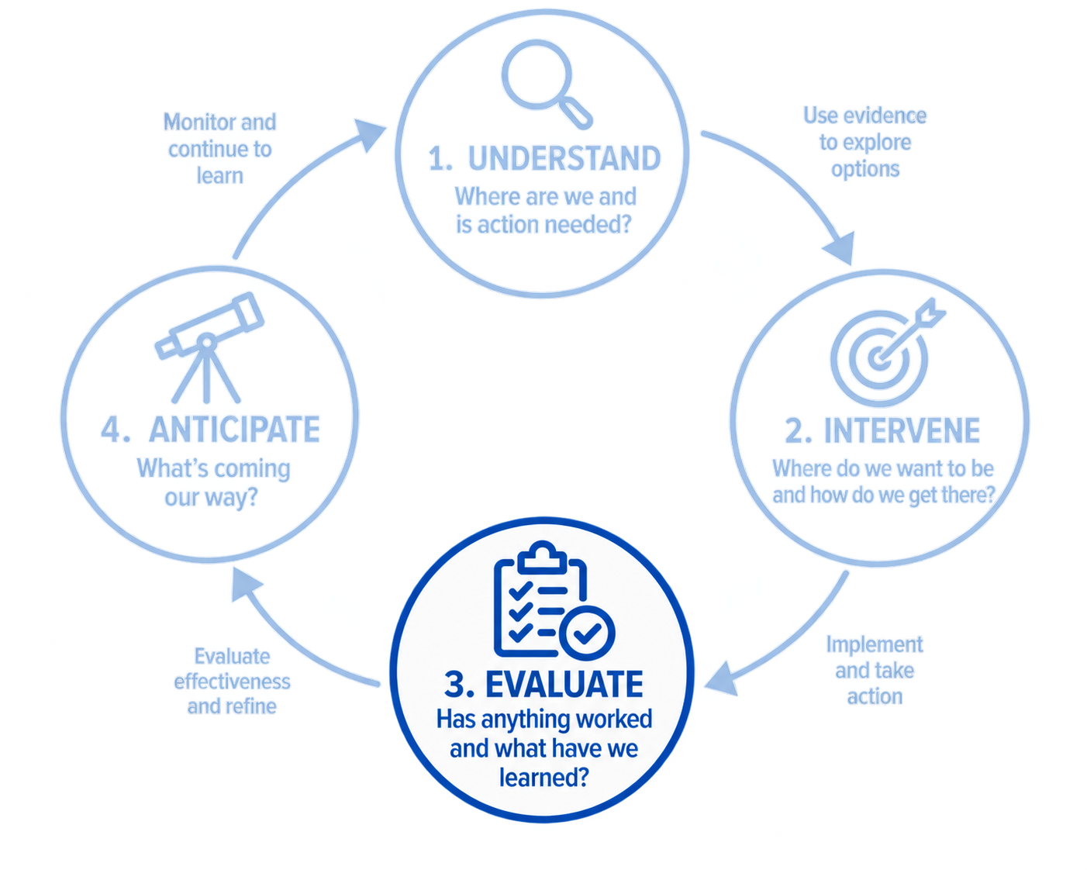
Programme Focus and Key Questions
Overview
Where are we and is action needed?
Where do we want to be and how do we get there?
Has anything worked and what have we learned?
What’s coming our way
Notes:
The third part of the programme is about learning from what we have already done.

Slide 24
PLAN AND PROVISION EFFECTIVENESS
Overview
Where are we and is action needed?
Where do we want to be and how do we get there?
Has anything worked and what have we learned?
What’s coming our way
Evaluate whether environmental flows achieve intended “use” and ecological objectives
  Detection of unintended use limitations and environmental effects
  Frequency, duration, and severity of restrictions
Assess whether residual flows are set appropriately and achieve intended outcome
Live dash boards and annual summaries to assist in rostering/rationing
Assess whether policies have reduced "paper allocation“ and returned allocation to being available
Assess whether pressure has been reduced on overallocated catchments/aquifers
RMA 35(2)(b), NEB 60B and Planning Bill Sch 3. 11(2)
Notes:
This is where we look to understand whether actions undertaken by ORC and community groups have achieved the intended objectives. This includes both regulatory approaches: such as minimum flows and allocations avoiding prolonged drying of a river and achieving the intended reliability target and as well as non-regulatory actions such as supporting irrigation groups to evaluate and improve their water management and rostering/rationing approaches. ​
Resolution: Pressure and action based
Similar to above, the resolution will be based on catchment pressure and will assess particular objectives set out in regulatory plans/community documents such as avoiding drying reaches, maintain ecological habitat, etc. However, rather than being only pressure based, we will also focus on areas where communities are putting in effort to improve water management even if pressure is low.
How would the current programme change?​
​
Assessing whether regulatory and non-regulatory settings are providing for their intended outcomes. Historically, council has not assessed this due to minimum flow implementation lags associated with deemed permits. ​
Assessing both the impact on users as well as environmental objectives. ​
Investigating “unavailable” allocation that isn’t used, why it isn’t used, and whether policies should be, and are, effectively returning it to being available. ​
Partnerships​
Partner with community groups and irrigation companies to understand whether flows are “workable” and providing for intended outcomes​
Integrate community data on drying reaches and effectiveness of residual flows in maintaining continuity or other intended outcomes​
Partner with irrigation groups and provide live dashboard and end of season summaries to help them refine management and rostering practices ​
​
Drivers​
Plan effectiveness is required under the RMA (35(2)(b)) and elements are required under the NEB to ensure avoidance of breaching limits (60B) and effectiveness of any bespoke provisions (Planning bill- Schedule 3 11(2)). We anticipate further guidance through either National Environmental Standards and/or national policy direction (NEB 61(b)).
Notably, this question is likely the question which in which community and catchment groups have the most interest.
Alignment with Councillor Priority Actions: ​
SRA4- Improve accessibility of environmental and natural hazard information, including consideration of property-level visibility and integration of relevant external data sources where practicable:
providing live dashboards and end of season management support​
SRA5- Ensure irrigation, water storage and hydro opportunities are appropriately enabled, including addressing any unintended regulatory or organisational barriers:
Investigates unused allocation, whether it should be returned to available, and if provisions are doing so, and investigates any over restricted flows​
SPA3- Identify and address barriers to good practice water use in the non-regulatory space, including working with water users, communities and sector expertise to support improved outcomes:
Support for during and end of season water rostering/rationing and providing information to help irrigation groups look at more efficient ways of doing so. ​
EDA7- Support landowner collaboration and environmental and flood resilience initiatives where these contribute to improved catchment outcomes:
Live dashboards to support more refined rostering/rationing of water during critical periods​

Slide 25
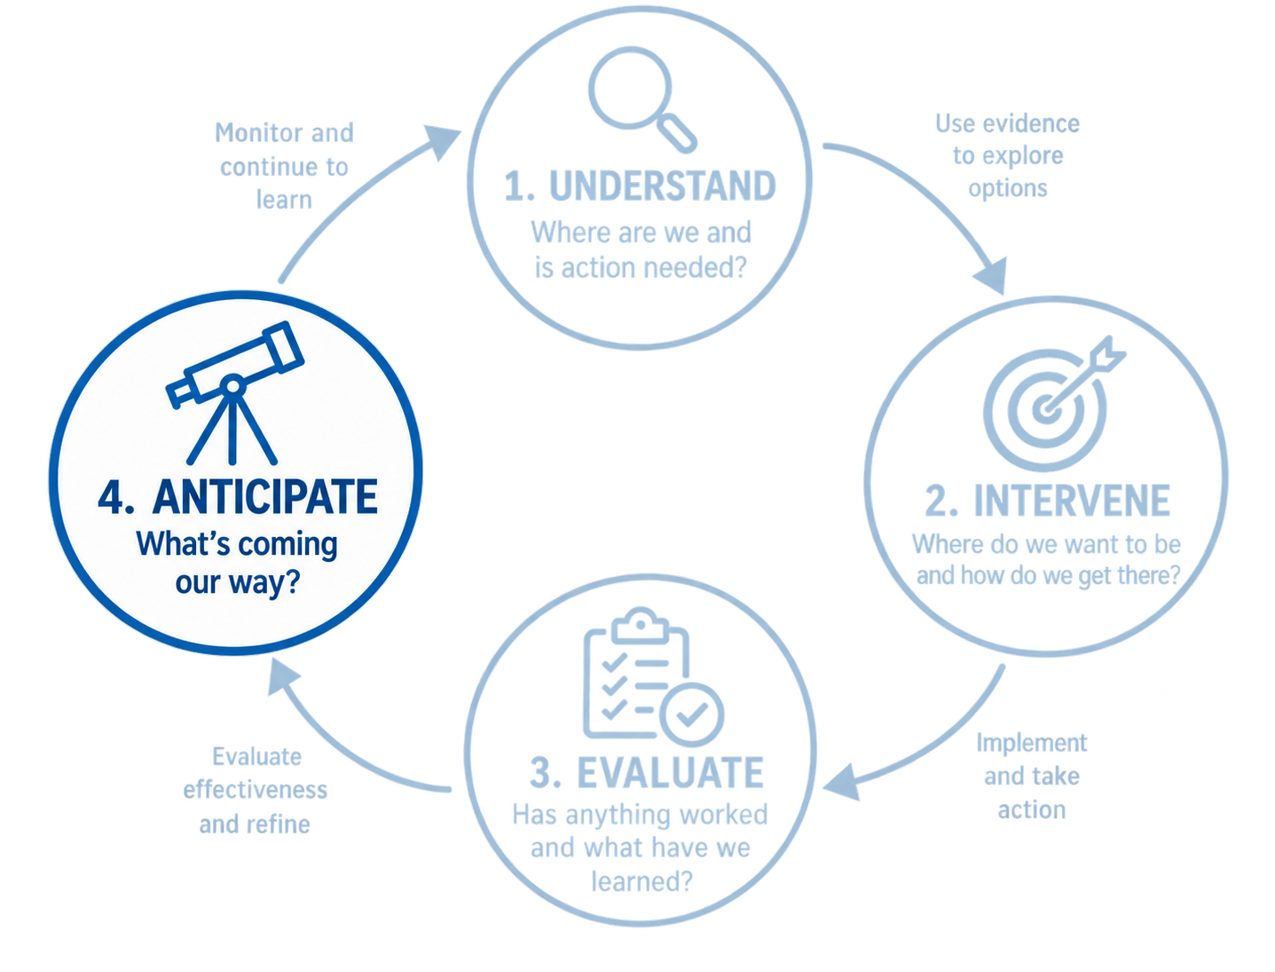
Programme Focus and Key Questions
Overview
Where are we and is action needed?
Where do we want to be and how do we get there?
Has anything worked and what have we learned?
What’s coming our way
Notes:
The final question is about the future/ whats coming our way.

Slide 26
FUTURE SCENARIOS, PRESSURES AND CLIMATE CHANGE
Overview
Where are we and is action needed?
Where do we want to be and how do we get there?
Has anything worked and what have we learned?
What’s coming our way
Identify areas of potential irrigation expansion to understand future pressure on catchments and aquifers
Proactively identify priority locations for flow, groundwater, water use and ecology monitoring
Understand how efficiency improvements, storage, managed aquifer recharge, and other options will fit into our management moving forward
Climate changes and risks to water users and ecosystem health
Proactively identify priority locations for flow, groundwater, water use and ecology monitoring
Evaluate water security for economic development, and environmental protection
RMA 7(i), NEB 57(d) and 60B(2(a))
Notes:
This is where we look to understand likely future scenarios under alternative land use and what climate change might look like and what it may mean for managing abstraction and flow alteration
Resolution: Regional with some pressure-based focus
Unlike in the other questions, this question will seek to identify areas which currently have low pressure, but are likely to see more in the future, or areas which have high pressure but may see further increases.
How would the current programme change?
The programme would change by incorporating forecasting how water demand and availability may change under future climate and land use scenarios rather than representing current demand. Currently, the programme often infers future pressure using qualitative interpretation but doesn’t incorporate formal analysis. This would be done by building on scenario models developed for question two.
Partnerships
Partner with community, territorial authorities, and industry groups to understand potential areas of change and where water availability is likely to face increased demand
Drivers
The RMA requires having regard for the effects of climate change. However, the NEB (57(d); 60B(2a)) has much more complex requirements around horizon/future focused information including incorporating predictions of likely future change in the medium to long-term when considering the capacity of the environment to withstand pressure and disturbance.
Alignment with Councillor Priority Actions:
EDA7-Support landowner collaboration and environmental and flood resilience initiatives where these contribute to improved catchment outcomes:
Understanding vulnerability under future climate scenarios
CPA6-Support structured engagement with Manuherekia water users to identify and address barriers to progressing water infrastructure and catchment outcomes
Support understanding of future irrigation and climate scenarios when progressing this work

Slide 27
Contaminants & Nutrients
Notes:
Cover off more specific details – tangible examples.
More specificality for catchments. E.g Manuherekia and storage etc. taieri (rock and pillar) land cover changes (tussock changes)
E.g add example; tracing abstraction from rovers down to estuary – like the kakanui.
Don’t use the word “protect” – triggering use manage instead of protect.

Slide 28
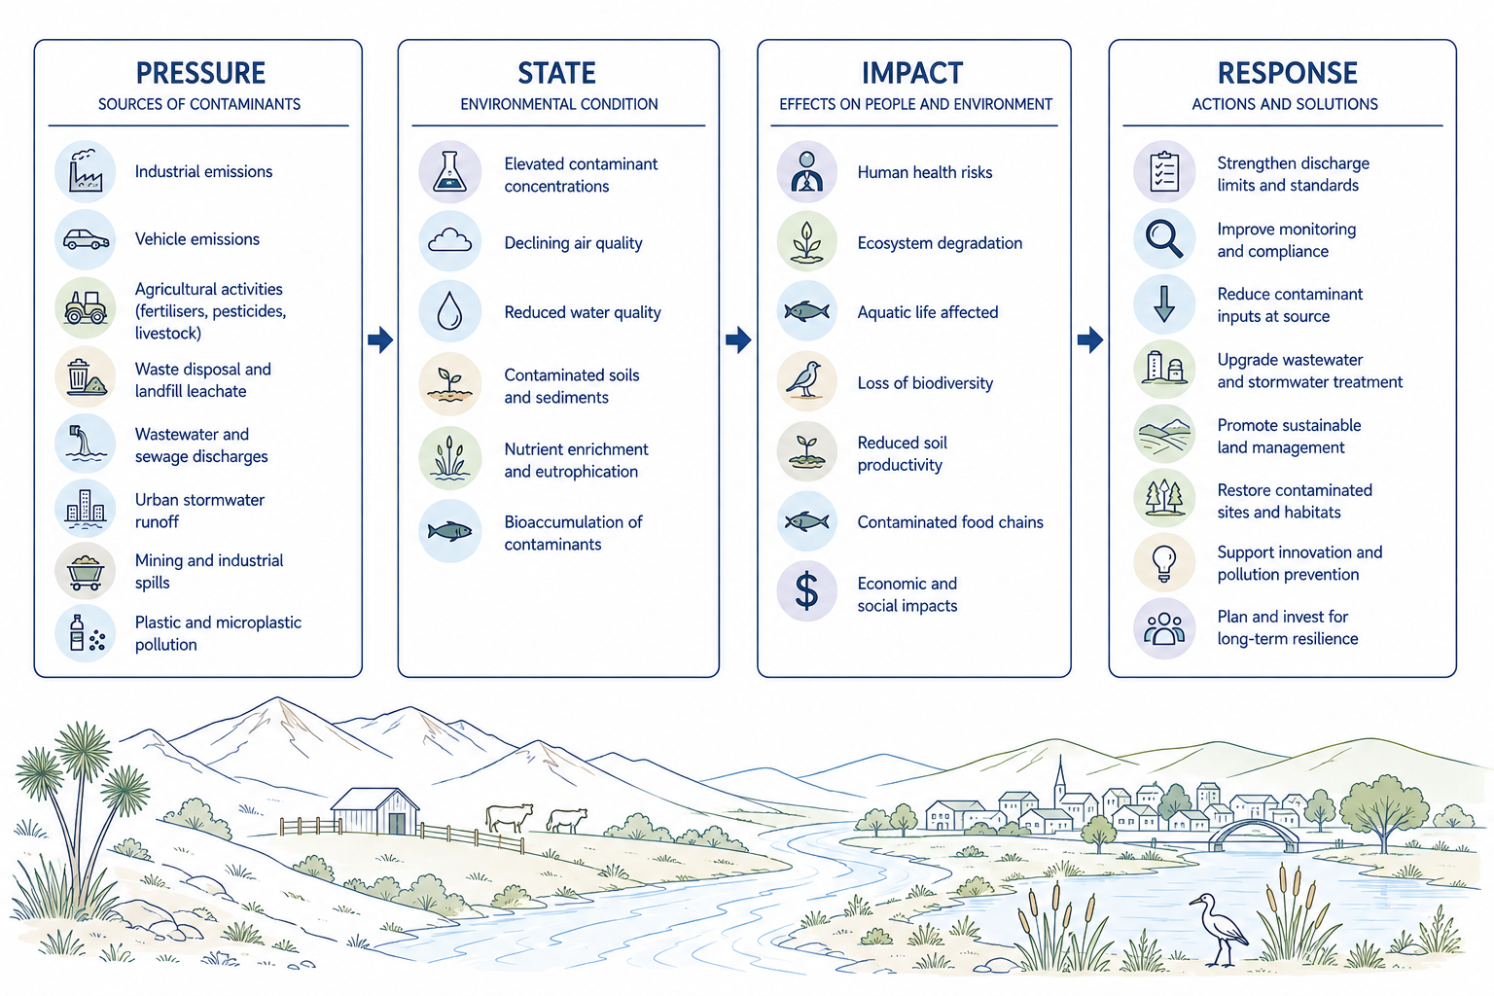
Example Programmes: Contaminants
Overview
Where are we and is action needed?
Where do we want to be and how do we get there?
Has anything worked and what have we learned?
What’s coming our way

Slide 29
Example Programmes: Contaminants
Overview
Where are we and is action needed?
Where do we want to be and how do we get there?
Has anything worked and what have we learned?
What’s coming our way
Notes:
This is the first major part of the programme.
The question here is: what is the current state of the system, what pressures are acting on it, and where are the risks?

Slide 30

RESOURCE USE, THREATS AND PRESSURES
Overview
Where are we and is action needed?
Where do we want to be and how do we get there?
Has anything worked and what have we learned?
What’s coming our way
Land use mapping through time to provide change in land use types and farm modelling to understand change in on farm practice
  Model farms tailored to high pressure catchments
Combine land use mapping and nutrient loss estimates to understand relative change in diffuse inputs
Air emissions inventories
Aggregate consented discharges to air, land, water and coast to understand point source inputs and contributions
RMA System- NPSFM 3.29(5), NEB 57 (1(c)) and 57(3(b-c))
Notes:
This is where we look to understand the sources of our contaminants and how they are changing through time. This includes understanding things like where air pollutants are coming from (emissions inventories and source apportioning), sediment source tracking to determine sediment sources in estuaries, and water quality accounting to investigate contaminant sources and relative contribution in water and ground water. For water quality, this is done by joining land use mapping, irrigated area mapping, and farm/land use modelling to estimate nutrient loss.
Some programmes (emission inventories) have a longer history at ORC whereas programmes like water quality accounting have only recently been developed. These programmes are key to explaining the “why” behind trends in state of environment monitoring as they help us understand the relative change in pressure in different areas.
As rivers, lakes, ground water, estuaries and wetlands have lags that mean we won’t necessarily see the on-land change in water for many years, and in some cases decades, contaminant accounts will also play a very important role in tracking improvement well before we see results in “in stream” monitoring data.
Resolution: Pressure based
In our resource use monitoring and contaminant accounts, we’d look to provide more detail more where pressure is higher. This includes providing emissions inventories in air sheds with higher risk of exceeding health guidelines (NESAQ) (Alexandra, Airtown, Clyde, Cromwell), and more tailored accounts based on data from that specific catchment in higher pressure areas (such as the Pomahaka/South Otago, Kakanui, Taieri, Manuherekia). For water quality contaminants, we’d still look to provide accounts everywhere but would need to extrapolate our understanding about nutrient loss from different land uses into lower risk catchments and aquifers.
How would the current programme change?
Completing inventories for higher risk airsheds rather just those with monitored issues and more regular inventories where things are changing more rapidly (such as urban development in central)
Maintain, and continue developing, an active water quality accounting programme. This programme has recently been developed and will fill gaps in understanding about water quality trends across rivers, lakes, estuaries, and wetlands.
The water quality accounting programme would be expanded to include point source data from consents rather than just diffuse/permitted activity pollutants.
Include ground truthing and manually amending to improve land use and irrigated area mapping
Partnerships
ORC currently partners with industry bodies (both using industry data and reviewing modelling) when modelling nutrient loss from different land uses. We’d look to maintain and expand these collaborations
There will also be an open opportunity for catchment groups to provide further data, or their own farm modelling, to incorporate into accounts to provide more tailored results if they are willing and interested.
Territorial authorities to understand emission and contaminant sources
Drivers
Contaminant accounting is a key element in identifying the cause of different trend patterns and plays an important role in informing allocation settings. Contaminant accounting isn’t explicitly required by the RMA. However, water quality accounting is explicitly required through the NPSFM (3.29). Under the NEB system, regional council would be required to understand any trends showing a change in SoE monitoring and the natural and human causes of those trends (57(1(c))) as well as understanding existing use (57(3(b-c))). As a result, under the NEB systems, accounts play an important role
Alignment with Councillor Priority Actions:
SRA4- Improve accessibility of environmental and natural hazard information, including consideration of property-level visibility and integration of relevant external data sources where practicable:
due to creation of accounting dashboards to help community groups understand where contaminant sources may be originating from
SPA1- Progress work to understand coastal environmental issues, opportunities and risks, in partnership with communities, to ensure a strong evidence base is available regardless of future regulatory settings:
Understanding where contaminants originate from plays an important role in helping understand issues, opportunities, and risks for the coastal environment
CPA1- Identify where Council effort and resources can achieve the greatest improvement in freshwater outcomes, informed by existing science, catchment planning and community priorities:
contaminant accounts contribute to this by informing sources of contaminants and where reductions may be beneficial
CPA2- Identify priority locations for targeted resource investment across river and lake systems, and report to Council on where effort will achieve the greatest environmental benefit, including consideration of areas such as Waihola, Tomahawk Lagoon, Dunstan, Lake Hayes and the Manuherekia:
Contaminant accounts contribute to this by providing information to understanding where contaminants are coming from and where pressure may be highest
CPA5- Identify opportunities to progress elements of the draft Land and Water Plan through non-regulatory approaches and existing mechanisms, where appropriate, to support timely environmental outcomes:
Contaminant accounting framework was developed based on tools developed to support the LWRP
CPA8- Identify priority locations for targeted resource investment into air quality improvement initiatives across the Otago Region with focus on greatest improvement in lowest quality airsheds:
Contaminant accounts contribute to this by identifying sources of contaminants.

Slide 31

STATE OF ENVIRONMENT
Overview
Where are we and is action needed?
Where do we want to be and how do we get there?
Has anything worked and what have we learned?
What’s coming our way
Soil health, rivers, lakes, estuaries, wetlands, ground water, and air quality
  Sub-catchment monitoring in high pressure areas
  Bottom of catchment monitoring in lower pressure areas
  Estuary and wetland health monitoring
  NESAQ compliant monitoring in degraded airsheds
RMA 35(2)(a), NEB 55 (3), 57(1(a)(c)(f)), 222 (bd), 224(2)
Further RMA System:
Freshwater: NPSFM Part 3 Subpart 3, 3.13, 3.27, 3.30 (2), Water Services Act S46​
Air: NES-AQ S15​
Land: RMA 30(1),(ca), NES-FW, RM Reg 32-36, Water Plan Policy 7D, rules 12C.1 and 12C.2, RM (FFP) Regulations 2023 s4&8
Estuaries: NZCPS policies 1, 7, 11a & 11b,14, 21, 22
Wetlands: NPSFM Part 3.18, 3.22 , 3.23, s1.3 , RMA 5,6(a), 15, 17​
Notes:
This is where we look to understand fundamental state and trends in the health of freshwater (surface and ground), air quality, soil health, estuaries and wetlands. State and trend monitoring detects whether there’s an issue which ORC needs to respond to and tracks whether the desired overall health outcomes are being met (such as achieving target states or above national bottom lines). There are also human safety programmes such as contact recreation safety, air quality monitoring, and drinking water monitoring which aim to provide information about risk to human health from contaminant levels in the environment.
Resolution: Pressure based
In our state of environment, we’d look to provide more resolution- such as sub-catchment level outputs, where pressure is higher (such as Kakanui, Pomahaka, Manuherekia Taieri) and bottom of catchment level where pressure is lower (Arrow, Cardrona, Shag, Pomahaka). We’d provide continuous monitoring compliant with the national standards in high-risk air sheds.
How would the current programme change?
Many of ORC’s State of environment programmes aimed at contaminant management have a long history. This the most heavily funded portion of ORC’s current science programme. However, it forms only one piece of the management cycle. While useful for identifying issues and tracking progress towards meeting a final outcome, SoE monitoring won’t give options or rapidly detect whether actions have worked. So, it is important to move beyond SoE monitoring and address the other questions needed to effectively manage the environment.
The programme here would change through:
Refining freshwater river and ground water monitoring toward higher risk areas while maintaining an element of regional representation to inform wider patterns and provide baselines to understand natural variation. This would allow saved funding to be reallocated in programmes which seek to more rapidly detect change from catchment actions.
Estuary SoE monitoring being refined toward measuring targeted estuary specific attributes. This would allow saved funding to be reallocated toward programmes which seek to inform restoration and effectiveness of actions
Additional air sheds would require SoE monitoring
Partnerships
National environmental monitoring standards (NEMS) (samples must be taken this way, to the lab in a specified time window, etc.), the need for consistent processing, and laboratory costs make integration of community data into base SoE datasets difficult. However, community data can be better used to help fill gaps and refine interpretation of the wider SoE data than it currently is. Community data will also play a key role water quality accounting as discussed in the prior section
Drivers
State of environment monitoring is required under the RMA (35(2)(a)) and NEB (222(bd); 224(2); 57(1(a), (c), (f); 55(3)). Air quality has requirements in the NESAQ, wetlands and water quality in the NPSFM, Land in the NES-FW- water plan and others, and coast in the NZCPS.
Alignment with Councillor Priority Actions:
SRA4- Improve accessibility of environmental and natural hazard information, including consideration of property-level visibility and integration of relevant external data sources where practicable:
We will look to shift to publishing interactive SoE reports and dashboard rather than static versions.
SPA1- Progress work to understand coastal environmental issues, opportunities and risks, in partnership with communities, to ensure a strong evidence base is available regardless of future regulatory settings.
Will provide base understanding of contaminant loads to estuaries, estuary health, and suitability of contact recreation sites in coastal environments.
CPA1- Identify where Council effort and resources can achieve the greatest improvement in freshwater outcomes, informed by existing science, catchment planning and community priorities:
Provides base information on where catchments are degraded and degrading.
CPA2- Identify priority locations for targeted resource investment across river and lake systems, and report to Council on where effort will achieve the greatest environmental benefit, including consideration of areas such as Waihola, Tomahawk Lagoon, Dunstan, Lake Hayes and the Manuherekia:
Provides information on state of catchments including whether catchments are degraded and degrading
CPA8- Identify priority locations for targeted resource investment into air quality improvement initiatives across the Otago Region with focus on greatest improvement in lowest quality airsheds:
Provides information on where airsheds are degraded and degrading

Slide 32
Programme Focus and Key Questions
Overview
Where are we and is action needed?
Where do we want to be and how do we get there?
Has anything worked and what have we learned?
What’s coming our way
Notes:
Once we understand the current state and the pressures, the next question is: what can we do about it?

Slide 33

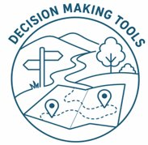
SCENARIO MODELLING AND DECISION SUPPORT TOOLS
Overview
Where are we and is action needed?
Where do we want to be and how do we get there?
Has anything worked and what have we learned?
What’s coming our way
On farm mitigation trials in partnership with industry bodies
Weight of evidence assessments for proposed actions
Literature reviews and guidance on best practice for mitigation and restoration in partnership with industry bodies
Using land use and model farms developed with industry and communities, model relative change in water and estuarine environments based on different land practice and mitigation scenarios
Model change in air quality under different incentive and emission scenarios
Map areas where the greatest change be achieved based on scenario modelling
Identify “hot spot” areas with high risk and high pressure
RMA 32(1) and 32(2), NEB 50, 56
Notes:
This is where we look to understand what actions we can take to reduce contaminants (both regulatory and non-regulatory), how far they’d get us, and where they are needed most. This includes trialling mitigations and developing best practice in partnership with industry groups and providing evidence assessments to evaluate how effective proposed actions, including those in CAPs, might be. We’d also look to model scenarios about how far different mitigation/restoration packages might get us toward the desired outcome and convert accounting information into “hot spots” to help identify where we can make the biggest difference.
Historically, ORC has done elements of this question to inform regulatory action when developing plans or plan changes. The intent would be to maintain an active programme providing up to date information to support regulatory or non-regulatory catchment group actions whenever needed rather than only holding this information when developing a plan change. This would more evenly spread cost through time rather than having peaks in cost and information availability followed by gaps. By maintaining the programme a more continuous level through time, we would anticipate overall cost efficiency.
Resolution: Pressure and action based
We’d again look to provide more resolution and detailed scenario outputs- such as sub-catchment level outputs, where pressure is higher (such as Kakanui, Pomahaka, Manuherekia Taieri or Alexandra for air quality) and higher-level outputs (bottom of catchment improvement) where pressure is lower. Evidence assessments and best practice can be tailored to catchments where groups are active, and pressure is high.
Operationally this will mean bespoke scenario assessments for higher pressure areas, allowing specific mitigation packages to be evaluated. Other areas will be assessed through regional approaches and a set of default interventions.
How would the current programme change?
Linking scenarios from land through water into ground water, wetlands and estuaries
Maintaining an active programme which regularly works with industry groups to provide best practice guidance in local settings and identified how far those actions may get us. This does not mean ORC produces the guidance itself, but may mean ORC works with industry groups to refine and develop their existing guidance.
Providing formal weight of evidence assessments to support proposed catchment group actions and regulatory policy. These identify how much evidence there is supporting that a specified action will help achieve the desired outcome
Partnerships
Industry groups will be partnered with when reviewing “best practice” guidance to ensure it is workable, implementable, and will be effective in Otago’s settings
We’d continue partnering with industry groups when trialling new mitigations
We’ll partner with catchment groups and community groups to determine what sort of scenarios they’d like to see, whether that’s the change achieved through implementing best practice or evaluating what alternative land use scenarios could look like. This will be easier in a regularly updating scenario programme rather than one targeted specifically at regulatory intervention.
Drivers
Determining options, and modelling how they may impact values, supports limit setting processes, which are a responsibility of regional council under both the RMA (30(1(fa))) and NEB (223). Both the RMA (32) and the NEB (56) have requirements for evaluating outcomes impacts on resources users. Scenario modelling enables these assessments.
Alignment with Councillor Priority Actions:
SPA1- Progress work to understand coastal environmental issues, opportunities and risks, in partnership with communities, to ensure a strong evidence base is available regardless of future regulatory settings.
Will provide understanding of different on land management scenarios would influence contaminant loads to coastal environment.
CPA1- Identify where Council effort and resources can achieve the greatest improvement in freshwater outcomes, informed by existing science, catchment planning and community priorities:
Mitigation options, how far they get us and where they would best be deployed will directly inform this priority
CPA2 Identify priority locations for targeted resource investment across river and lake systems, and report to Council on where effort will achieve the greatest environmental benefit, including consideration of areas such as Waihola, Tomahawk Lagoon, Dunstan, Lake Hayes and the Manuherekia:
Mitigation options, how far they get us and where they would best be deployed will directly inform this priority
CPA6 Identify priority locations for targeted resource investment into air quality improvement initiatives across the Otago region, with a focus on the greatest environmental improvements in the lowest quality air sheds:
The mitigation effectiveness, scenario and hotspot aspects covered here will direction inform this priority.

Slide 34
Programme Focus and Key Questions
Overview
Where are we and is action needed?
Where do we want to be and how do we get there?
Has anything worked and what have we learned?
What’s coming our way
Notes:
The third part of the programme is about learning from what we have already done.

Slide 35
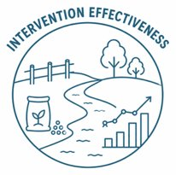

PLAN AND PROVISION EFFECTIVENESS
Overview
Where are we and is action needed?
Where do we want to be and how do we get there?
Has anything worked and what have we learned?
What’s coming our way
Tailored to areas where more actions have been implemented and applied to those with less
  Determine the extent of uptake
  Estimated effectiveness of specific interventions based on evidence assessments
  Model expected improvement based on implementation
  Trends in indicator response from SoE
Combine accounting with state of environment monitoring and intervention effectiveness to understand whether ORC’s plans are having their intended outcomes
  Expected overall improvement
  Trends in indicator response
RMA 35(2)(b), NEB 60B and Planning Bill Sch 3. 11(2)
Notes:
This is where we look to understand whether the actions undertaken by ORC and community groups have achieved the intended objectives. This includes both regulatory approaches, such as rules about land use and/or discharges, and nonregulatory actions such as planting, or creating a wetland. This is done by understanding which, and how widely, actions have been implemented, whether the actions are still expected to be effective for their intended issues, evaluating the expected change given our level of implementation, and then investigating environmental indicators to see if they are responding. Another example would be evaluating how much an air quality subsidy has been used, evaluating how much change we might expect based on uptake and then comparing that to air quality trends where uptake is high.
Resolution: Action based
Studies aimed at these questions will be aimed at where catchment and community groups are active and implementing things (such as Pomahaka, East Otago, Manuherekia and many others). By targeting areas with higher implementation, we will still be able to contextualise the level of impact different actions would have where implementation is lower or groups are less active.
How would the current programme change?
Utilizing a suite of techniques to track implementation and demonstrate action effectiveness. This includes evaluating evidence actions will work through to farm modelling and instream catchment monitoring and modelling. This is a shift change for the science programme as we do not have currently have a suite of programmes aimed at trying to demonstrate whether actions have been implemented and are effective. Instead, we rely on instream monitoring. This is problematic as a single area of intensification could offset the other work undertaken to improve the rest of the catchment. This set of studies will look to demonstrate the improvement achieved locally and across the catchment as well as continue to use SoE information to demonstrate whether the overall outcomes are being achieved.
Partnerships
Partner with community groups and catchment groups to understand the changes they’ve made, where they’ve made them.
Integrate community data to help contextualise results and more rapidly detect environmental response.
Partner with industry groups to estimate broad scale implementation and effectiveness of mitigations
Drivers
Plan effectiveness is required under the RMA (35(2)(b)) and elements are required under the NEB to ensure avoidance of breaching limits (60B) and effectiveness of any bespoke provisions (Planning bill- Schedule 3 11(2)). We anticipate further guidance through either National Environmental Standards and/or national policy direction (NEB 61(b)).
Notably, this question is likely the question which in which community and catchment groups have the most interest.
Alignment with Councillor Priority Actions:
This question doesn’t directly connect with councillor priority actions. However, it is linked with CPA1, CPA2, EDA4 as it will evaluate whether the actions undertaken have achieved the desired outcomes. This includes identifying whether provisions are overly restrictive.

Slide 36
Programme Focus and Key Questions
Overview
Where are we and is action needed?
Where do we want to be and how do we get there?
Has anything worked and what have we learned?
What’s coming our way
Notes:
The final question is about the future/ whats coming our way.

Slide 37

FUTURE SCENARIOS, PRESSURES AND CLIMATE CHANGE
Overview
Where are we and is action needed?
Where do we want to be and how do we get there?
Has anything worked and what have we learned?
What’s coming our way
Evaluate possible future land use change and risks from climate change
Proactively identify high risk periods for land uses
Identify emerging contaminants and assess Otago’s risk to them
  Air, water, estuaries, wetlands, and soil health
Proactively identify priority locations for monitoring
RMA 7(i), NEB 57(d) and 60B(2(a))
Notes:
This is where we look to understand what likely future scenarios such as alternative land use, management practice, and climate change might look like, what it may mean for contaminant levels, and whether there are any new or emerging contaminants that need to be considered
Resolution: Region wide
Unlike in the other questions, this question will seek to identify areas which currently have low pressure, but are likely to see more in the future, or areas which have high pressure and may see further increases or may see decreases.
How would the current programme change?
The programme would change by incorporating forecasting how contaminant levels in soil, air and water may change under future climate and land use scenarios rather than representing current land use and contaminant levels. Currently, the programme often infers future pressure using qualitative interpretation but doesn’t incorporate formal analysis. This would be done by building on scenario models developed for question 2.
Partnerships
Partner with community, territorial authorities, and industry groups to understand potential areas of change and urbanization and intensification is likely to occur
Continue to partner with governmental and research agencies to participate in understand Otago’s exposure level to emerging contaminants.
Drivers
The RMA requires having regard for the effects of climate change. However, the NEB (57(d); 60B(2a)) has much more complex requirements around horizon/future focused information including incorporating predictions of likely future change in the medium to long-term when considering the capacity of the environment to withstand pressure and disturbance.
Alignment with Councillor Priority Actions:
EDA7 Support landowner collaboration and environmental and flood resilience initiatives where these contribute to improved catchment outcomes
.: Improve understanding of useful and effective actions under climate and land use scenarios to increase resilience.

Slide 38
Habitat Loss
& Physical Disturbance
Notes:
Cover off more specific details – tangible examples.
More specificality for catchments. E.g Manuherekia and storage etc. taieri (rock and pillar) land cover changes (tussock changes)
E.g add example; tracing abstraction from rivers down to estuary – like the kakanui.
Don’t use the word “protect” – triggering use manage instead of protect.

Slide 39
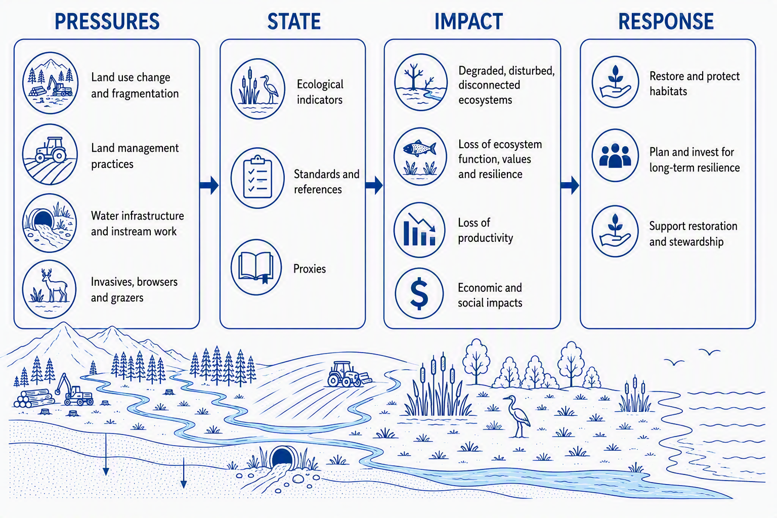
Example Programmes: Habitat Loss and Physical Disturbance
Overview
Where are we and is action needed?
Where do we want to be and how do we get there?
Has anything worked and what have we learned?
What’s coming our way

Slide 40
Example Programmes: Habitat Loss and Physical Disturbance
Overview
Where are we and is action needed?
Where do we want to be and how do we get there?
Has anything worked and what have we learned?
What’s coming our way
Notes:
This is the first major part of the programme.
The question here is: what is the current state of the system, what pressures are acting on it, and where are the risks?

Slide 41
RESOURCE USE, THREATS AND PRESSURES
Overview
Where are we and is action needed?
Where do we want to be and how do we get there?
Has anything worked and what have we learned?
What’s coming our way
Land use and practice mapping through time to identify change. Vegetation cover monitoring and high disturbance activity mapping, such as forestry harvest and cropping, to identify erosion risk
Map and prioritize instream structures that act as barriers to fish passage
Wetland pressure index compiled from surrounding land use, irrigation, and invasive species presence
Aggregate consent data including winter grazing, instream works and structures, earthworks
RMA- Not explicit, NPSIB 3.22, NPSFM 3.26; NEB 223, 57(1) and 57(3(b-c))
Notes:
This where we seek to understand how land use change and practice may be altering habitats/ecosystems. This includes things like denuding an area of vegetation cover resulting in loss of habitat and increased erosion vulnerability, drainage of wetland systems, forestry harvest, and instream structure stopping fish passage. Alongside the broadscale resource use and pressure mapping indicated here, programmes would also aggregate consent data to investigate whether cumulative effects from consented activities may be having untended effects. ​
Resolution: Pressure based
In our resource use monitoring, we’d prioritize having higher resolution in closer proximity to threatened ecosystems, species, and areas prone to erosion.​
How would the current programme change?​
Wetland pressure monitoring would be moved to occurring every 5 years for the region to provide an indication of how pressures on wetlands are changing over timescale more relevant to management rather than every 10 years. ​
Mapping programmes will better integrate and identify high erosion areas and will have a ground truthing programme
Incorporating this information into the programme will help identify where and why ecosystem extent or species may be decreasing due to habitat loss. Notably, many of the requirements for this work stream, such as land use change mapping, are incorporated under contaminants and abstraction. So, these are not necessarily “additional” requirements. ​
Partnerships​
ORC currently partners with industry bodies (both using industry data and reviewing modelling) when understanding and representing practice on different land uses such as farms or forestry. We’d look to maintain and expand these collaborations​
There will also be an open opportunity for catchment groups to provide further data if they are willing and interested. ​
We will also partner with catchment groups to understand interventions or how practice has changed such as fish passage structure remediated by a catchment group​
Drivers​
Identifying resource use as it related to habitat loss and physical disturbance isn’t explicitly required by the RMA, though protecting significant habitats and drivers are present in the NPSIB (3.22) and NPSFM (3.26). If we don’t collect and evaluate this data, we cannot say why ecosystem extent (such as wetlands or dryland ecosystems) may be disappearing in a quantitative way. Under the NEB system, regional council would be required to understand any trends showing a change in SoE monitoring and the natural and human causes of those trends (57(1(c)); 57(3(b)); 57(3(c))) and consider existing uses when setting limits. As a result, under the NEB system, this information will play an important role​
Alignment with Councillor Priority Actions: ​
SPA1- Progress work to understand coastal environmental issues, opportunities and risks, in partnership with communities, to ensure a strong evidence base is available regardless of future regulatory settings:
Understanding location of activities and coastal structures plays an important role in developing our understanding of coastal environmental issues
CPA1- Identify where Council effort and resources can achieve the greatest improvement in freshwater outcomes, informed by existing science, catchment planning and community priorities.
Understanding resource use plays an important role in understanding where the greatest improvements can be made. This includes understanding where wetlands are under the greatest pressure, which instream structure remediation will make the largest difference, which sources of erosion are contributing to freshwater issues, and whether aggregated consenting outcomes are in line with expectations. ​
CPA2- Identify priority locations for targeted resource investment across river and lake systems, and report to Council on where effort will achieve the greatest environmental benefit, including consideration of areas such as Waihola, Tomahawk Lagoon, Dunstan, Lake Hayes and the Manuherekia:
Understanding resource use plays an important role in understanding where the greatest improvements can be made. This includes understanding where wetlands are under the greatest pressure, which instream structure remediation will make the largest difference, which sources of erosion are contributing to freshwater issues, and whether aggregated consenting outcomes are in line with expectations.

Slide 42
STATE OF ENVIRONMENT
Overview
Where are we and is action needed?
Where do we want to be and how do we get there?
Has anything worked and what have we learned?
What’s coming our way
Ecosystem extent in terrestrial, wetland, salt marsh and marine habitats
Monitoring of threatened ecosystems with high biodiversity
Monitoring of indicator species and regional threat status assessments
Freshwater and fish
Soil health and erosion indices
Wetland condition
Estuary health
Significant coastal habitats, such as kelp forests
RMA 35(2)(a), NEB 55 (3), 57(1(a)(c)(f)), 222 (bd), 224(2)
Freshwater: NPSFM Part 3 Subpart 3, 3.30 (2)
Land: RMA 30(1),(ca), s55(1)(a), RM(FFP) Reg 2023 Part 1, s44&8, NPSIB 3.22, 3.25
Estuaries & Coast: NZCPS policies 1, 7, 11a & 11b,14, 21, 22
Wetlands: NPSFM Part 3.18, 3.22 , 3.23, s1.3 , RMA 5,6(a), 15, 17​
Notes:
This is where we look to understand fundamental state and trends of indicators which relate to habitat loss and physical disturbance. These include things like ecosystem extent, condition, and species monitoring or threat status assessments. In many cases, the relationships between resource use and “environmental state” are very strong for habitat loss. Conversion of native vegetation to an alternative land use will result in loss of ecosystem extent; a barrier to fish passage will result in a reduced fish and potentially invertebrate community upstream. As a result, in some cases acting to fix the problem is more straight forward than with contaminants.
Resolution: Pressure based
In our state of environment, we will use remote sensing to track ecosystem extent in terrestrial, wetland, and salt marsh ecosystems. More detailed monitoring will be targeted at ecosystems which are the highest threat, are off public lands, and have disproportionately high biodiversity values such as dry land ecosystems.
Species monitoring is targeted at groups which can act as an indicator for a wider species community with the state of the other being assessed based on existing knowledge and available datasets which community monitoring contribute to. Freshwater monitoring will leverage the wider SoE network but will add tailored fish monitoring to areas where it is likely to detect if there are any issues (forestry areas and urban areas) and where there are threatened species off public land.
How would the current programme change?
Many of ORC’s State of environment programmes in this area are relatively new.
A subset of wetlands under high pressure would maintain more frequent monitoring rather than on a 10-year rotation.
Freshwater biodiversity monitoring will rely on invertebrates and the wider contaminant network for broad scale but re-prioritize fish monitoring into sites where fish species are likely to detect wider impacts such as catchments with forestry or urban environments and will overlap with monitoring of threatened species
Estuary monitoring will reduce to a tailored programme aimed at monitoring the needed requirements for each estuary.
Partnerships
This portion of state of environment monitoring has the greatest opportunity to use citizen science and incorporate community data. Observations of species on iNaturalist and other databases can be used to help track where different species are present and create a wider understanding how unmonitored species are tracking.
Community collected e-DNA samples that are placed into accessible repositories will be used to help provide and interpret broader scale patterns for terrestrial and aquatic species
We would also partner with the Department of Conservation to ensure monitoring is complimentary, but not duplicating or taking over, the role of department of conservation
Drivers
State of environment monitoring is required under the RMA (35(2)(a)) and NEB (222(bd); 224(2); 57(1(a), (c), (f); 55(3)). Water quantity also has requirements under the NPSFM.​ Wetlands and water quality have requirements in the NPSFM, Land in the NES-FW- water plan and others, indigenous biodiversity in NPSIB (3.22, 3.25) and RPS and coast in the NZCPS.
Alignment with Councillor Priority Actions:
SPA1- Progress work to understand coastal environmental issues, opportunities and risks, in partnership with communities, to ensure a strong evidence base is available regardless of future regulatory settings:
Estuary and monitoring of significant coastal habitats plays an important role in understanding coastal issues and building an evidence base
CPA1- Identify where Council effort and resources can achieve the greatest improvement in freshwater outcomes, informed by existing science, catchment planning and community priorities:
Understanding state of environment also plays an important role in understanding where the greatest improvements can be made. This includes understanding how wetland extent and condition is changing, estuary health, and state of freshwater biodiversity. Some programmes are not identified as aligning with this priority due to not being aimed at “freshwater” outcomes.
CPA2- Identify priority locations for targeted resource investment across river and lake systems, and report to Council on where effort will achieve the greatest environmental benefit, including consideration of areas such as Waihola, Tomahawk Lagoon, Dunstan, Lake Hayes and the Manuherekia:
Understanding state of environment also plays an important role in understanding where the greatest improvements can be made. This includes understanding how wetland extent and condition is changing, estuary health, and state of freshwater biodiversity. Some programmes are not identified as aligning with this priority due to not being aimed at “freshwater” outcomes.

Slide 43
Programme Focus and Key Questions
Overview
Where are we and is action needed?
Where do we want to be and how do we get there?
Has anything worked and what have we learned?
What’s coming our way
Notes:
Once we understand the current state and the pressures, the next question is: what can we do about it?

Slide 44
SCENARIO MODELLING AND DECISION SUPPORT TOOLS
Overview
Where are we and is action needed?
Where do we want to be and how do we get there?
Has anything worked and what have we learned?
What’s coming our way
Ecosystem restoration and biodiversity management trials in partnership with industry bodies
Weight of evidence assessments for proposed actions
Literature reviews and guidance on best practice for mitigation and restoration in partnership with industry
Scenarios evaluating level of protection provided to ecosystems and species through different intervention packages
Identify biodiversity focus areas with numerous species
Identify “hot spots” with high risk and pressure and potential for mitigation/restoration
Identify fish passage restoration priorities
Develop a landscape risk tool and use soil microclimate sites to support condition-appropriate land management
RMA 32(1) and 32(2), NEB 50, 56
Notes:
This is where we look to understand what actions we can take to protect, restore, and improve habitats to support ecosystems and species, where we should do them, and how that might impact resource users. This includes trialling mitigation techniques in ecosystems unique to Otago, conducting weight of evidence assessments to support what actions would be beneficial, and working with industry group and other agencies to provide best practice guidance. These programmes also demonstrate the level of protect provided under different potential policy settings and quantify the trade-offs of doing so with the respect to land use limitations. They also identify biodiversity focus areas and hot spots where restoration or protection would be particularly beneficial.
Resolution: Region wide and pressure based
Region wide biodiversity focus areas will provide a base understanding of areas where biodiversity is particularly high for the region. Scenarios will focus on areas with greater pressure and high biodiversity values off public land. This would focus on particular dryland ecosystems, fish passage barriers, and wetland ecosystems.
How would the current programme change?
Working with industry groups and others to develop and provide best practice and restoration guidance to support species and ecosystems
Developing a scenario evaluation programme to understand the level of change that would be achieved under different mitigation scenarios, and how it would impact land users if different interventions/protections were implemented
Providing wider weight of evidence assessments to support proposed community and catchment group actions
Partnerships
Industry groups will be partnered with when reviewing “best practice” guidance to ensure it is workable, implementable, and will be effective in Otago’s settings
We’d continue partnering with catchment, community and industry groups when trialling new mitigations
We’ll partner with catchment groups and community groups to determine what sort of scenarios they’d like to see, whether that’s the change achieved through implementing best practice or evaluating what alternative land use scenarios could look like
We’d continue partnering with DOC and other govt. agencies
Drivers
Determining options, and modelling how they may impact values, supports allocation and limit setting processes, which are a responsibility of regional council under both the RMA (30(1(fa))) and NEB (223). Both the RMA (32) and the NEB (56) have requirements for evaluating outcomes impacts on resources users. Scenario modelling enables these assessments.
Alignment with Councillor Priority Actions:
SPA1- Progress work to understand coastal environmental issues, opportunities and risks, in partnership with communities, to ensure a strong evidence base is available regardless of future regulatory settings:
This question aligns as biodiversity focus areas will help identify areas in the wider coastal environment and scenarios would evaluate how different policies may strict land or coast use under different sets of policies.
CPA1 Identify where Council effort and resources can achieve the greatest improvement in freshwater outcomes, informed by existing science, catchment planning and community priorities:
Mitigation options, how far they get us and where they would best be deployed will directly inform this priority
CPA2 Identify priority locations for targeted resource investment across river and lake systems, and report to Council on where effort will achieve the greatest environmental benefit, including consideration of areas such as Waihola, Tomahawk Lagoon, Dunstan, Lake Hayes and the Manuherekia:
Mitigation options, how far they get us and where they would best be deployed will directly inform this priority

Slide 45
Programme Focus and Key Questions
Overview
Where are we and is action needed?
Where do we want to be and how do we get there?
Has anything worked and what have we learned?
What’s coming our way
Notes:
The third part of the programme is about learning from what we have already done.

Slide 46
PLAN AND PROVISION EFFECTIVENESS
Overview
Where are we and is action needed?
Where do we want to be and how do we get there?
Has anything worked and what have we learned?
What’s coming our way
  Fish passage restoration
  State/condition of created wetlands and restored ecosystems
  Estimated effectiveness of specific interventions undertaken by community/catchment groups
Combine accounting with state of environment monitoring and intervention effectiveness to understand whether ORC’s plans are having their intended outcomes
  Expected overall improvement
  Trends in indicator response
RMA 35(2)(b), NEB 60B and Planning Bill Sch 3. 11(2)
Notes:
This is where we look to understand whether the actions undertaken by ORC and community groups have achieved the intended objectives. This includes both regulatory approaches such as prohibited activities around wetland drainage, and non-regulatory actions such as a catchment group remedying fish passage.
Resolution: Action based
These programmes will focus on where more action has occurred through community group, CAP, and catchment group actions. We will apply the learnings from these larger programmes that are more likely to have impacts to areas where there has been less action, which means we may not detect the impacts directly in these areas.
How would the current programme change?
Developing a programme and shifting focus and effort to understanding the likely outcome and effectiveness of on the ground actions.
Partnerships
Partner with community groups and understand actions undertaken, location, and then provide our expertise to inform likely outcomes
Integrate community data monitoring data to help understand wider outcomes for species, ecosystems, and habitat condition
Drivers
The RMA requires having regard for the effects of climate change. However, the NEB (57(d); 60B(2a)) has much more complex requirements around horizon/future focused information including incorporating predictions of likely future change in the medium to long-term when considering the capacity of the environment to withstand pressure and disturbance.
Alignment with Councillor Priority Actions:
This question doesn’t directly connect with councillor priority actions. However, it is linked with CPA1, CPA2, EDA4 as it will evaluate whether the actions undertaken have achieved the desired outcomes. This includes identifying whether provisions are overly restrictive.

Slide 47
Programme Focus and Key Questions
Overview
Where are we and is action needed?
Where do we want to be and how do we get there?
Has anything worked and what have we learned?
What’s coming our way
Notes:
The final question is about the future/ what’s coming our way.

Slide 48
FUTURE SCENARIOS, PRESSURES AND CLIMATE CHANGE
Overview
Where are we and is action needed?
Where do we want to be and how do we get there?
Has anything worked and what have we learned?
What’s coming our way
Evaluate possible future land use change and intensification and risks from climate change
Understand vulnerability of ecosystems and species to climate change to further enable prioritization of efforts
RMA 7(i), NEB 57(d) and 60B(2(a))
Notes:
This is where we look to understand what likely future scenarios under alternative land use and climate change might look like and what it may mean ecosystems, species and the habitats that support them. Unlike in the other questions, this question will seek to identify areas which currently have low pressure, but are likely to see more in the future, or areas which have high pressure but may see decreases as land use changes
How would the current programme change?
The programme here would change by incorporating forecasting how we expect things change in the future enabling proactive response and prioritization of areas where interventions can help
Partnerships
Partner with community, territorial authorities, and industry groups to understand potential areas of change and where water availability is likely to face increased demand
Drivers
The RMA requires having regard for the effects of climate change. However, the NEB has much more complex requirements around horizon/future focused information including incorporating predictions of likely future change in the medium to long-term when considering the capacity of the environment to withstand pressure and disturbance.
Alignment with Councillor Priority Actions:
EDA7- Support landowner collaboration and environmental and flood resilience initiatives where these contribute to improved catchment outcomes:
understanding vulnerability of habitat and related biodiversity values under future climate scenarios

Slide 49
Example Programmes: Pests, Invasives and Exotic Species
Overview
Where are we and is action needed?
Where do we want to be and how do we get there?
Has anything worked and what have we learned?
What’s coming our way
Notes:
Pest, invasive and exotic species are also a pressure on many of our biodiversity and state values. This includes things like deer, trout, possums, rabbits, but also lake snow, lagrosiphone, didymo and others.

Slide 50


Example Programmes: Pests, Invasives and Exotic Species
Overview
Where are we and is action needed?
Where do we want to be and how do we get there?
Has anything worked and what have we learned?
What’s coming our way
Notes:
From a science programme perspective, we do not have a developed programme aimed at informing how we manage this pressure. Some programmes do monitor state values such as terrestrial and aquatic biodiversity that would be affected by pests, invasives, and exotic species. However, we have very few programmes aimed assessing monitoring pest species themselves. We also don’t maintain a programme which looks at how far interventions might get use and where they should be applied, or how effective the interventions undertaken have gotten us nor what pests are likely to be introduced and how will they impact on things.
How would the programme change:
This programme could be developed in collaboration with the biosecurity team to provide an evidence base to improve ORC’s management of pest, invasive, and exotic species. However, as this is not currently a developed programme, it may require additional resourcing.
Partnerships
Partnerships would be identified during programme development but would include government agencies such as MPI and DOC, as well as community groups and stakeholders.
Drivers
ORC has responsibility for pest species under the biosecurity act. In addition, limits set for biodiversity under the NEB may be impacted by pest, invasive, and exotic species.
Alignment with Councillor Priority Actions:
Developing this type of programme for the organization would align with councillor priority actions:
EDA1: Strengthen pest management outcomes for control of rabbits, with the establishment of a working group and a focus on practical delivery, partnerships, and community and landowner collaboration.
EDA 2: Assess opportunities for eradication or a step-change intervention for lagarosiphon, including appropriate funding options and delivery models.
EDA 3: Support community and voluntary efforts to control wilding pines. Advocate for fair contributions from government and those responsible for the source of the wildings.
CPA 1: Identify where Council effort and resources can achieve the greatest improvement in freshwater outcomes, informed by existing science, catchment planning and community priorities.

Slide 51
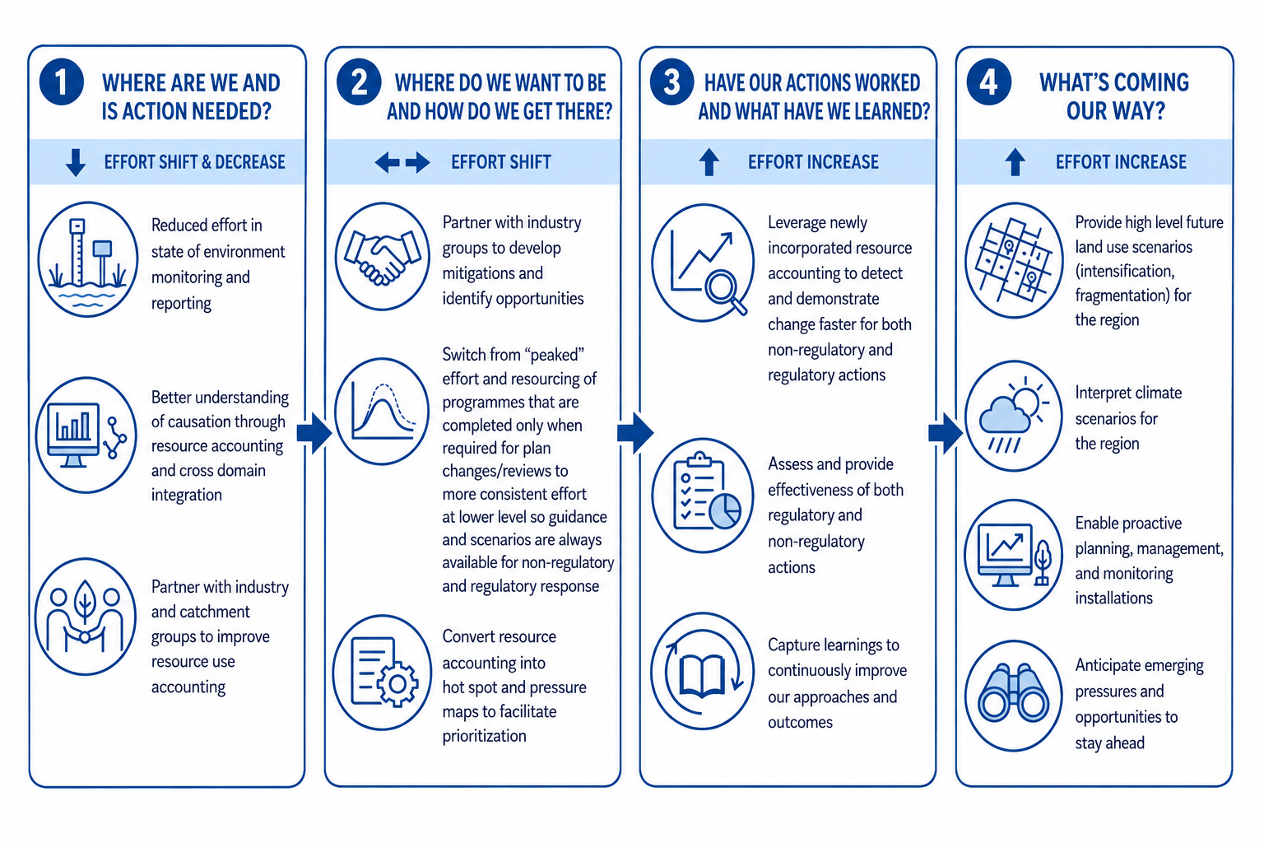
Overall change

Slide 52
Questions / Discussion
Notes:
Cover off more specific details – tangible examples.
More specificality for catchments. E.g Manuherekia and storage etc. taieri (rock and pillar) land cover changes (tussock changes)
E.g add example; tracing abstraction from rovers down to estuary – like the kakanui.
Don’t use the word “protect” – triggering use manage instead of protect.

