Slide 1
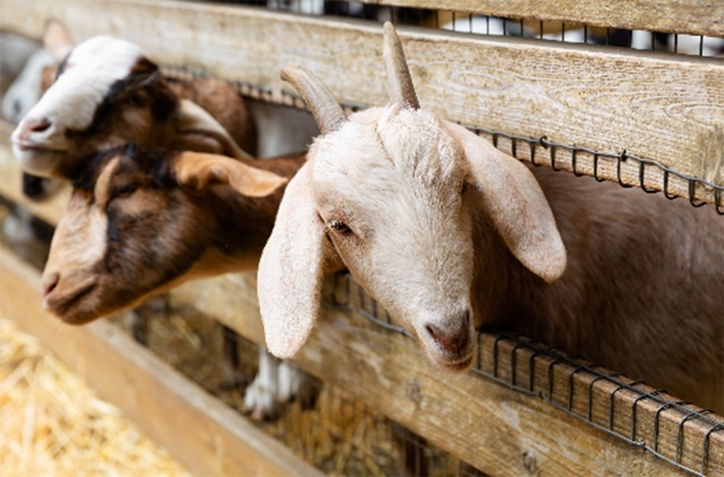
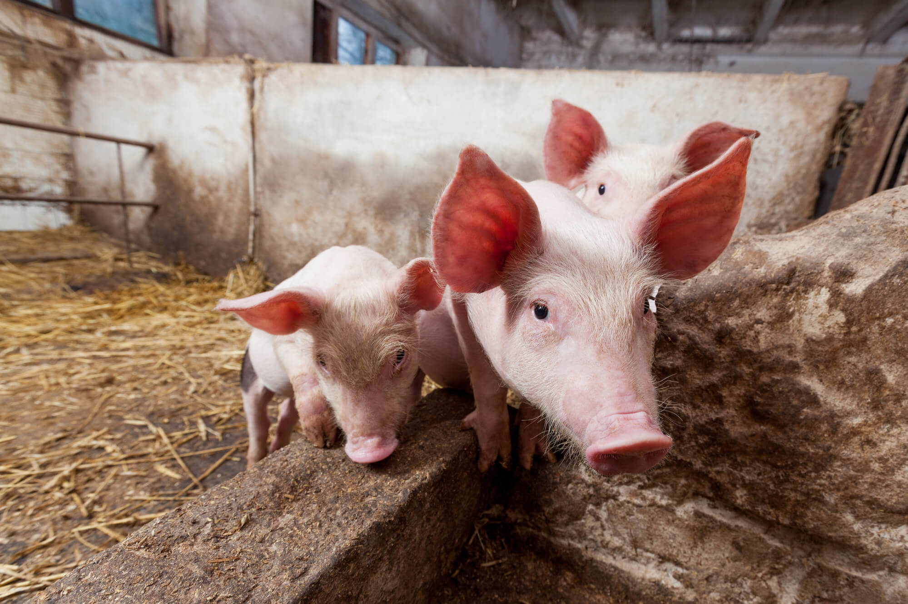
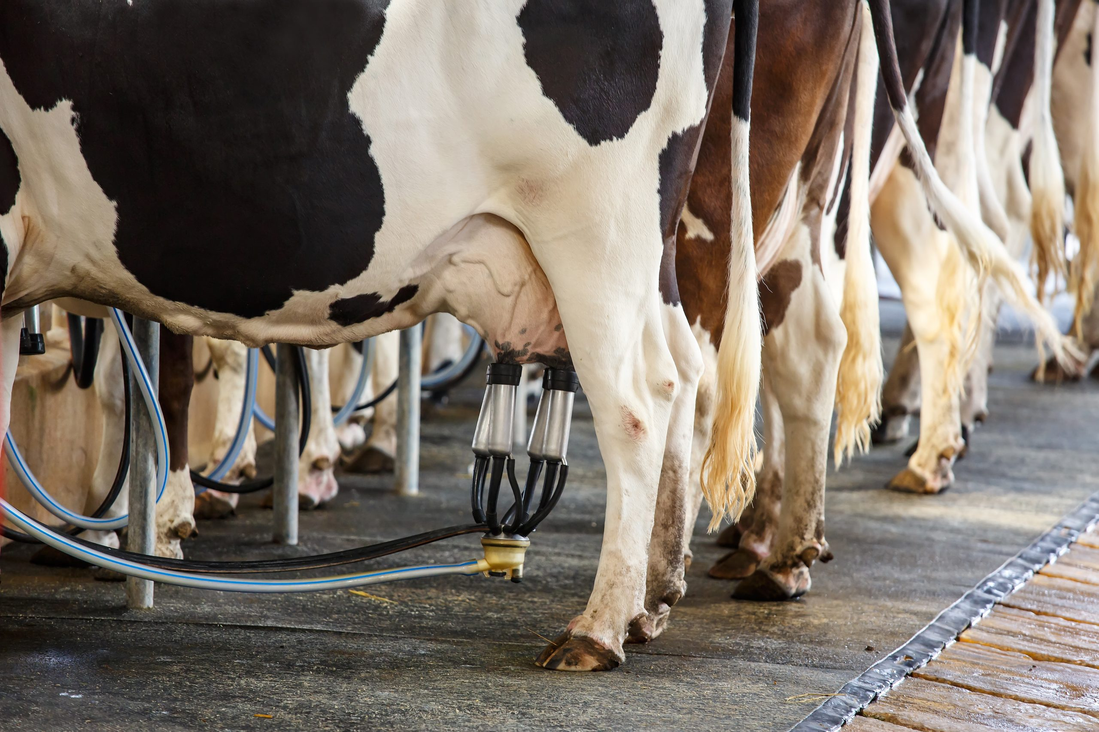

ORC Consents Advice
Animal Effluent Rules Regional Plan: Water for Otago
January 2026
Notes:
Intro staff.
Tom Albert Consents Planner
Mike Cummings Team Leader Compliance
Jack Mathieson Catchment Adviser
Polly Brownlee Catchment Adviser
Mat Bell - Consents Team Leader.

Slide 2

What we will cover
Rules about effluent storage and discharge
How to apply for a resource consent
Upcoming changes to the RMA

Slide 3
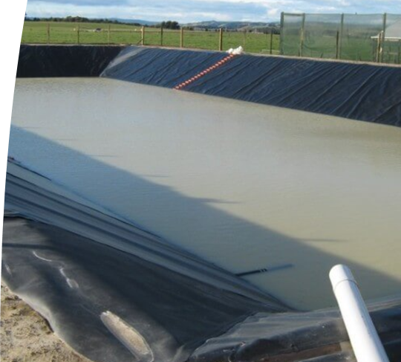
What consents do I need?
Discharge permit
Permit to discharge effluent to land (always)
Permit to discharge odour to air (in certain circumstances)
Land Use Consent
Building a new storage facility
Stockholding areas and feedlots (in certain circumstances)
Notes:
New Rules in Chapter 14 of the RPW for land use
New Rules in Chapter 12 of the RPW for discharges
New policies in Chapter 7 Water Quality
You will potentially need a land use consent and a discharge permit associated with your system.
Land Use consent is required for storage of effluent from your pond, clip tank etc.
Accessories of ponds are not considered storage in the definition (e.g. stone trap, weeping wall, pump chamber etc) they are c
A discharge permit is required to discharge effluent to land in most situations, apart from small scale discharges (less than 35m3 year). The timing of when this consent is needed is dependent on the land use rule that is triggered.
An air discharge permit may be required for the pond location and spray irrigation depending on distances to other properties, roads etc. With good management this can be avoided.

Slide 4
Discharge of effluent to land
All dairy farms with more than 35m³ of waste per year need a discharge permit to put liquid animal effluent onto land.
If you also need a land use consent, you can apply for this at the same time.
Discharging solid animal effluent is usually permitted – you don’t need a consent for this.
Council’s assessment focuses on management of the discharge – setbacks from rivers and bores, controlling depth and rate, avoiding ponding and runoff
Notes:
There are triggers if discharging within 20 m of the property boundary
Less than 35m3 per year

Slide 5
I already have a pond – do I need a consent?
Constructed before 25 March 2020? then you do not need consent if you meet these permitted activity requirements.
Your milk processor might be able to help you with storage calculations
If you don’t meet the requirements, you need a consent.
Constructed after 25 March 2020? You need a consent
See rule 14.7.1.1 of the Regional Plan: Water for Otago
It is sized at the 90% volume of the DESC | √
In the last five years a SQP has certified it as having no visible holes, cracks or defects | √
Meets the pond drop test criteria | √
Management plan (schedule 21) | √
Notes:
Note upgrading pond is a new structure.

Slide 6
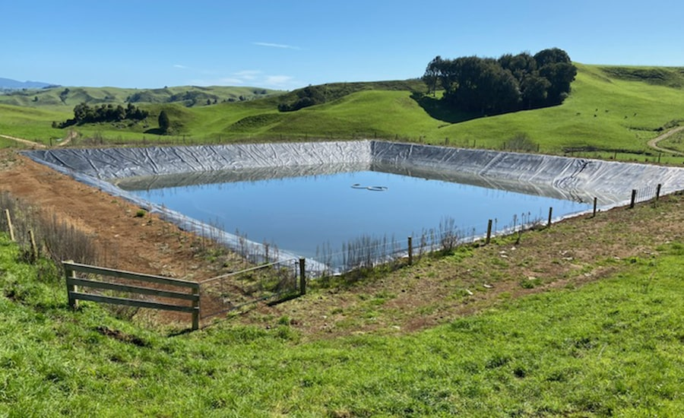
Building a new pond, or using a pond built after 25 March 2020
You need a consent.
Council’s assessment focuses on location, management plan, design of pond to ensure adverse effects on the environment are avoided
If your pond meets certain criteria (design certified by a Chartered Professional Engineer, not within 50 metres of a lake, river, or bore, etc) then Council will always grant you your consent.
You can apply for your discharge permit at the same time
See rule 14.7.2.1 of the Regional Plan: Water for Otago
Notes:
Required under Rule 14.7.2.1 Controlled Activity, or Discretionary Rule 14.7.3.1 of the RPW.

Slide 7
Components of an animal effluent system
This is your sludge bed, weeping wall, sumps etc.
No consent required if:
the volume is less than 35,000 litres; and
It has no holes, visible cracks or defects; and
It is not located within 20m of specific features, or above subsurface drainage.
If volume is over 35,000 litres, needs to be certified by qualified person in the last 5 years. You also need to have a management plan in place.
If you can’t meet these requirements, then you need a consent.
Notes:
A suitably qualified person is defined in Schedule 20 of the RPW. Has two parts one outlining requirements for assessing Animal Effluent Systems, and the other for using the Dairy Effluent Calculator.

Slide 8
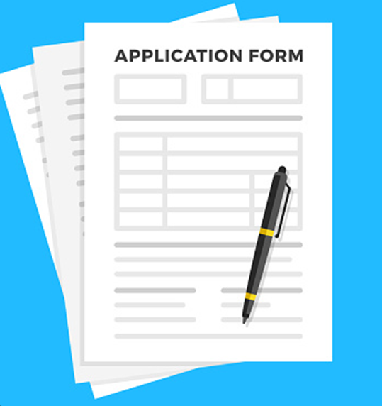
What information goes in my application?
Plans for your storage
Dairy Effluent Storage Calculation using the DESC
Policy and effects assessment
Management Plan
Notes:
We have tried to make the application forms as user friendly as possible like the IWG process – trying to keep things simple. Have done alot of the assessment for you so you can tick what applies rather than reading through a plan full of policies to see what applies.

Slide 9
Management Plans
Schedule 21 of the Water Plan sets out what you need
Need this for your discharge and land use
Key questions:
What if I already have a management plan?
Can I provide a management plan as a condition of consent?
Notes:
(a)Prepared by the owner or their agent;
(b)Reviewed at least once every 12 months; and
(c)Provided to the ORC upon request.
Needs basic info showing key info of farm showing location of pond, where you are discharging, watercourses, bores etc as well as contingency measures if things go wrong

Slide 10
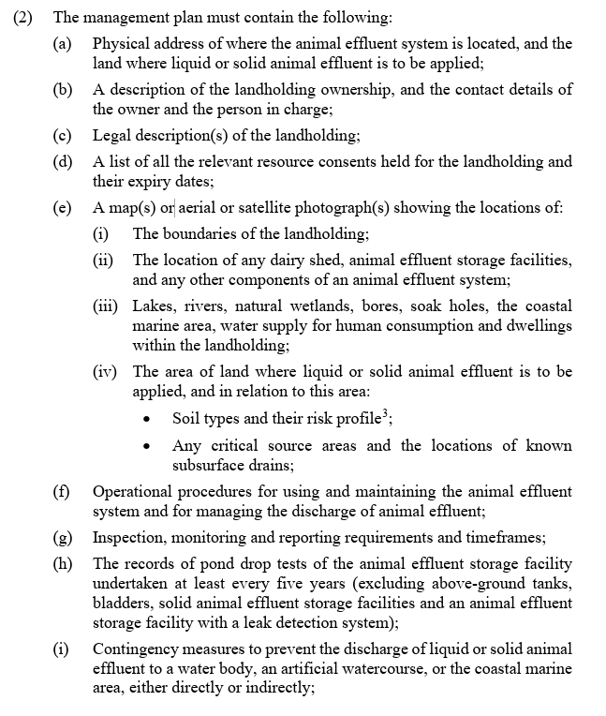
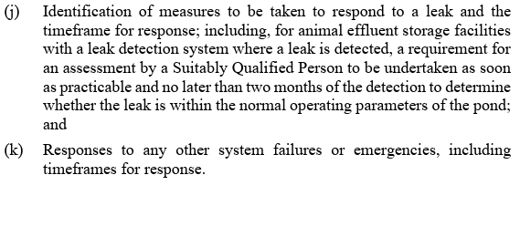

Slide 11
How much does it cost?
Discharge to land permit | $3,500 fixed fee
Discharge to land + Land use consent for pond | $5,000 fixed fee
Complex applications e.g. multiple consents for stockholding areas, ponds, components + discharge permit | $3000 deposit, final cost determined by scale of charges – see our website
Notes:
A suitably qualified person is defined in Schedule 20 of the RPW. Has two parts - one outlining requirements for assessing Animal Effluent Systems, and the other for using the Dairy Effluent Calculator.

Slide 12
I don’t need a consent – do I need to prove it?
Sometimes farm owners are asked to show that they don’t need a consent (e.g. for dairy conversion, small water takes, effluent ponds operating under permitted activity rules)
You can apply for a Certificate of Compliance from Council. This is a written certification that an activity does not require a resource consent.
Your application must include:
A full description of the activity/proposal and the site where the activity will be undertaken
Copies of all necessary plans, details and calculations to enable the proposal to be checked for compliance with the regional plan.
A clear explanation of how the activity/proposal meets all the relevant provisions of the plans or standards

Slide 13
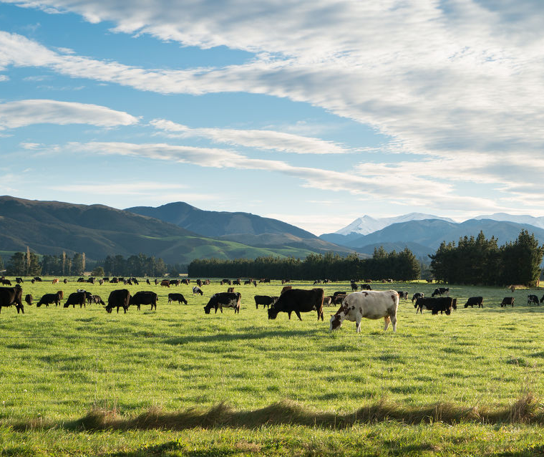
What should I be doing now?
Good time to think about:
If you need consent:
Have a chat to us
Start preparing your application
For the future:
Pond drop tests
Get someone to do a DESC
What storage on farm may look like for you
Getting someone to do a visual inspection of your storage
Talking to a trusted advisor and Council

Slide 14
What is changing?
Central government has signalled the RMA will be replaced
Changes to Regional Plan rules have been paused while changes are happening
You still need to follow the current rules – this includes resource consents
Notes:
In relation to PC6AA, regulatory staff have advised that, as traversed at the hearing for PC6AA, provisions such as Policy 7.D.2, and Rules 12.C.1.1(g), 12.C.1.1A and 12.C.1.3 are unenforceable, uncertain and ambiguous. Some challenges include the inability for land users to be able, in practice, to ensure that the discharge contaminant thresholds set out in Schedule 16, are complied with everywhere on their property, at all times, when the flow at the relevant flow sites is below median flows. The intent of PC6AA was for these rules to not take effect, i.e., they would be superseded by enforceable clear rules through the new land and water plan. The notification of the new plan was delayed last year (From March 2024 Council agenda)
In the background there is currently work being undertaken on this issue, and the ORC has also entered into discussions with the MFE (MFE letter from June 2025 Council meeting)

Slide 15
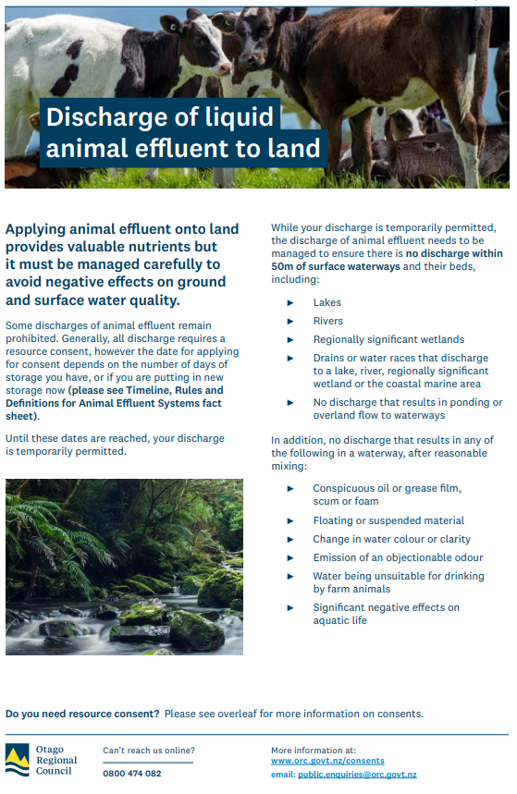
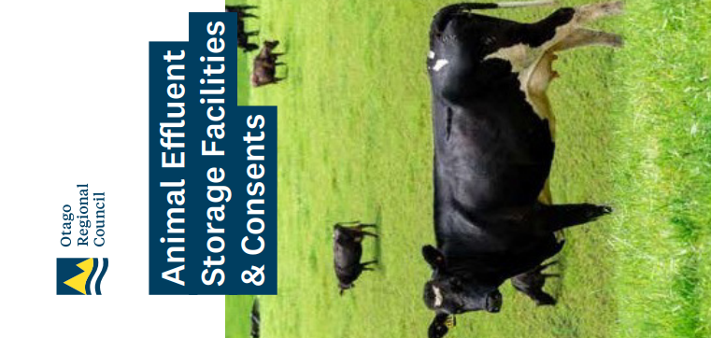
How we could help
Resources – orc.govt.nz
Application forms
Effluent Management guide
Writing an assessment of environmental effects
Contact us: consent.enquiries@orc.govt.nz
We can answer any questions. We can also organise a pre-application meeting to discuss your consent requirements in detail.
Notes:
Farmers guide on website
https://www.orc.govt.nz/environment/land-care/managing-nutrients/effluent-management/

