Slide 1
ORC half year update
March 2025

Slide 2
Agenda
Chair update
Update on major projects
Half year results
Outlook
Questions

Slide 3
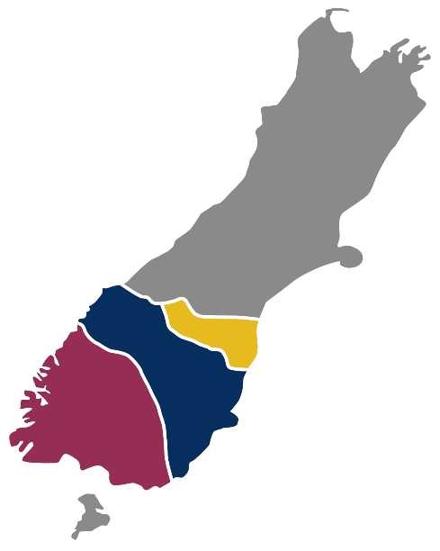

New Zealand’s “always open” port – Our Strategy
New Zealand’s ‘”always open’ port
Leverage existing infrastructure to be always open
Our in-house dredging
Renewable harbour defences
We adapt quickly
Open for growth
First port open post an extreme event
Consenting is smoother
North Otago
Otago
Southland
Provide space to customers adapted to their needs
Provide buffer capability to be “always open”
Mosgiel Hub increases windows/storage
Attract imports
Remove trucks from road
Provide great service
Sustainable growth
Lower carbon outcomes
Port Chalmers
Dunedin Bulk Port
Mosgiel Hub
Build a better business
Decisions based on accurate and complete data
Doing more with the same, safely
Reduce property climate change risk
Property enables the Port
Higher margins
Less volatility
Reliable returns
Logs
Apples
Timber
Meat
Dairy

Slide 4
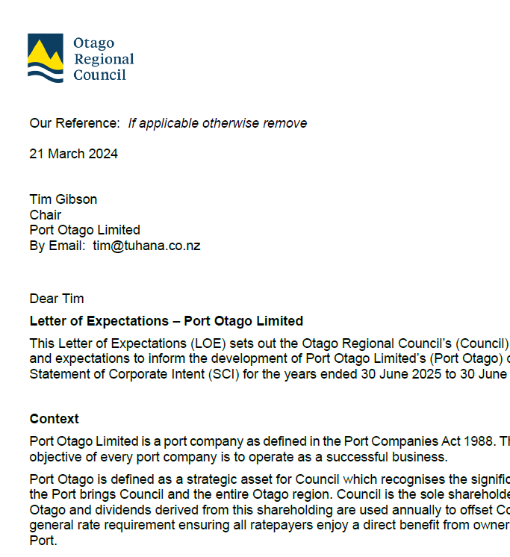
Your input
Financial
  $18m dividend FY25 and $20m thereafter
  Sponsor the Rescue Helicopter for $350k pa
Decarbonisation
  Develop a decarbonisation Roadmap
Environmental
  Continued commitment to understand and mitigate the wider environmental impacts of the port's activities.
25 February 2025
Tim Gibson
Chair
Port Otago Limited
By Email: tim@tuhana.co.nz
Dear Tim
Letter of Expectations – Port Otago Limited
This Letter of Expectations (LOE) sets out the Otago Regional Council’s (Council) priorities and expectations to inform the development of Port Otago Limited’s (Port Otago) draft Statement of Corporate Intent (CSI) for the years ended 30 June 2026 to 30 June 2028.

Slide 5
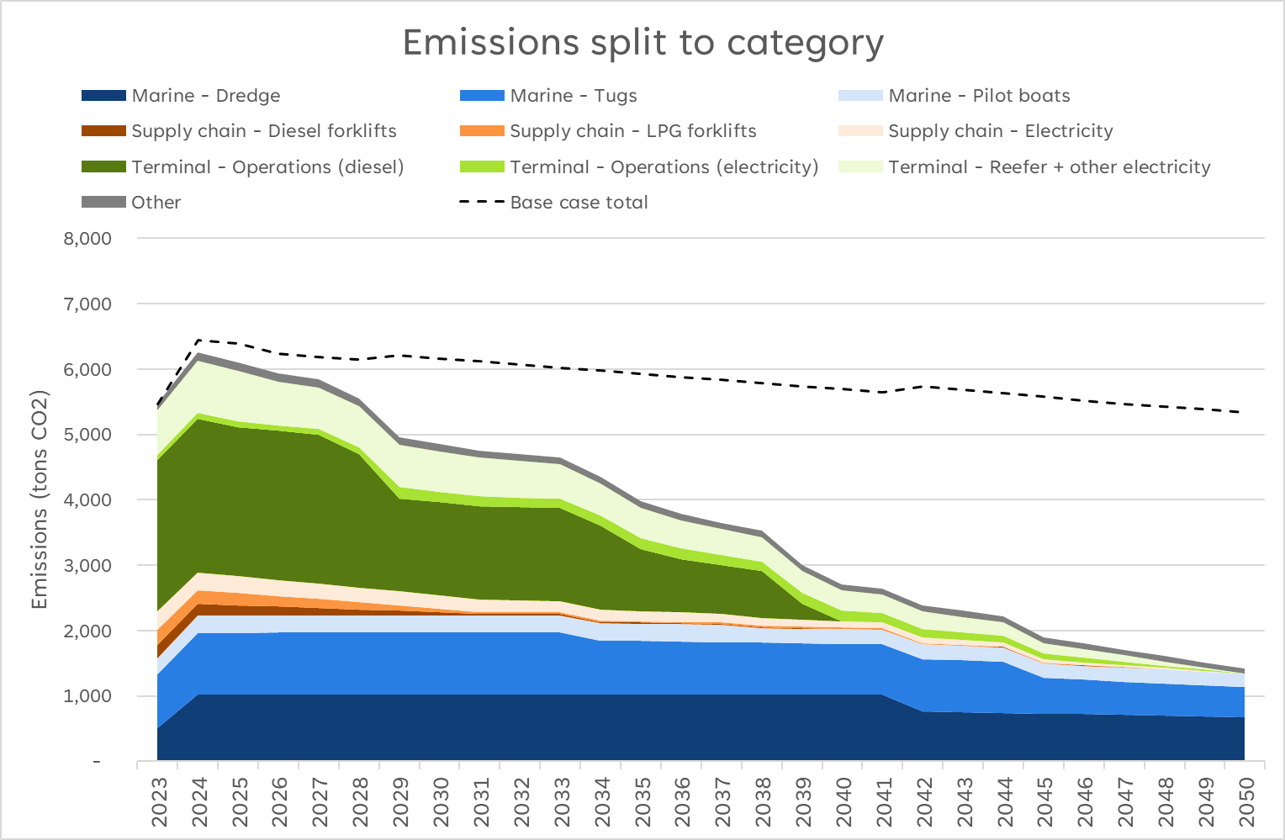
Port Otago decarbonisation roadmap
FY2020 will be taken as a starting point to measure reductions.
From that benchmark of around 6,800 tons of CO2:
  34% reduction achieved by 2030.
  61% reduction achieved by 2040
79% reduction achieved by 2050 compared to 2020.
  Main source of emissions would be marine operations, where diesel engines remain, and dual fuel engines are assumed to have 20% residual emissions.
2020 emissions
12% reduction compared to 2020 by 2030
51% reduction compared to 2020 by 2040
74% reduction compared to 2020 by 2050

Slide 6
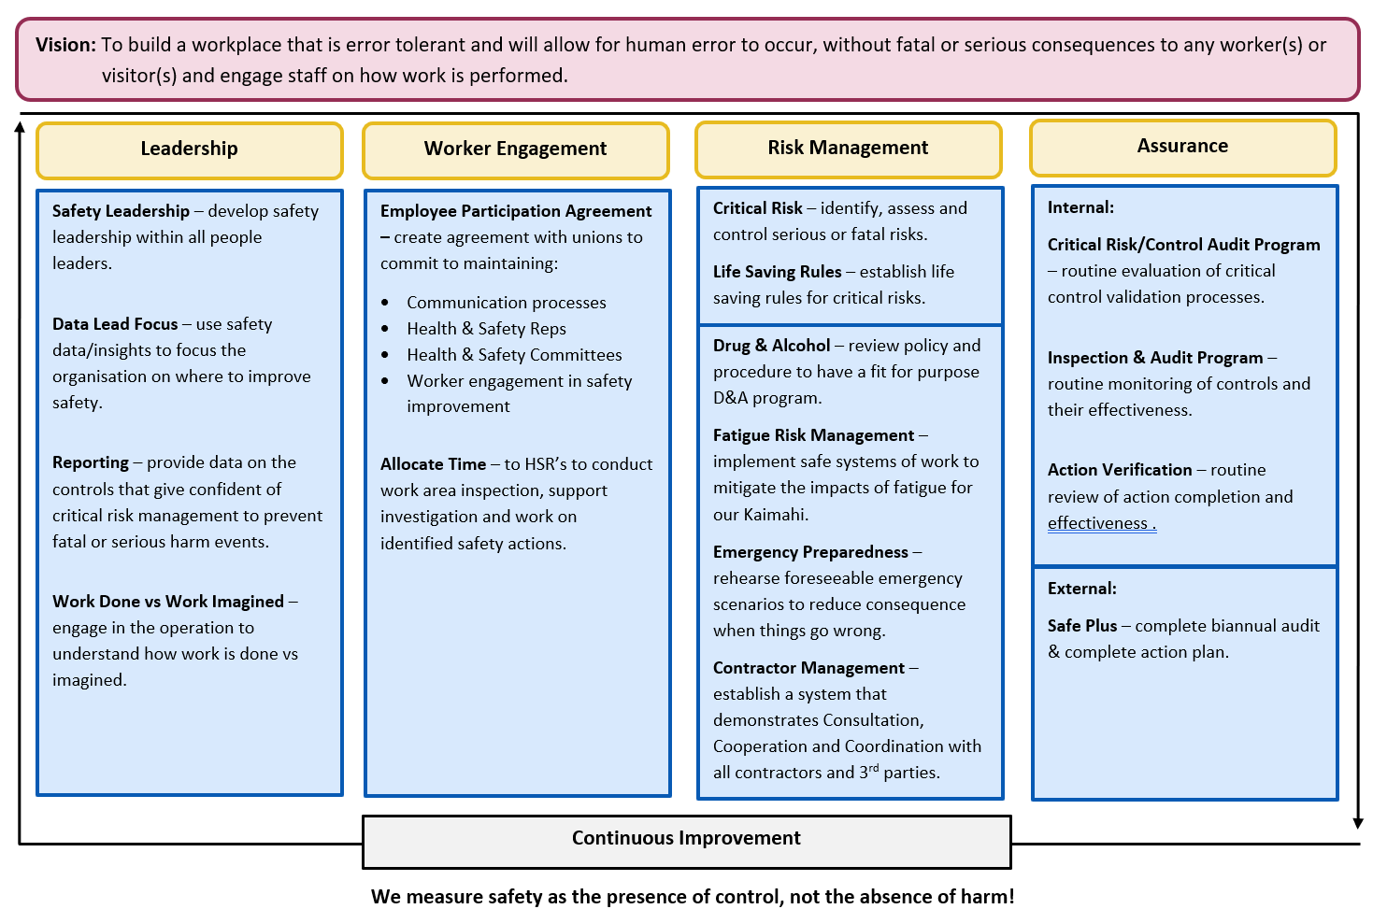
Health & Safety Strategic Framework

Slide 7
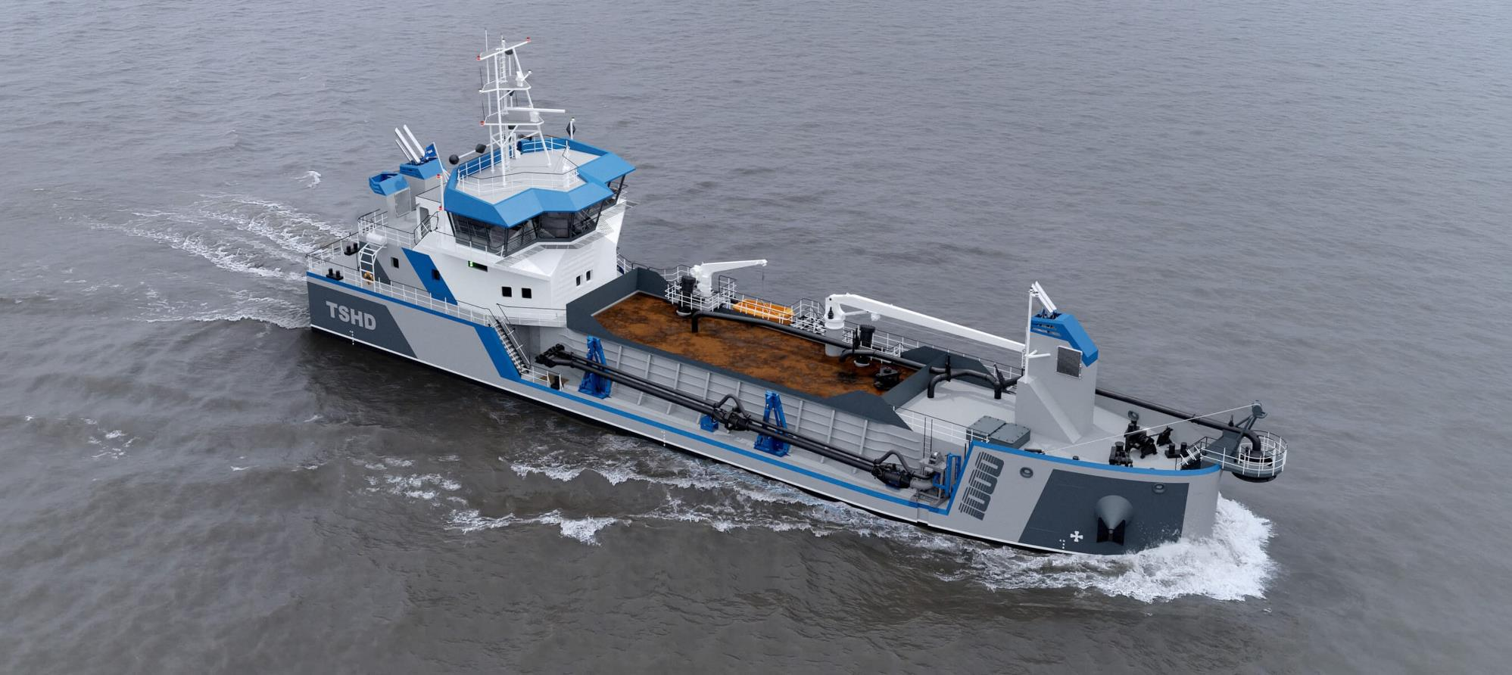
Dredge JV

Slide 8
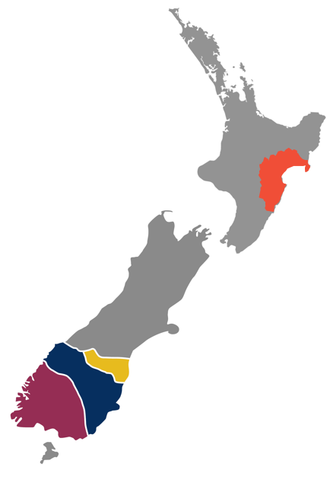


Port Otago and Napier Port
1. Volumes | Containers TEU | Logs JAS | Cruise visits
Napier Port | 245k | 3.0m | 89
Port Otago | 269k | 1.1m | 118
2. Regional ports | Lower North Island
 | Lower South Island
NZ Regional Ports Dredging LLP
Based in Dunedin and winter in Napier
Damen TSHD 1000 under construction in Vietnam and delivery is Oct 2026
Total cost is $37m NZ dollars

Slide 9
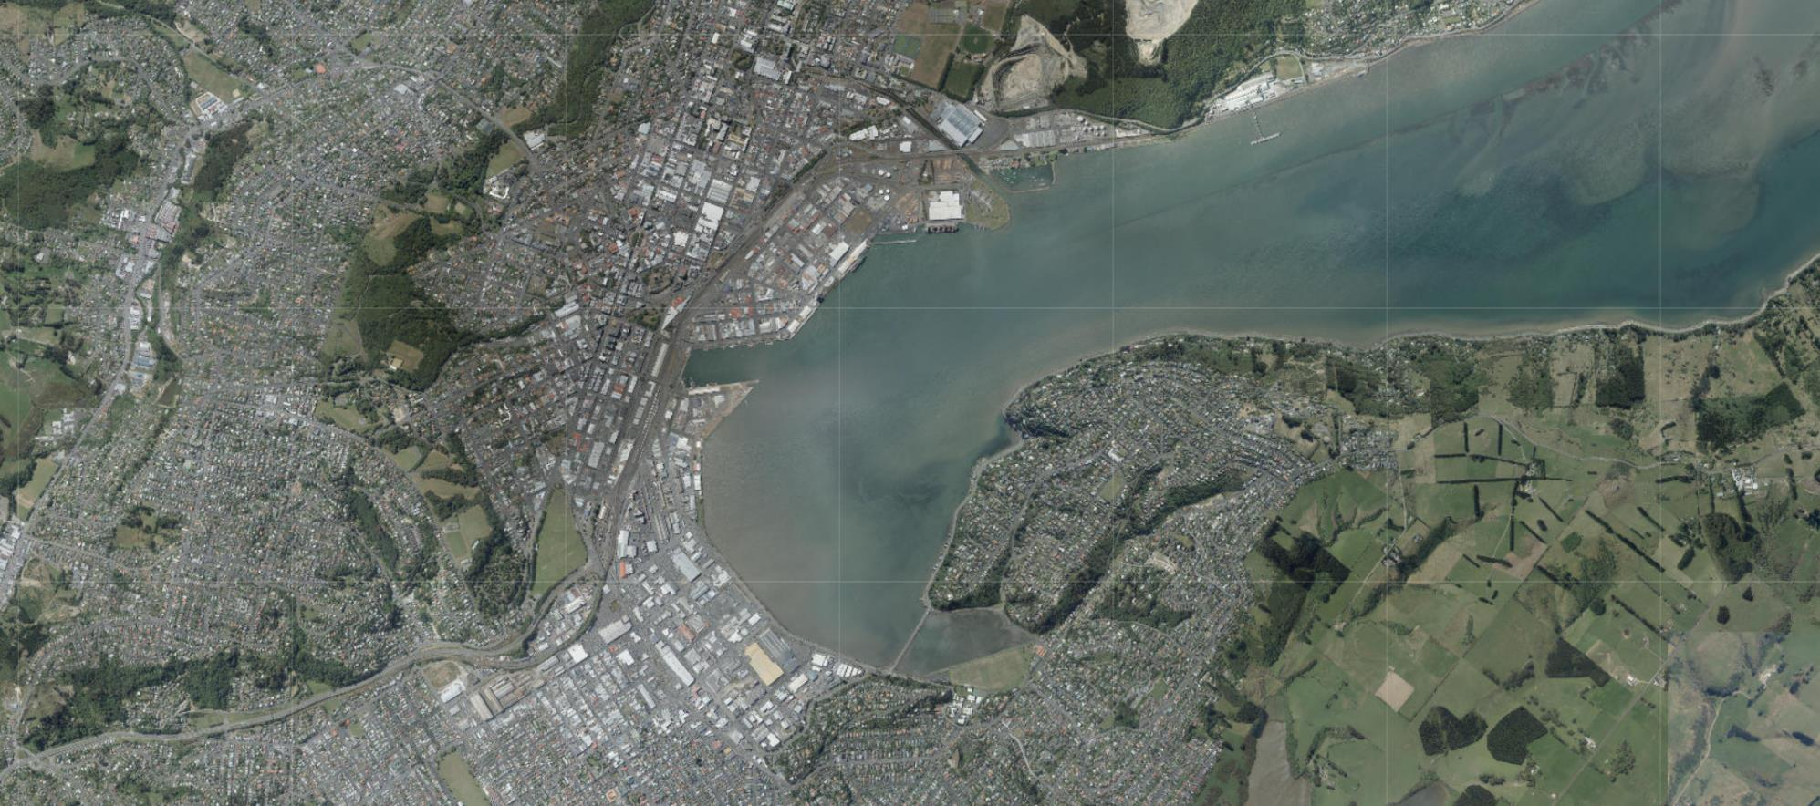
Dunedin Ground Lease Strategy
A
B
C

Slide 10
Progress

Slide 11
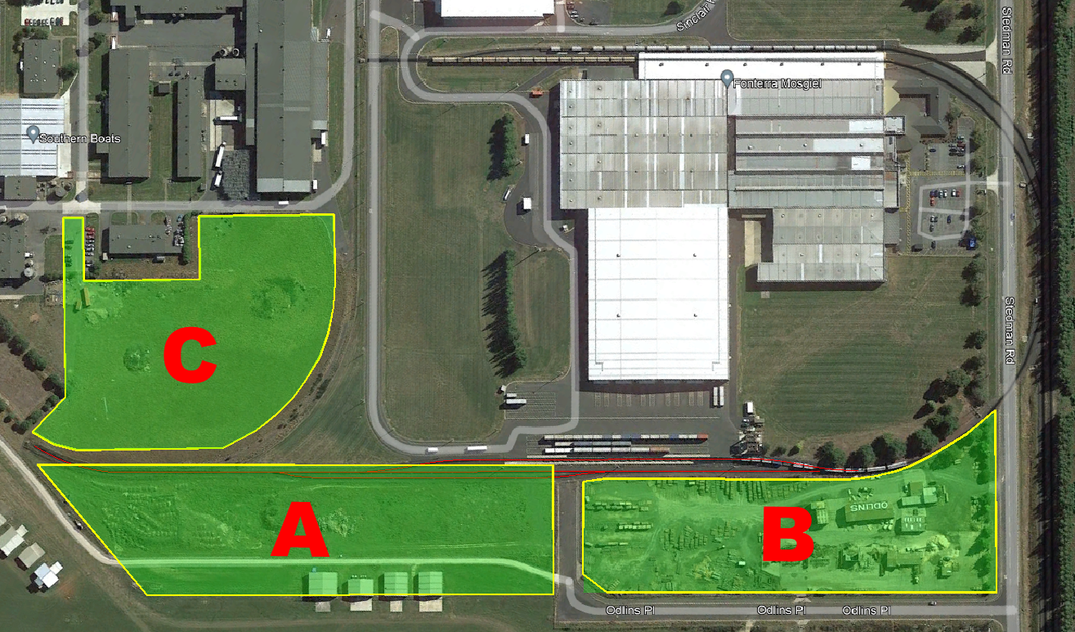
Port Otago land divested
Sold to
A
Otago Helicopter Trust
SIL JV
BC

Slide 12
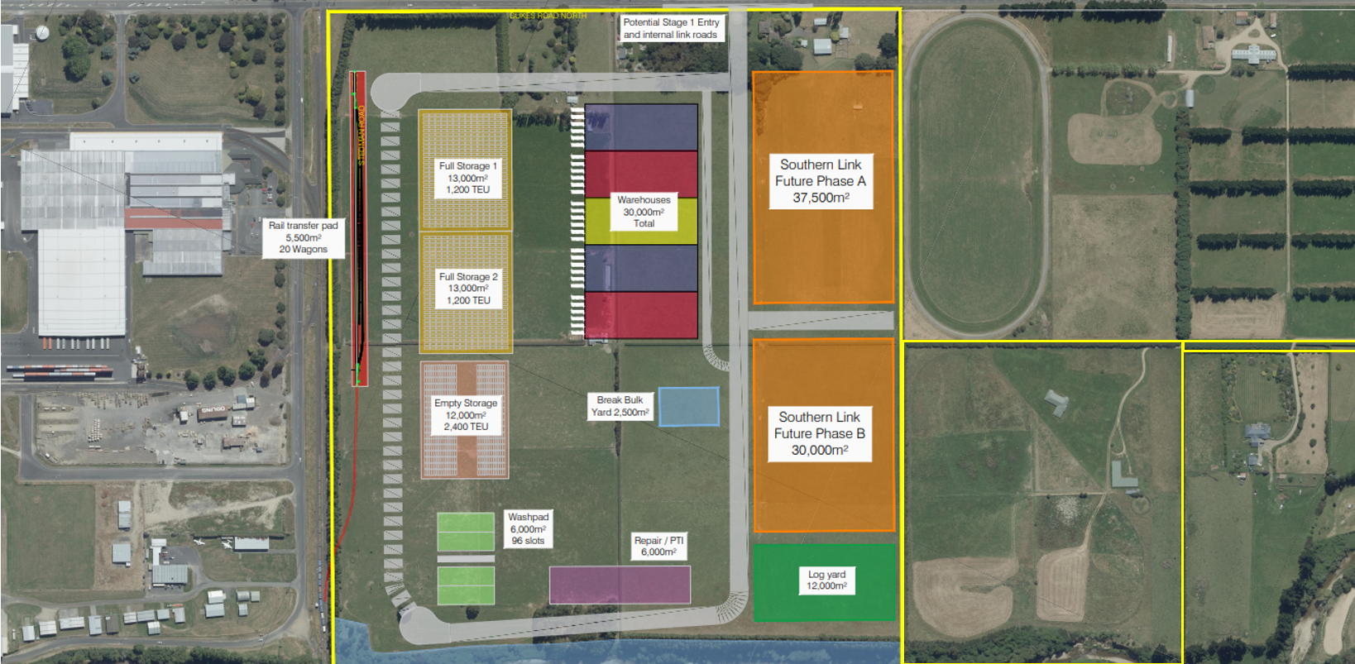
Inland Port/Logistics hub – Southern Link

Slide 13
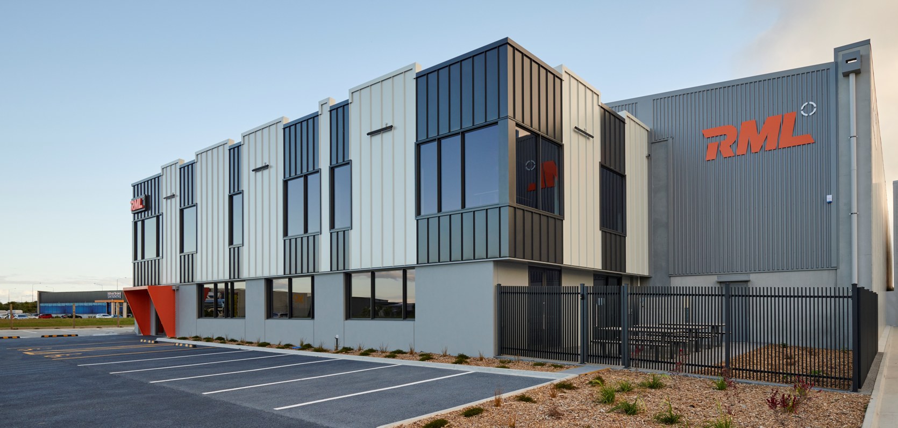
RML- complete –rent $680kpa

Slide 14
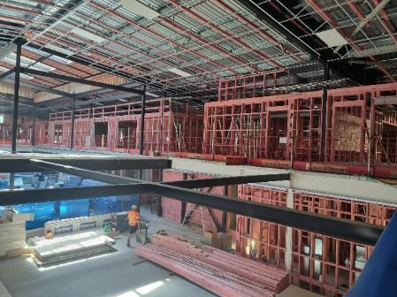
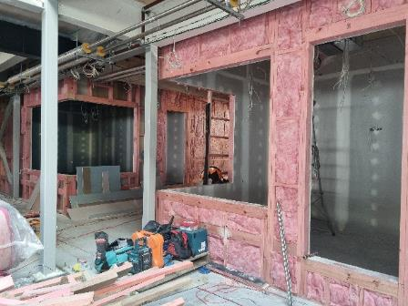
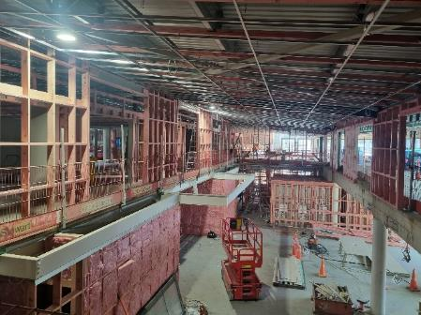
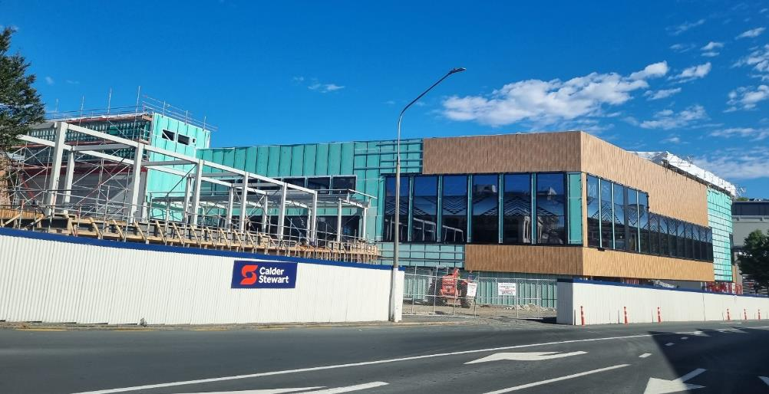
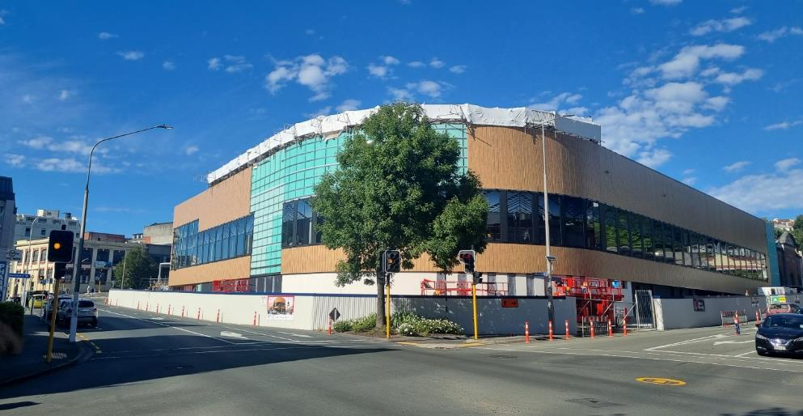
Whare Runaka
No material changes in the last quarter
Completion expected Nov 25
Cost escalation reducing as construction progresses

Slide 15
Container TEU
6 months ended December | This year 000’s | Last year 000’s | Variance %
Full exports | 31 | 33 | (6%)
Full imports | 9 | 7 | 28%
Empty | 27 | 31 | (13%)
Transship | 46 | 46 | 0%
TOTAL | 113 | 117 | (3%)
Year to date TEU’s
TEU: Twenty foot equivalent units
Notes:
GS - Everyone will go home healthy and safe

Slide 16
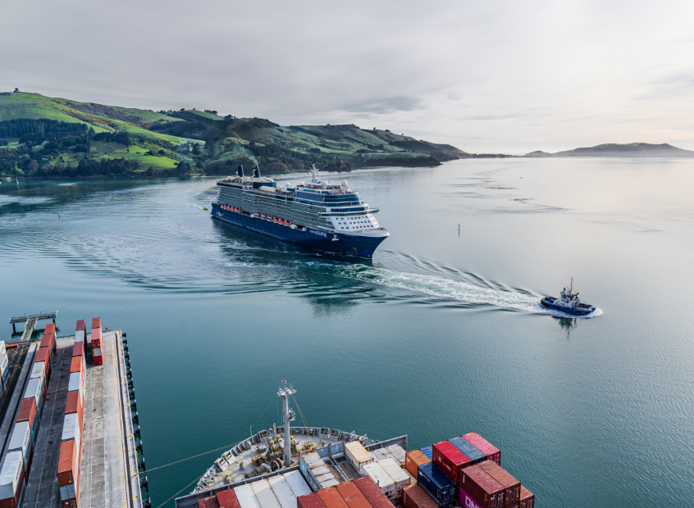
Cruise
6 months ended December | This year | Last year | Variance %
Port Chalmers | 22 | 26 | (15%)
Dunedin | 4 | 7 | (43%)
Otago visits | 26 | 33 | (21%)
Fiordland piloted | 17 | 20 | (15%)
Cruise passengers | 46,000 | 55,000 | (16%)
Otago cruise ship expenditure (estimated) | $21m | $25m
Notes:
GS - Everyone will go home healthy and safe

Slide 17
Bulk tonnes
6 months ended December | This year 000’s | Last year 000’s | Variance %
Logs | 462 | 504 | (8%)
Fuel | 229 | 229 | 0%
Fertiliser | 61 | 63 | (3%)
Other | 53 | 65 | (18%)
TOTAL | 805 | 861 | (7%)
Notes:
GS - Everyone will go home healthy and safe

Slide 18
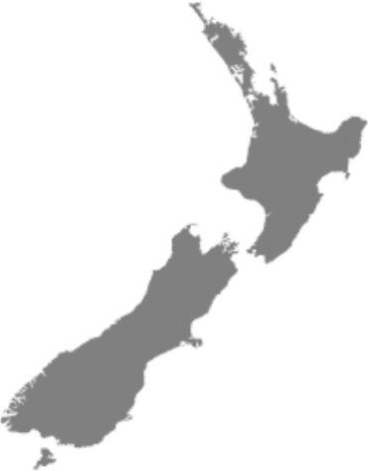
Investment property
34%
Auckland
$215m
6 months ended December | This year $m | Last year $m | Variance %
Investment property rentals | $15.8 | $14.8 | +7%
EBITDA – investment properties | $11.6 | $10.9 | +6%
Gain on property sales | $4.7 | $1.8 | +161%
Property portfolio value | $637.0 | $623.6 | +2%
22%
Hamilton
$141m
44%
Dunedin
$281m
Notes:
GS - Everyone will go home healthy and safe

Slide 19
Group financials
6 months ended December | This year $m | Last year $m | Variance%
Revenue | $61.2 | $60.0 | +2%
EBITDA
Port Operations | $10.6 | $14.6 | (27%)
Investment Properties | $11.6 | $10.9 | +6%
Gain on asset sales | $6.4 | $1.8 | +255%
 | $28.6 | $27.3 | +5%
Surplus before tax | $18.1 | $16.8 | +7%
Tax | ($3.0) | ($3.8)
Group NPAT | $15.1 | $13.0 | +16%

Slide 20
Balance sheet strength

Slide 21
Risks/opportunities in the medium term
Challenging economic conditions in NZ resulting in lower growth
Potential trade flow impacts from change in US policies affecting global shipping
Lower cruise volumes next 2- 3 years
The impact of increased extreme weather events

Slide 22
Feedback / Questions?

