Slide 1
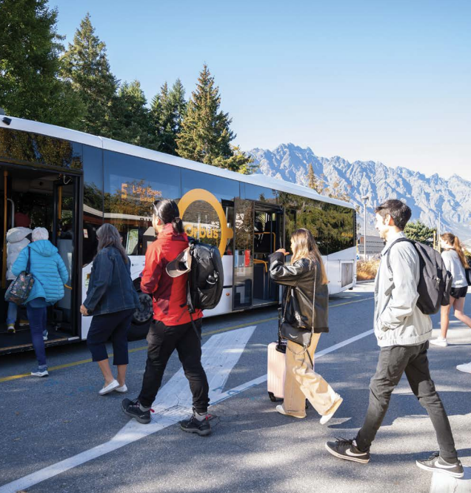
Regional Public
Transport Plan
Fare Investigations
2026
Anita Dawe, Grace Longson and Jack Cowie
September 2026

Slide 2
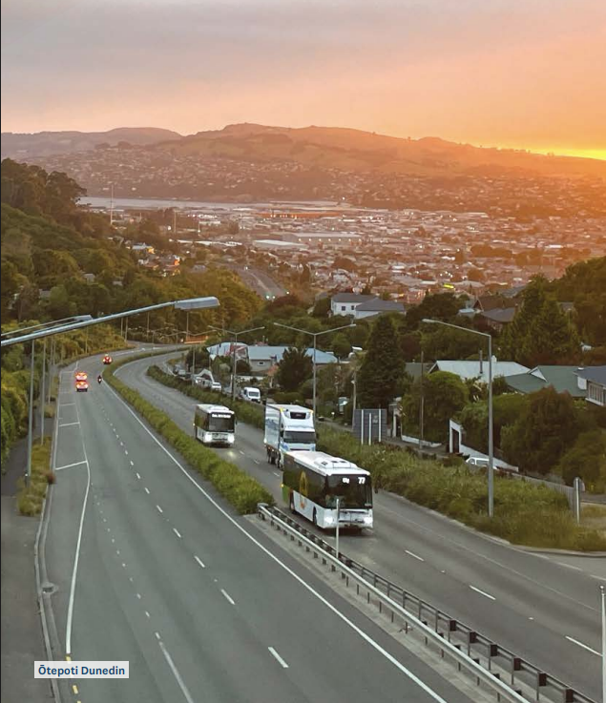
Agenda
Survey overview
Overview of respondents
The importance of fares
Zonal fares
Fare capping
Ferry fares
Removal of cash
Notes:
Fare survey results

Slide 3
Public survey overview
Target audience: bus users
Ensured clear distinction between Dunedin and Queenstown respondents
Open-answer responses
  staff have provided illustrative examples for common themes
  a lot of data that is complex to sort through and hard to represent in its totality
Recommended decision-making approach
  Not a “vote” or a “popularity contest”
  Considerations outside the survey’s scope that may affect staff recommendations and Council’s ultimate decisions
Designed to have respondents consider trade-offs Council must make
Aiming to distinguish “how would this affect you” vs. “what would you prefer”
Notes:
Open public survey, primary audience of bus users
Geography is an important consideration – results on some questions diverge between Dunedin and Queenstown
Many questions have “expected answers” – so take care to interpret results against your expectations. E.g. we don’t expect people to be happy to pay higher zonal fares
Most questions have associated open-answer sections. This is a lot of data that is complex to sort through; staff have attempted to illustrate some examples and some themes in these answers but it is a large amount of info here that is hard to represent in its totality
Not a “vote” or a “popularity contest”. There are considerations outside the survey’s scope that may affect recommendations and council’s ultimate decision
Aiming to align survey questions with decisions and trade-offs Council is making – otherwise responses may not be useful to councillors
It was hard to do this on so some topics, such as zonal fares – making it harder to interpret results
On some questions we ask “how would this affect you” while on others we ask “what would you prefer” – on one topic (fare capping) we asked both

Slide 4
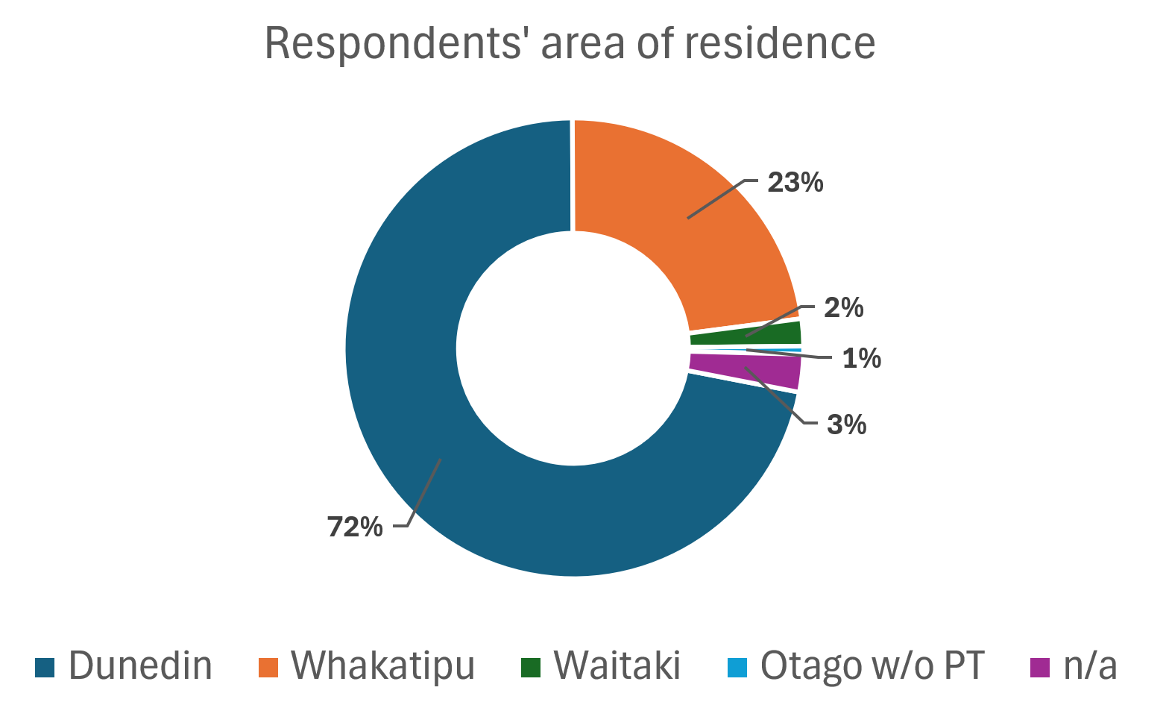
Survey respondents
Notes:
An expected ratio between Dunedin and Whakatipu
Waitaki a decent number -- existing Palmerston + Oamaru due to new service
Only 5 responses from people identified as in areas of Otago unserved by PT
51 responses couldn't be identified to a particular area (didn't answer question or answer can't be interpreted)
Overwhelmingly a survey of bus users

Slide 5
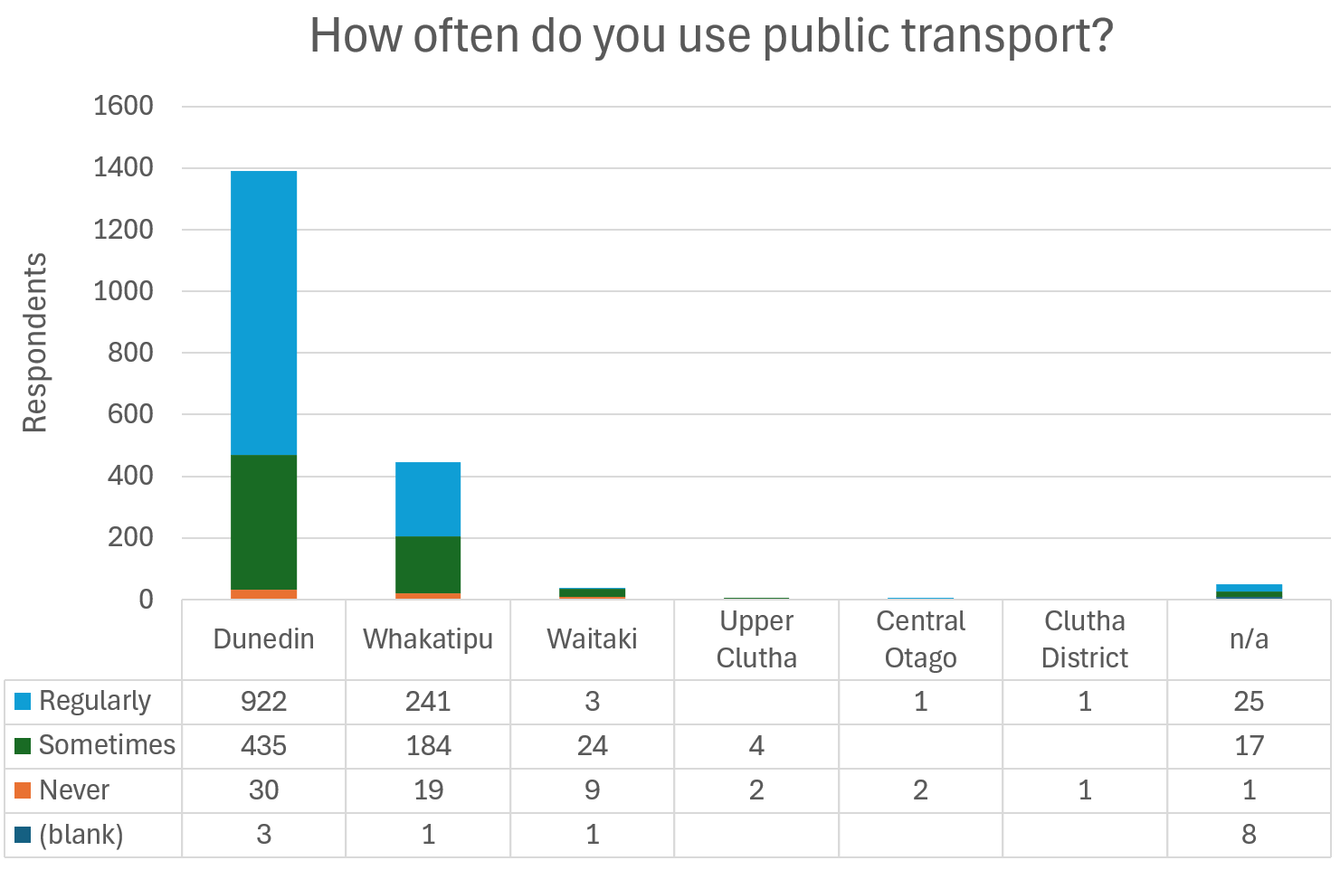

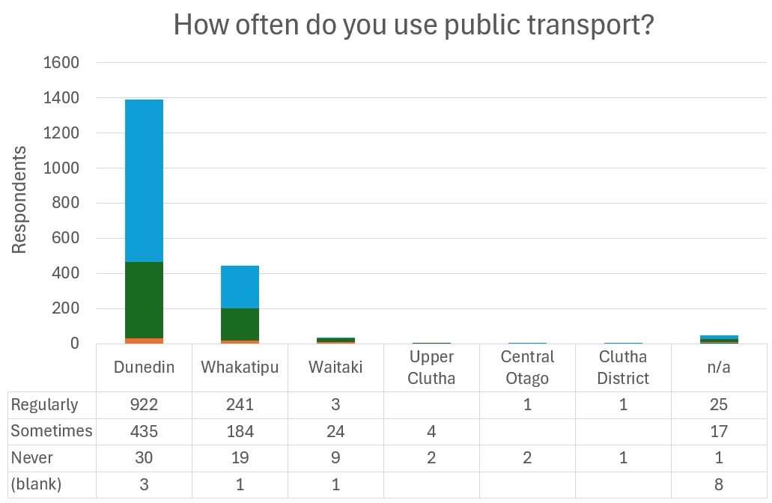





Survey respondents
Notes:
Overwhelmingly a survey of bus users A larger proportion of "sometimes" rather than "regular" users in Queenstown -- probably reflects "latent demand" for QT buses

Slide 6
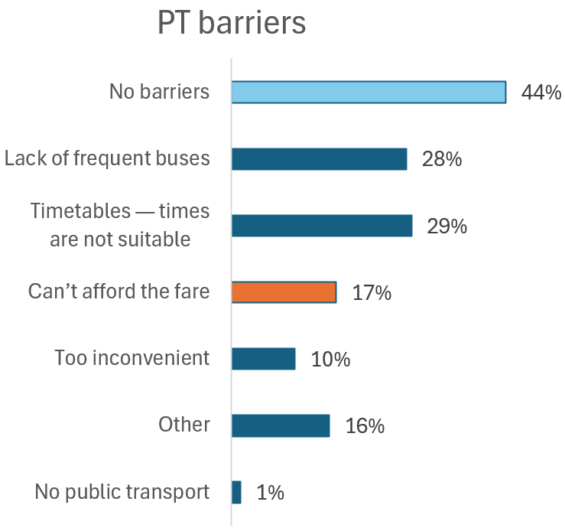
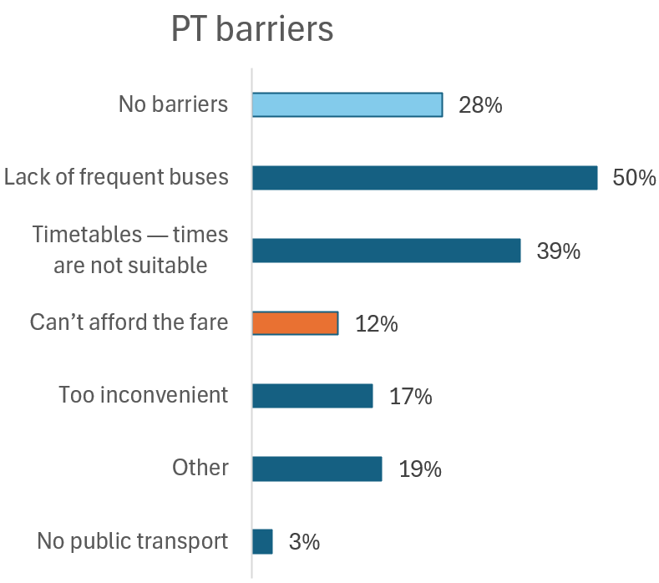
What barriers prevent you from using public transport more often?
Dunedin
Queenstown
Notes:
This question shows that our users consider fares to be a secondary barrier to usage
Multiple answers could be chosen (so they don’t add to 100%)
Across both networks, frequency and timetable -- which are reasonably similar matters -- are twice as important as fares (33% vs 16%)
Dunedin drives the Otago average: 29% frequency, 28% timetables, and only 17% fares
Queenstown is very different: 50% frequency, 39% timetables, and only 12% fares.
So take care to weigh up the real importance of cheap fares -- it's not infinitely important

Slide 7
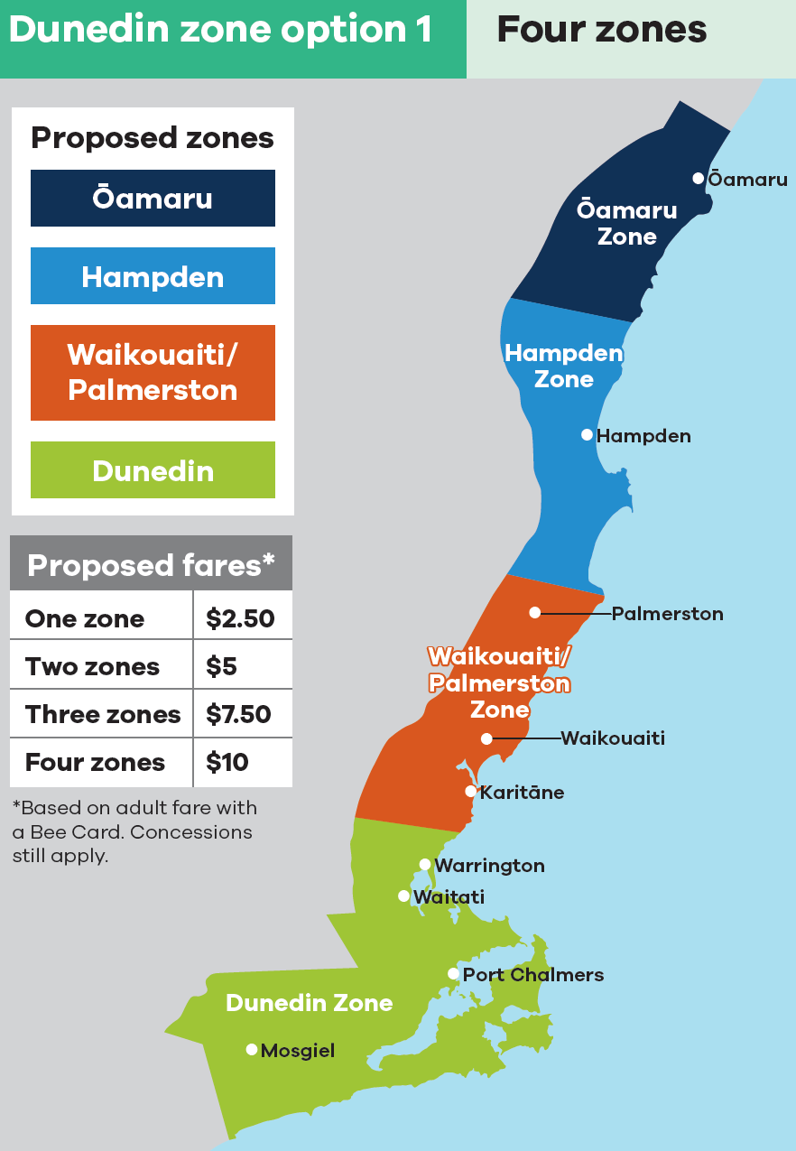
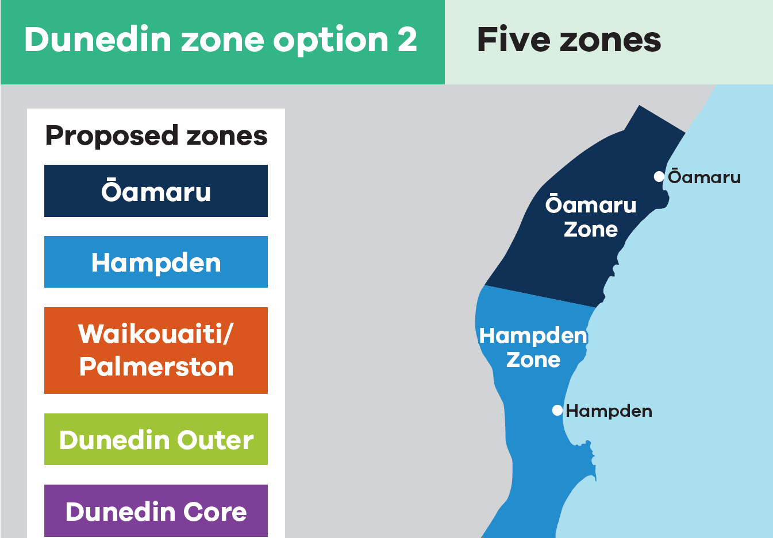
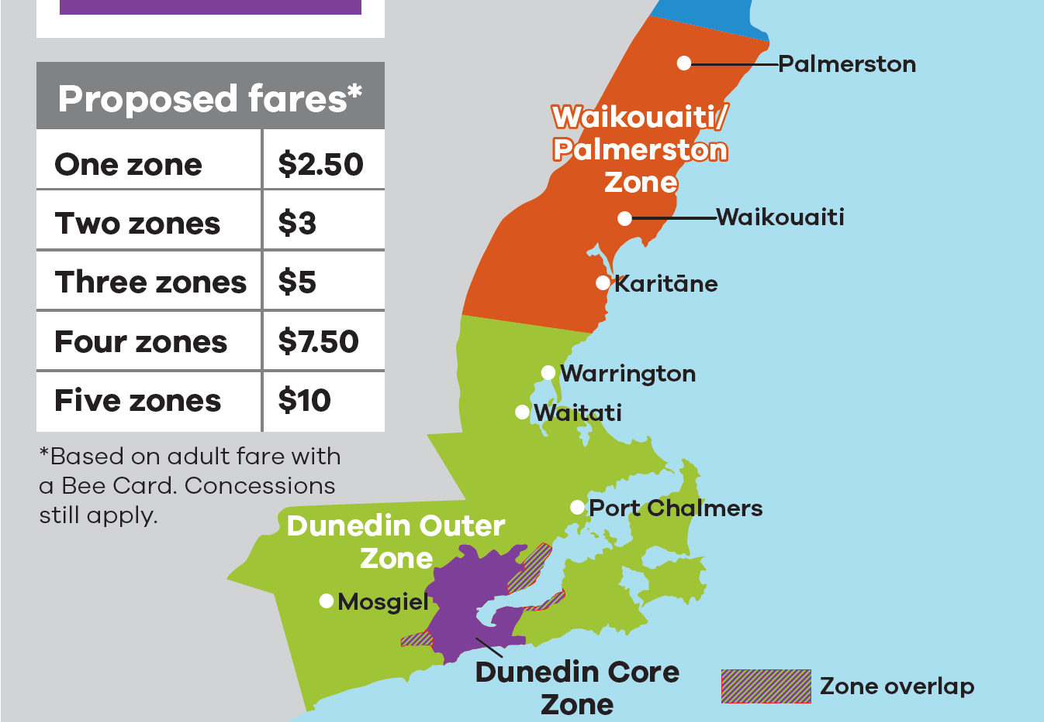
Notes:
Dunedin network proposed zone options
Option 1 is considered the ‘do minimum’ to support the overall economic viability of longer distance Palmerston – Dunedin and Ōamaru – Dunedin routes (the latter launching October 2026) and to enable fair fares for shorter duration trips on these routes.
Zone overlaps -- Option 2 for both PT networks include zone overlaps, which are areas that are considered part of both adjacent zones. Zone overlaps seek to improve fairness for users by ensuring those taking shorter-distance trips that cross zone boundaries do not pay an unduly high fare. For instance, in Dunedin a user would only pay a one-zone fare if they were travelling from Green Island to either the Dunedin CBD or Mosgiel because Green Island is within the zone overlap between the Dunedin Core and Dunedin Outer zones.

Slide 8
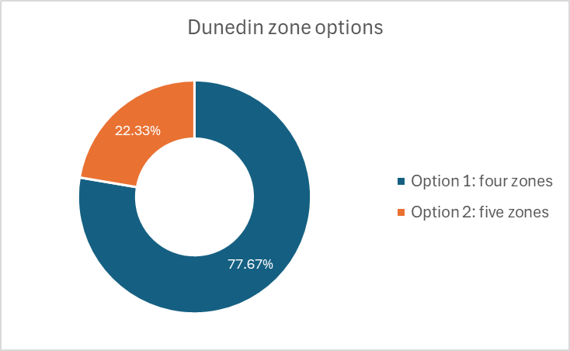
Preferred zonal systems: Dunedin
Option 1: four zones
Pros – Simple, affordable, popular
Cons – Generates less revenue overall, shorter trips subsidise longer trips, indirectly supports dispersed land use
Option 2: five zones
Pros – Material revenue increase in the short-term, longer distance trips pay a fairer share
Cons – Higher fares, more complex
Notes:
Similar preference clear in QT and Dunedin for fewer zones.
Numbers are in line with expectations – asking people to pay more money usually going to be met with a “no”.
Beyond fairness considerations, this subsidisation indirectly supports dispersed land use patterns rather than the consolidated urban form that encourages the uptake of walking, cycling and public transport.

Slide 9
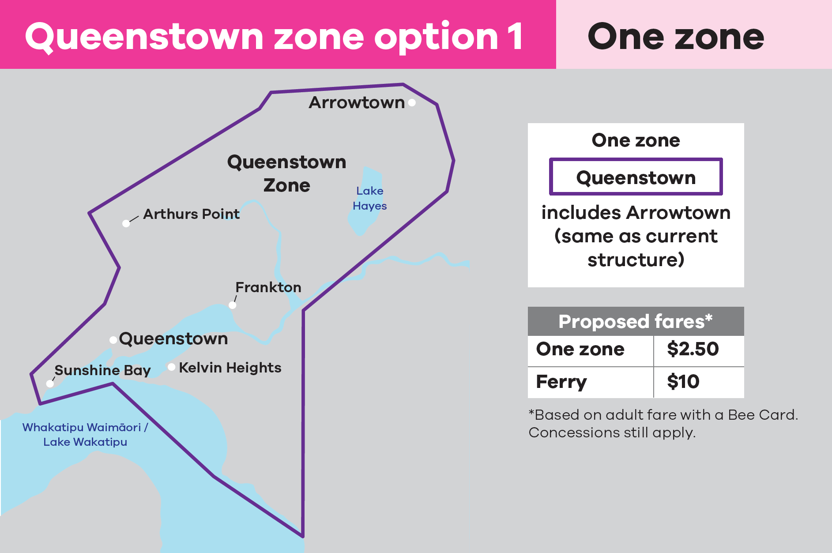
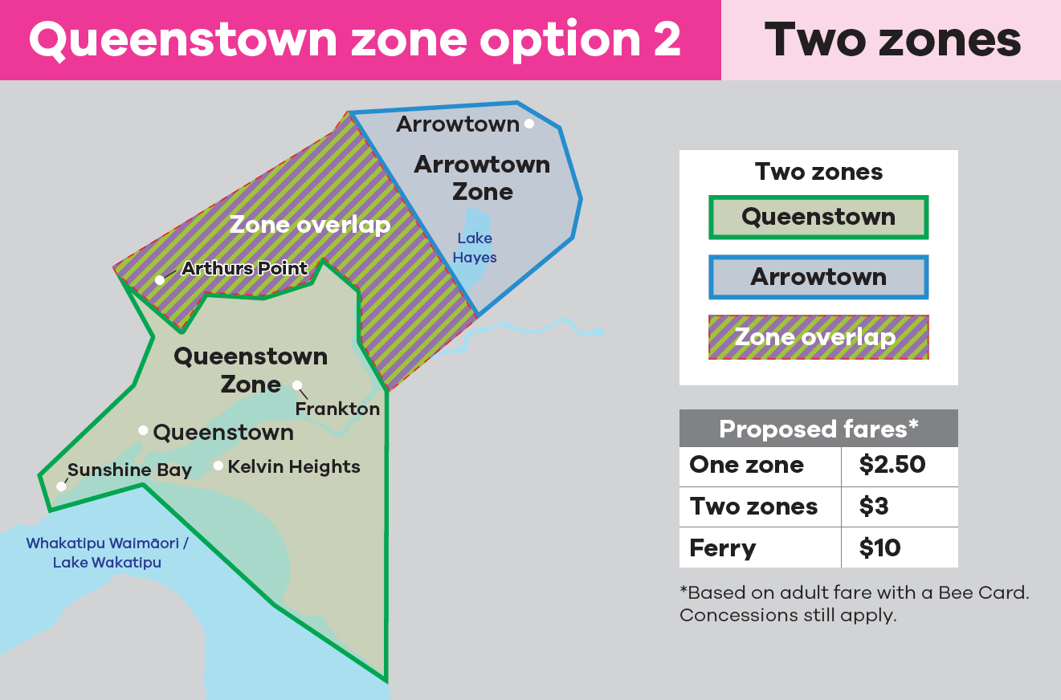
Dunedin
Queenstown
Notes:
Queenstown network proposed zone options

Slide 10
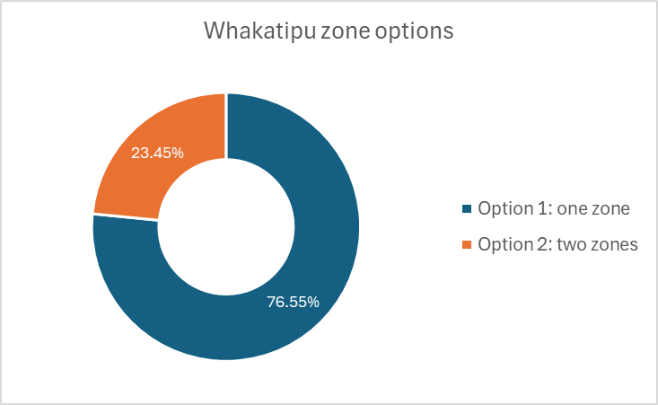
Preferred zonal systems: Queenstown
Option 1: one zone (i.e. flat fares)
Pros – Simple, affordable, popular, helps to reduce congestion
Cons – Generates less revenue overall, shorter trips subsidise longer trips, indirectly support dispersed land use
Option 2: two zones
Pros – Material revenue increase in the short-term, longer distance trips pay a fairer share
Cons – Higher fares, more complex, some trips of the same distance have different fares (e.g. Arrowtown – Frankton vs. Jacks Point – Queenstown)
Notes:
Similar preference clear in QT and Dunedin for fewer zones.
Numbers are in line with expectations
There was not a clear way to get direct feedback on trade-offs
So we could weigh this against the stated importance of fares relative to other factors
But it'd be a hard case to make

Slide 11
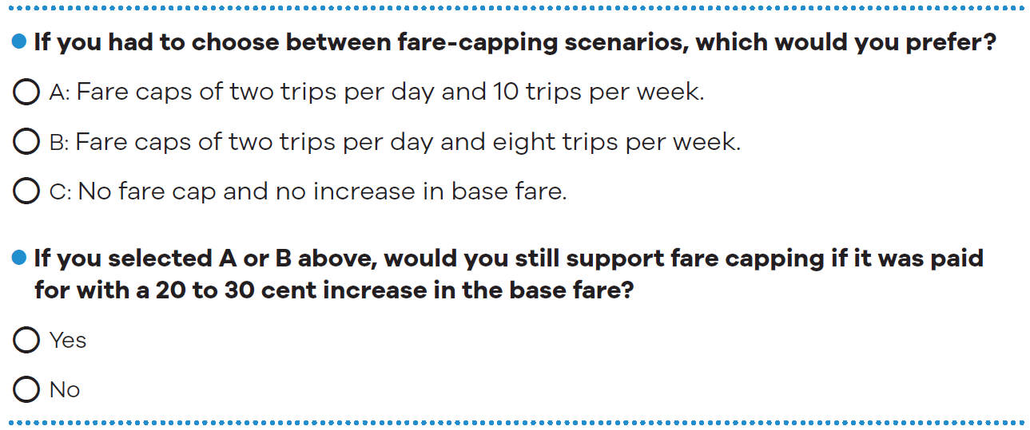
Fare capping vs fare increase – stated preference questions
Notes:
To understand respondents’ preference for the proposed fare capping options, these two questions were asked.
“If you had to choose between fare-capping scenarios, which would you prefer”
And “ if you selected A or B above, would you still support fare capping if it was paid for with a 20 to 30 cent increase in the base fare?”

Slide 12
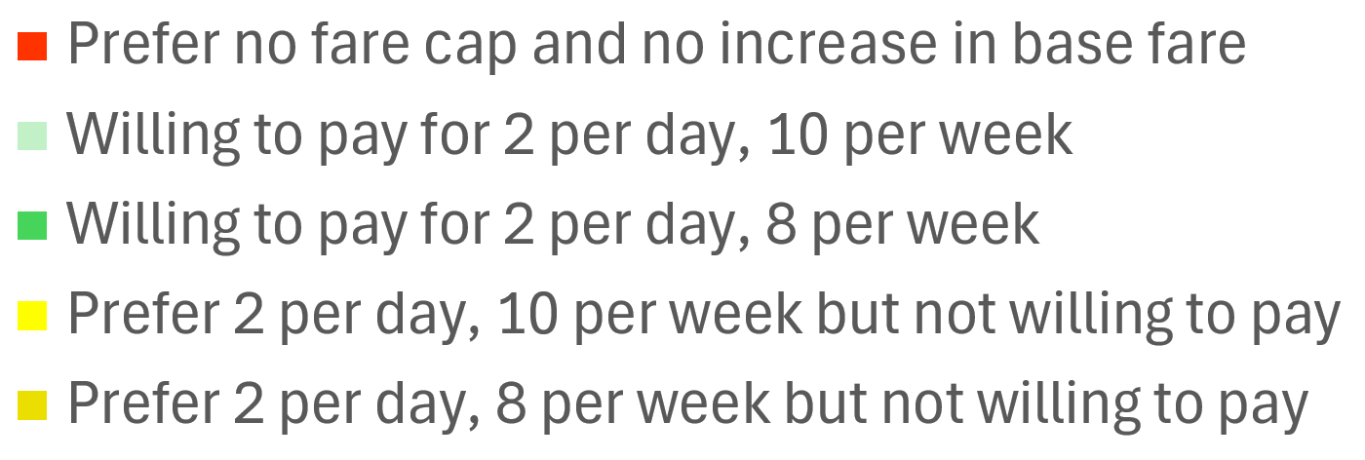
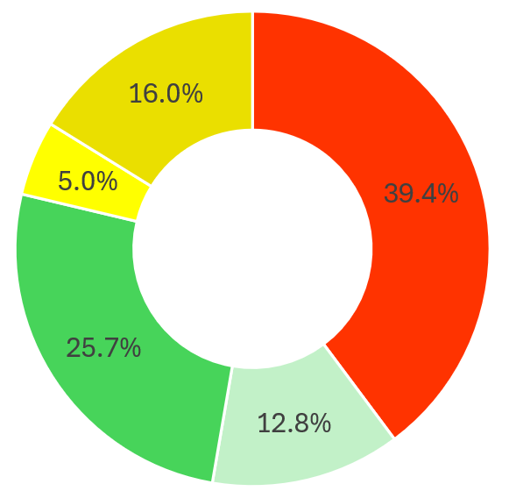
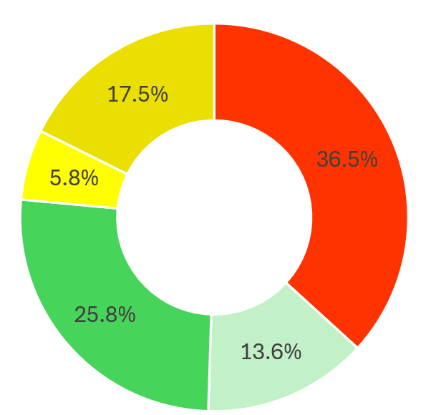
Fare capping vs fare increase – stated preference results
Dunedin
Queenstown
Notes:
These two charts show the results of the previous two questions
Red corresponds to the share of respondents who answered they prefer no fare cap and no increase in base fare
Green corresponds to those who answered they prefer one of the two fare capping options and would accept a base fare increase
Yellow corresponds to those who answered they prefer one of the two fare capping options BUT weren’t willing to pay for a base fare increase
The, the lighter green and yellow reflect those who prefer the weekly cap being set at 10 trips while darker green and yellow correspond to those who preferred it being 8 trips
In total, across both networks, 60% supported fare capping in principle (represented in the yellow and green shares of the pie chart)
39% of respondents opposed (or weren't interested in) fare capping
But only 38% supported fare capping if it the cost was paid for in a fare in a fare increase
People who supported a weaker fare cap (10 per weak) were generally more supportive of paying the cost
People who supported a strong fare cap (8 per week), which was significantly more people, were less willing to pay the cost
This would show that there is a lot of support for fare capping as a mechanism to reduce average fares
But if pressed to make a financially-neutral decision, this support evaporates. This is not surprising as most users will not take enough trips to reach the cap, thus if a fare increase came in alongside fare capping, most users would only experience the fare increase.
We also asked the similar questions about the anticipated effect on fare capping and a corresponding base fare increase on people – “how would this change affect you” rather than “do you support this change”. Because the results to both questions were very similar we have chosen to dive into only this stated preference question in this briefing.
A full analysis of both sets of questions will be available for your to review in the Technical Note, which will be attached to the September Council paper.
It might be noted that the sequencing of questions may have weakened the support for "balanced fare capping" (i.e. covering the cost of fare capping with a base increase)
Respondents would probably have a bias towards "splitting their answer" this way
But ultimately 50% more people opposed "balanced fare capping" than supported it, which is a strong margin
There was marginally stronger support for fare capping from Queenstown-based respondents (63%) (relative to Dunedin respondents (60%))

Slide 13
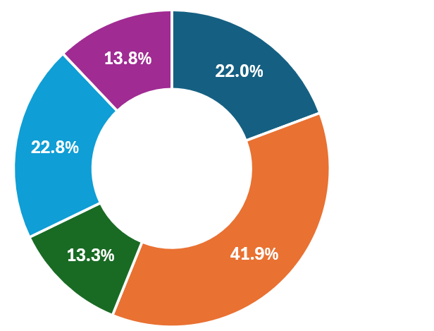
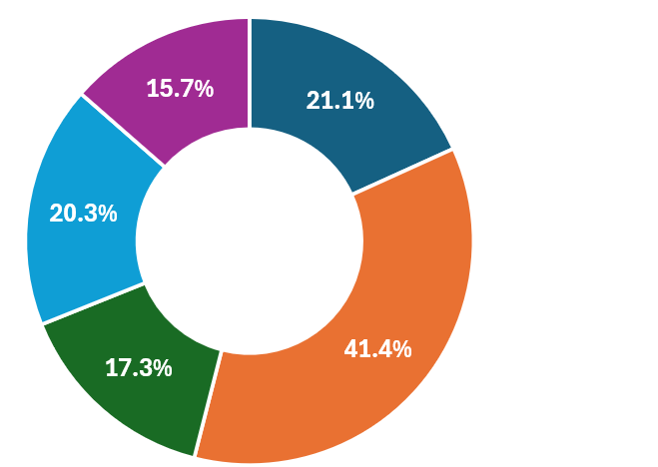
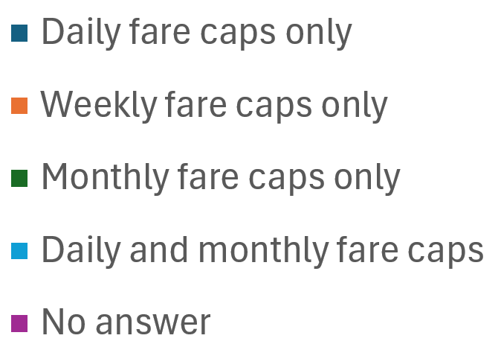
Alternative fare capping options
Dunedin
Queenstown
Notes:
The survey also asked for people’s views on alternative fare capping scenarios to the proposed daily/weekly caps option.
The results were highly mixed. Roughly 1/3rd of respondents thought a weekly cap only would be preferrable.
This question didn’t have an explicit option of “I prefer the proposed daily/weekly fare capping scenario” so we think that many people who felt this way may have answered this still answered question.
The takeaways
the weekly cap is considered a good option (42%)
The lack of support for the monthly-only option tells us that respondents prefer daily or weekly lengths of rewards over the traditional monthly pass, the fare product used by other public transport authorities before capping was available

Slide 14
Fare capping: suggested decision-making approach
Desired outcome of fare capping | Recommended fare change
Maximise patronage incentives | Implement two-trip daily and eight-trip weekly caps AND maintain the base fare
Maintain existing revenue levels | Implement either daily/weekly fare cap option AND increase the base fare OR do not implement fare capping
Reward only highly frequent users | Implement two-trip daily and ten-trip weekly caps AND increase the base fare
Avoid fare increases | Implement either daily/weekly fare cap option AND maintain the base fare OR do not implement fare capping
Notes:
Overall the results on fare capping were mixed. Adding in the element of proposing to increase the base fare to offset the cost of fare capping gave meaningful results but also added complication.
We’ve created this table as a possible guide for how to make a decision for fare capping based on outcomes you wish to achieve.
[Explain table]

Slide 15
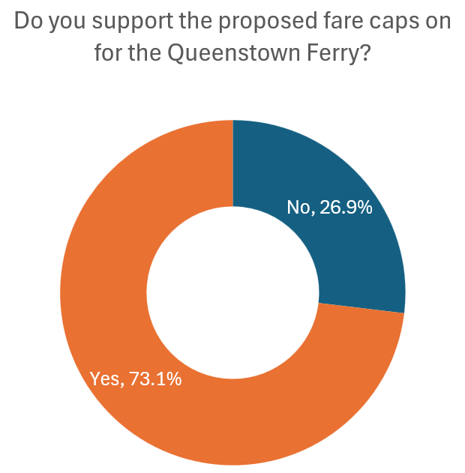
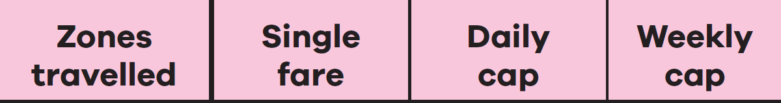

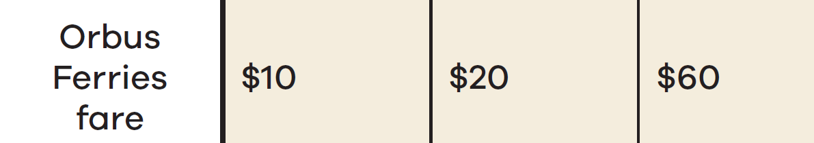
Queenstown Ferry
Proposed fare capping:
Equivalent to two trips daily, six trips weekly
Additional proposed ferry fare changes:
Accept concessions
Enable free transfers
Notes:
Not too much to say here, the proposal to introduce fare capping on the QT Ferry and this was well-supported.
Our proposal is that the fare capping will apply to the ferry even if we don’t do it elsewhere.
In the council paper we will also be recommending that the QT ferry:
Implement fares concession the same as those in place for bus services, such as 50% off for Community Service Cardholders and 40% off for children and youth
Free transfers within 45 minutes of tagging off the first trip for any trip including the ferry, with no extra fare on top of the higher ferry fare

Slide 16
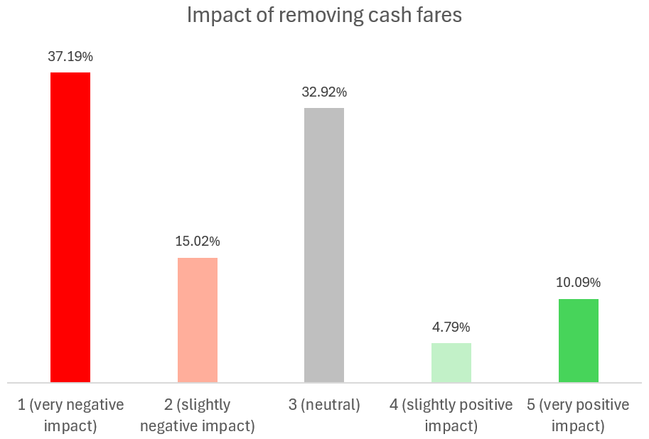
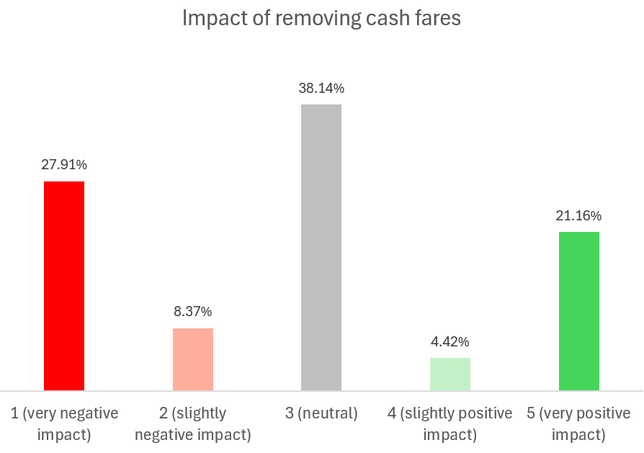
Cash fares
Dunedin
Queenstown
Notes:
Unsurprisingly the overall views are negative on removal of cash,
Although a lot of people give neutral responses and a notable minority (13%) see positives
Queenstown respondents are a lot more positive than Dunedin respondents
28% very negative vs 21% very positive in QT, vs 37% and 10% in DN
May not full take into account one major user group in QT (tourists) but tourists should have reasonable bank-card access
Difference may be significant enough to suggest cash-removal in QT only is a viable option.

Slide 17
Decisions for September paper:
Zonal fares
The September paper will ask you to make decisions on the following:
1. Dunedin zonal fares
  Implementing four zones from 1 October in Dunedin, specifically to enable the Oamaru – Dunedin service trial;
  Keeping flat fares for trips within urban Dunedin (four zones), or implementing core and outer urban zones (five zones); and
  When to implement the four or five fare zones for Dunedin: in line with school term 1 (January 2027) or with Motu Move and the next FY (July 2027)
2. Queenstown zonal fares
  Keeping flat fares (one zone), or implementing a Queenstown/Frankton and an Arrowtown zones (two zones); and
  When to implement Queenstown zone changes: in line with school term 1 (January 2027) or with Motu Move / next FY (July 2027)

Slide 18
Decisions for September paper:
Fare capping and cash fares removal
The September paper will ask you to make decisions on the following:
3. Fare capping
  Implementing fare capping on the bus network
  Increasing the base fare to offset the presumed cost of fare capping
4. Queenstown ferry fare changes
  Implementing fare capping and improve the integration of ferry fares with the following changes:
    Fare caps of $20 per day and $60 per week for adult fares, equivalent to two trips daily and six trips weekly
    Fare concessions the same as those in place for bus services
    Free transfers within 45 minutes of tagging off the first trip for any trip including the ferry, with no extra fare on top of the higher ferry fare
4. Removing cash fares
  Removing cash as a method of on-board fare payment or maintain cash fares and redefine them for consistency (e.g. 20% higher than card fares)

Slide 19
Thank you
Questions/Pātai/Feedback?

Slide 20
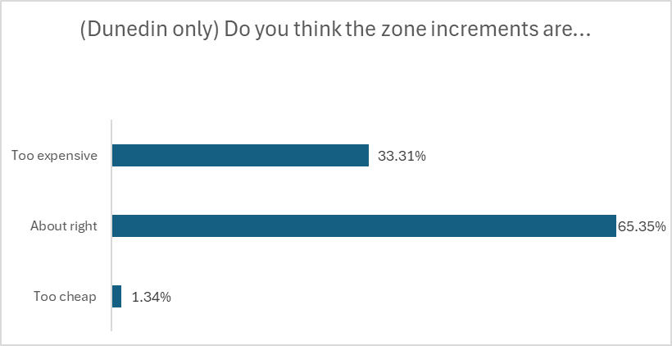
Increments of zonal fares
Notes:
Not much to say
Few people are going to answer to say they want to pay more for zonal travel
But by 2:1 ratio people seem to think it's fair

Slide 21
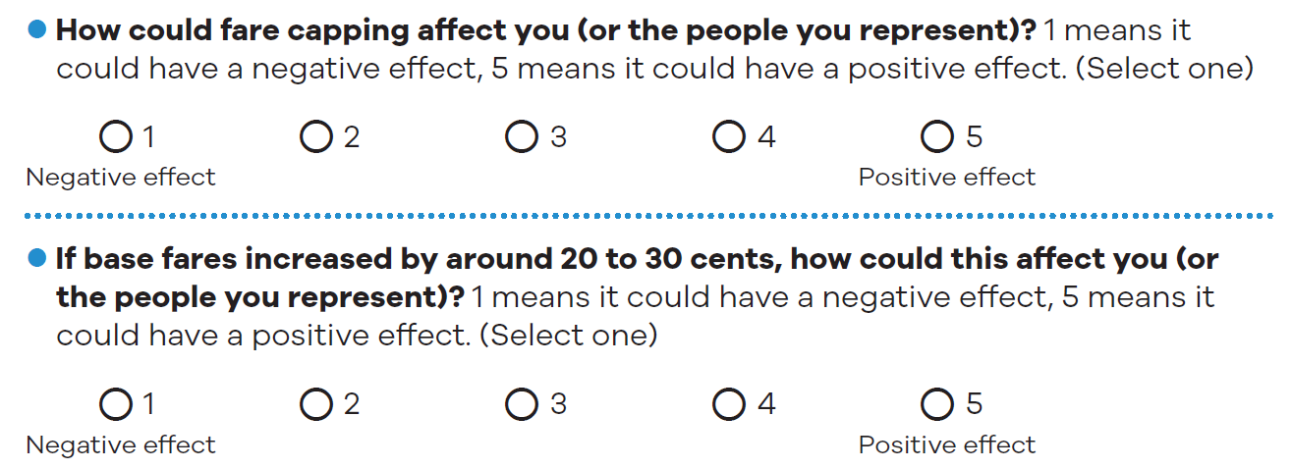
Fare capping vs fare increase – stated impacts
Strong
Strong
Reverse effects
Positive
Negative
No effect
Weak
Weak
Notes:
In this question, the positive impact of fare capping is weighed against the negative impact of fare increases that might be required to pay for capping
This is not "what would you prefer" but "how would this affect you"
Consistent with the preference question later, we see the balance of stated impacts are against fare capping if it is paid for in a fare increase
However, the margin is substantially closer than the stated preferences question that comes next
Additionally, there is an imbalance in the strength of impact
Slightly more people thought fare capping would have a large positive impact, than thought a fare increase would have a large negative impact
However more people thought fare capping would have no impact, than thought a fare increase would have no impact
Hence public perception is more polar for fare capping (either a strong impact or no impact)
Whereas public perception of fare changes are more nuanced (larger proportion of moderate responses)
Answers in Whakatipu vs Dunedin were similar in most respects
except that Whakatipu respondents gave a lot less "small effect" answers -- they generally felt that if there was an effect, it was a large effect
E.g. Dunedin had 33.0% and 32.7% "large effects" Whakatipu had 38.5% and 38.0%

Slide 22
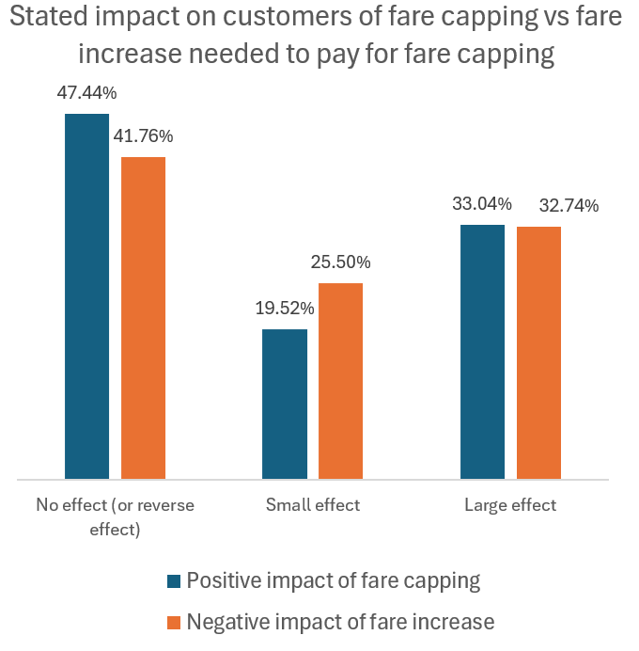
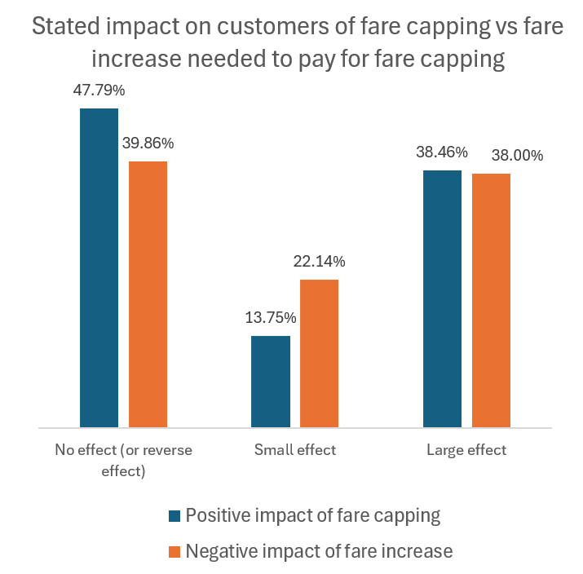
Fare capping vs fare increase – stated impacts
Dunedin
Queenstown
Notes:
In this question, the positive impact of fare capping is weighed against the negative impact of fare increases that might be required to pay for capping
This is not "what would you prefer" but "how would this affect you"
Consistent with the preference question later, we see the balance of stated impacts are against fare capping if it is paid for in a fare increase
However, the margin is substantially closer than the stated preferences question that comes next
Additionally, there is an imbalance in the strength of impact
Slightly more people thought fare capping would have a large positive impact, than thought a fare increase would have a large negative impact
However more people thought fare capping would have no impact, than thought a fare increase would have no impact
Hence public perception is more polar for fare capping (either a strong impact or no impact)
Whereas public perception of fare changes are more nuanced (larger proportion of moderate responses)
Answers in Whakatipu vs Dunedin were similar in most respects
except that Whakatipu respondents gave a lot less "small effect" answers -- they generally felt that if there was an effect, it was a large effect
E.g. Dunedin had 33.0% and 32.7% "large effects" Whakatipu had 38.5% and 38.0%

Slide 23
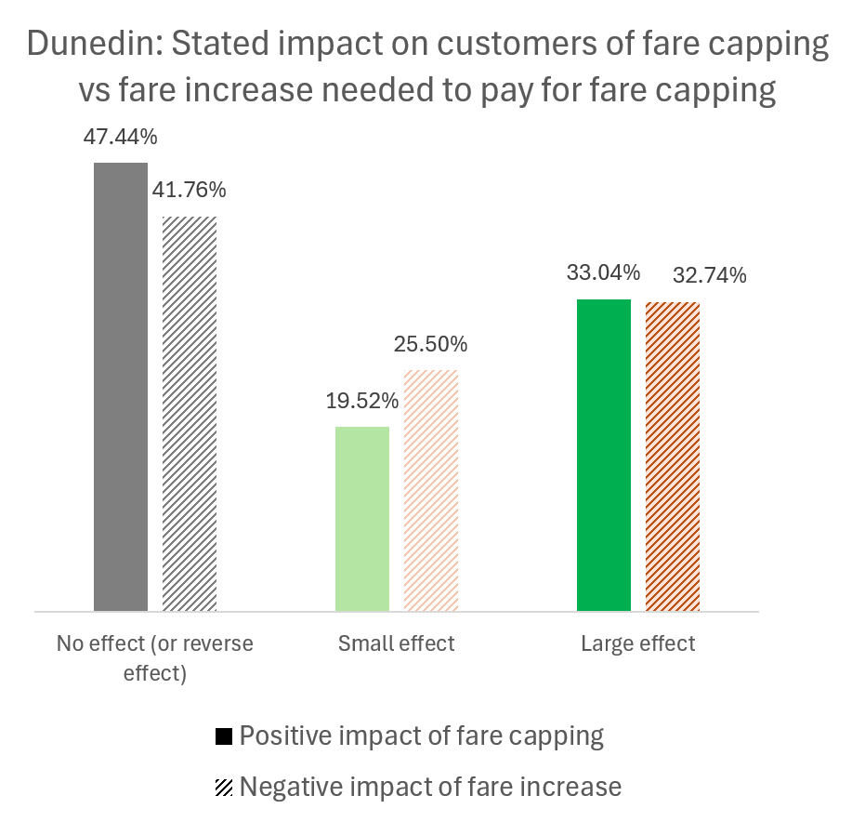
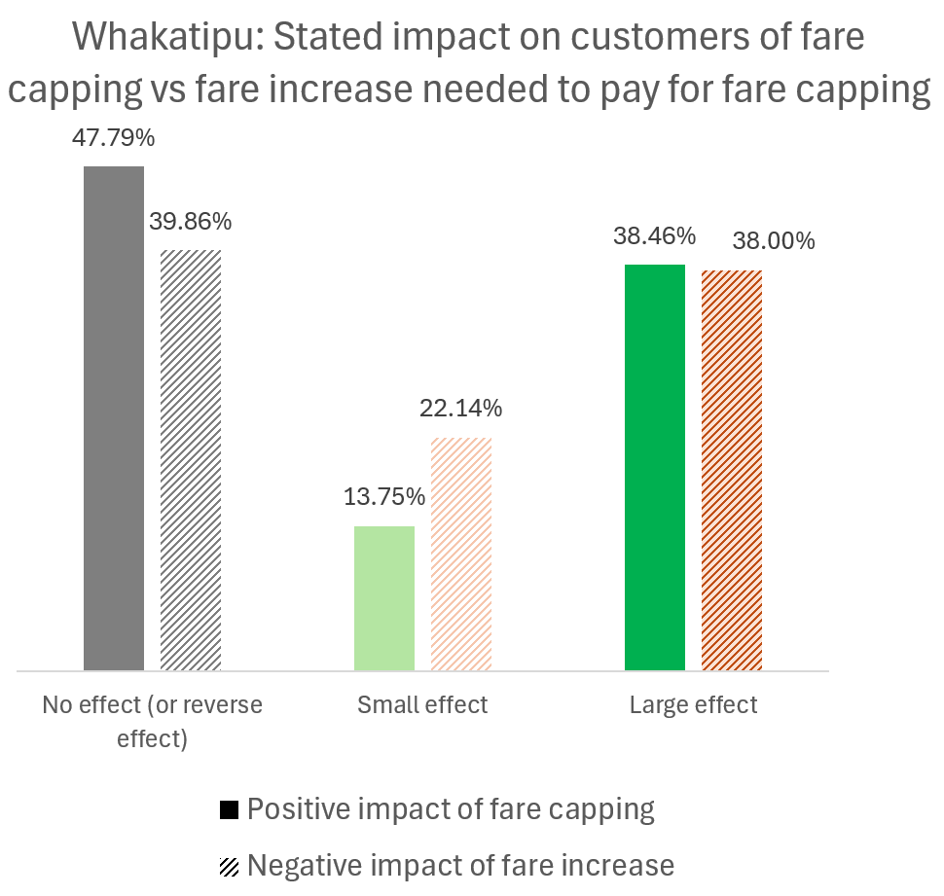
Fare capping vs fare increase – stated impacts
Dunedin
Queenstown
Notes:
In this question, the positive impact of fare capping is weighed against the negative impact of fare increases that might be required to pay for capping
This is not "what would you prefer" but "how would this affect you"
Consistent with the preference question later, we see the balance of stated impacts are against fare capping if it is paid for in a fare increase
However, the margin is substantially closer than the stated preferences question that comes next
Additionally, there is an imbalance in the strength of impact
Slightly more people thought fare capping would have a large positive impact, than thought a fare increase would have a large negative impact
However more people thought fare capping would have no impact, than thought a fare increase would have no impact
Hence public perception is more polar for fare capping (either a strong impact or no impact)
Whereas public perception of fare changes are more nuanced (larger proportion of moderate responses)
Answers in Whakatipu vs Dunedin were similar in most respects
except that Whakatipu respondents gave a lot less "small effect" answers -- they generally felt that if there was an effect, it was a large effect
E.g. Dunedin had 33.0% and 32.7% "large effects" Whakatipu had 38.5% and 38.0%

