Slide 1


Private Equity Workshop
May 2025

Slide 2
Otago Regional Council Performance Update
The portfolio increased 7.4% in the 12 months to March 31st versus a benchmark return of 5.7% (outperformance of 1.7%).
This outperformance was been driven by strong relative returns from most equity asset classes, as well as NZ fixed interest.
Subsequent to quarter end, and up until 12th May, the portfolio has increased a further c. +1.1% (+$320,000).
It serves as a timely reminder that market headlines can often feel more severe than their actual impact on portfolio returns, with our broad diversification approach helping to protect the portfolio from elevated levels of market volatility.

Slide 3
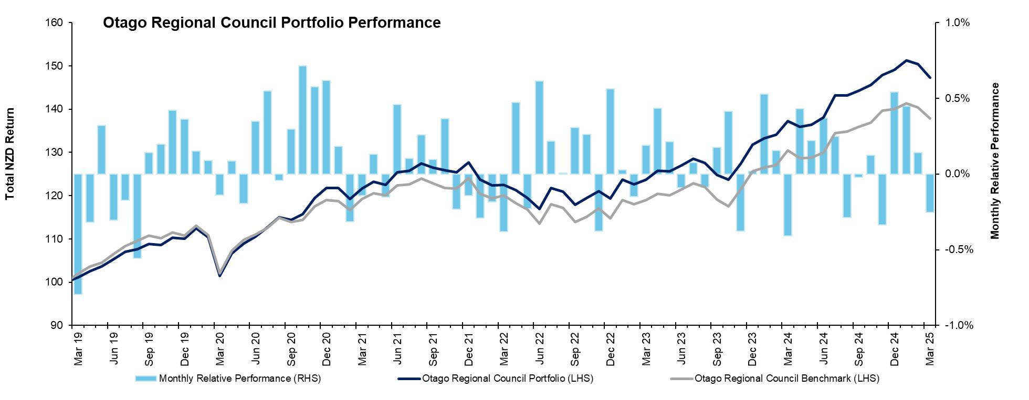
Performance Since Inception
Since inception, the portfolio has increased c. 47% vs the composite benchmark return of 38%.
This performance is testament to our focus on active portfolio management and strong portfolio construction.

Slide 4
Otago Regional Council Positioning
During the quarter, we reduced the previous modest tactical overweight we held to defensive assets to fund a modest overweight to NZ equities.
Not only have NZ equity valuations become less demanding, but we suspect earnings revisions are set to improve given a nascent economic recovery.
We also believe the defensive and high-quality attributes of the NZ market are attractive in the current volatile global environment.

Slide 5
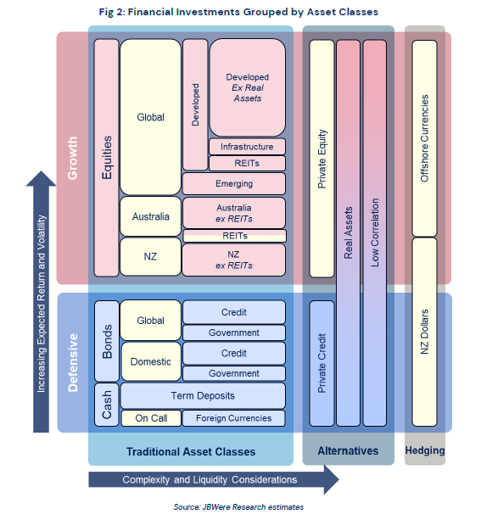
What is Private Equity?
Private Equity Explained
Private Equity (PE) is an alternative asset and consists of investing in the equity of private companies not listed on a public exchange.
The main strategy of a PE firm, or manager, is to:
purchase businesses which they believe are undervalued or have a large opportunity for growth;
take control of the management of a company to improve efficiency and performance; and
pursue an exit strategy aimed at crystallising investor return once the PE firm believes they are unable to add additional value within a reasonable timeframe.
There are various classifications of PE which may include: Buyout, Growth, Startup/Venture Capital (VC), and Secondaries which reflect the lifecycle stage of the target investment, and structure of the investments.

Slide 6
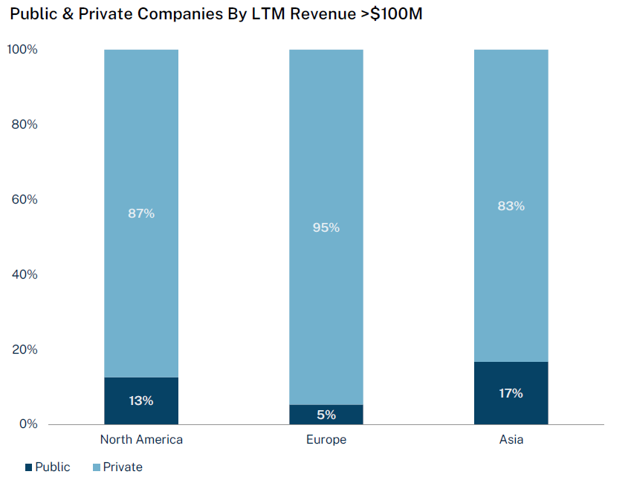
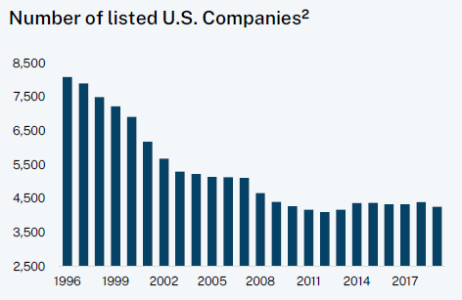
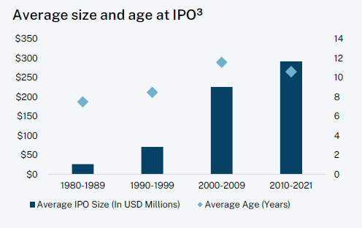
What is Private Equity?
Private Equity Explained
Private markets are significantly larger than their private market counterparts.
Globally, there are over 140,000 private companies with revenue over US$100mn vs approximately 19,000 public companies with the same revenues.
Interestingly, the number of public companies is shrinking. This is arguably due to a combination of factors:
rising regulatory burdens and the costs (including disclosure) of being a public company
the growth of private equity, venture capital, and private credit has provided vast alternative funding sources
Reflecting similar forces, companies are often waiting far longer to ‘go public’, if at all.
Source: Capital IQ
Source: World Bank
Source: Jay Ritter

Slide 7
Private Equity – a return enhancer
Private Equity investments are typically viewed as a return enhancer in a portfolio of traditional assets. This return enhancement stems from the ability of investors to harvest an illiquidity premium, which is embedded in most private investments. However, it also comes from other sources, including:
Control: The ability of a PE manager to align their interests with company founders or to take control of company management through board representation to improve efficiency and performance.
Information: PE firms or managers are often able to gain a competitive edge from utilising information that is not publicly available, nor required to be made publicly available.
Access to innovation: There is arguably more opportunity to access innovation and value creation in private markets that may not be available in the public markets.
Alignment: Perhaps more so than in public markets, PE firms themselves, in addition to the remuneration structures for their key employees, are constructed to align interests to those of the investor to drive attractive returns.

Slide 8
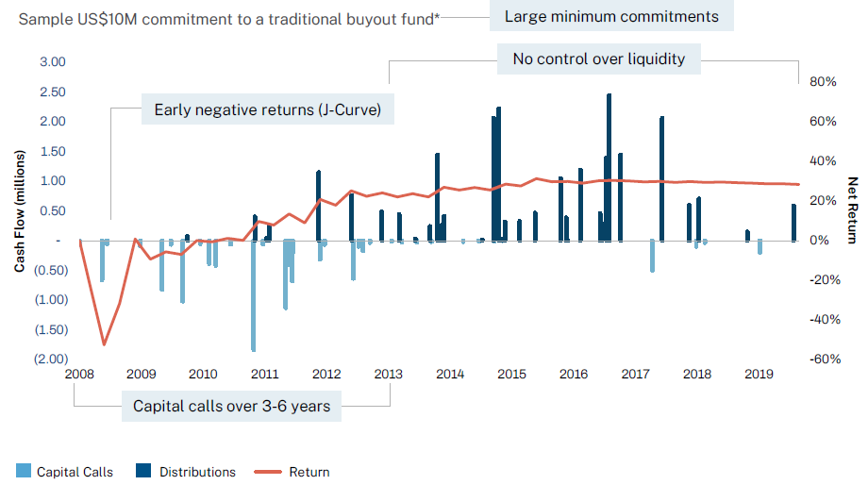
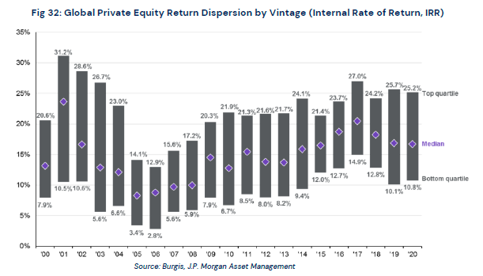
But there are some challenges and disadvantages
There are unique aspects of PE that can make it challenging for some investors to access.
Illiquidity: Most PE funds operate with a closed-end structure, which means there is typically little, if any, opportunity for investors to exit early.
Cash flow management: Calls for capital (but also distributions) are unpredictable, which can pose operational and opportunity cost challenges for investors.
J-Curve: The return profile of closed-end PE funds tends to follow a “J-Curve”, with low or even negative returns in the short-term.
Manager selection and due diligence: Unlike in active public equity funds, the performance differential and persistence of top quartile managers has historically been far more pronounced within PE. Naturally, however, as investor demand to access these successful managers increases, the hurdles for entry can become meaningfully higher, and prohibitive for all but large, sophisticated investors.
High fees: Justified by the highly active approach by the manager, but also to ensure alignment of interest between manager and investor, fees can be meaningfully higher than for traditional asset class investments.
Time: PE is very much a long-term investment (perhaps 10+ years). Additionally, setting up a truly diversified PE portfolio, with various managers and fund vintages, takes meaningful time and resource.
Source: Hamilton Lane

Slide 9
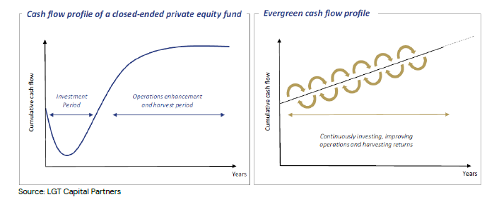
The Fund-of-Fund approach can help mitigate some of those challenges
In many instances, the challenges highlighted on the previous slide can be mitigated by a fund-of-fund approach.
These funds typically operate an open-ended (i.e. indefinite lifetime) or ‘evergreen’ structure, providing investors with a turnkey exposure to a potentially broad portfolio of PE managers and fund vintages, often spread across different geographies and sectors and styles of PE investing.
Importantly, these open-ended products also typically provide investors with some liquidity (perhaps monthly or quarterly)
For these reasons we believe these fund-of-fund offers are an attractive way for investors new to the asset class to gain exposure.
Of course, there are still costs and other considerations.
  On top of the fees that the underlying PE managers will charge, the fund manager will also charge fees associated with the costs of running the fund and the skills involved in manager selection.
  As a ‘pooled’ product, investors who require highly customised solutions or have specific ESG or responsible investing requirements may struggle to find something that completely aligns with their interests.

Slide 10
Impact on long-run risk/return expectations for ORC portfolio

Slide 11
Other considerations
Alignment with ORC’s Responsible Investment Policy
The ORC maintains a Responsible Investment policy that precludes investments in entities with certain business involvements (cannabis, firearms and weapons, tobacco, nuclear generation, fossil fuels, pornography, predatory lending and severe ESG controversies, as well as limits on companies with revenue from gambling and alcohol).
Most PE managers also maintain a formal exclusions policy. However, it is important to note that :
  It can be more difficult to assess an unlisted company’s business involvements versus publicly listed peers, given differing disclosure obligations and the general lack of third-party data providers.
  Exclusions can be difficult to apply in segments of these funds where mangers don’t have direct control (e.g. LP investments).
  Given the illiquid nature of the investments, divestment when a breach is discovered, is not often a realistic option.
Outside of using a segregated mandate (which is unlikely due to the size of investment being considered), it is unlikely we’ll be able to find a PE manager where there is complete alignment with ORC’s policy. Therefore, the ORC would need to be comfortable with the potential for these funds to own entities that do not completely align with their ethical standards/values, although in all likelihood, these positions would likely be small.
What is common practice in this instance, and it has been the approach taken by some of our institutional clients that have invested in these types of vehicles, is to acknowledge the difficulties of obtaining full alignment with their RI policies and to have an exception or calve out for Private Equity.

Slide 12
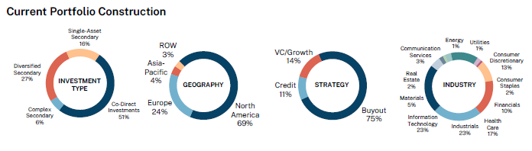
Hamilton Lane – Global Private Assets Fund (GPAF)
Key highlights
Hamilton Lane is one of the world’s largest private asset managers, with ~US$960bn under management/supervision
The GPAF provides turnkey access to a diversified and fully deployed fund of private assets (i.e. no capital calls)
Provides monthly liquidity (with restrictions)
Offers both AUD hedged and unhedged share classes
Targets a 10-12% pa return net of fees over a 5-10 year period. Since inception (May 2019), it has returned 12.19% pa (as of 31 March 2025).
Through its commercial relationships, JBWere has negotiated a reduced management fee of 1.40% pa (there are additional performance and indirect fees).
Hamilton Lane has a strong commitment to ESG objectives and does have a formal exclusions policy (it applies a negative investment screen for the following sectors across its discretionary investment business: thermal coal, oil sands, non-sustainable forestry practices, controversial weapons, abusive lending practices, pornography, animal cruelty, child and forced labour, human trafficking and tobacco/nicotine production

Slide 13
Disclaimer
This presentation has been prepared by JBWere (NZ) Pty Limited (“JBWere”) which holds a licence issued by the Financial Markets Authority to provide a financial advice service.
Any advice provided in this document solely relates to the investment opportunities identified in it. In preparing this document, JBWere’s Investment Strategy Group did not take into account the particular investment objectives, financial situation, goals or needs ("financial circumstances") of any particular person. Accordingly, before acting on any advice contained in this document, you should assess whether the advice is appropriate in light of your own financial circumstances or contact your adviser.
The content of this document is of a general nature and is intended as a source of general information only. To the extent that any views expressed in this document constitute financial advice, the scope of that financial advice is limited to JBWere’s views on the identified investment opportunities based on our research and has not been personalised for any recipient.
This document is being furnished to you solely for your information and may not be copied or redistributed to any other person. It is provided on the condition that you keep it confidential and do not copy or circulate it in whole or in part. In particular, the information may not be redistributed outside of Australia and New Zealand via e-mail or otherwise.
JBWere and its respective related entities distributing this document and each of their respective directors, officers and agents (“the JBWere Group”) believe that the information contained in this document is correct and that any estimates, opinions, conclusions or recommendations contained in this document are reasonably held or made as at the time of compilation. However, no warranty is made as to the accuracy or reliability of any estimates, opinions, conclusions, recommendations (which may change without notice) or other information contained in this document. To the maximum extent permitted by law, (but, in respect of our clients, subject to the applicable terms and conditions of our engagement with them), the JBWere Group disclaims all liability and responsibility for any direct or indirect loss or damage which may be suffered by any recipient through relying on anything contained in or omitted from this document.
This document may contain a restatement, summary or extract of a report prepared by UBS New Zealand Limited or a related body corporate ("UBS Report") or by Moelis Australia Security Pty Ltd or a related body corporate ("Moelis Report"). Please contact your JBWere adviser if you would like a copy of the UBS Report or the Moelis Report.
No fees, expenses, or other amounts are payable for the provision of financial advice in this document. However, if you act on any information or advice contained in this document, a brokerage or other fees may be payable.
For information about the financial advice services provided by JBWere, including an overview of our complaints and dispute resolution process, and the statutory duties applicable to us and our advisers, please see our publicly available disclosure statement, which is available at https://jbwere.co.nz/about-us/important-disclosures/.
JBWere uses the ‘JBWere’ brand under licence from JBWere Limited (ACN 137 978 360), a subsidiary of National Australia Bank Limited (ABN 12 004 044 937) (NAB). JBWere is not a member of the NAB group of companies (NAB Group). No member of the NAB Group guarantees, or supports, the performance of JBWere’s obligations to any party.
Copyright JBWere (NZ) Pty Ltd ABN 13 138 488 418. All rights reserved. No part of this communication may be reproduced without the permission of JBWere.

