Slide 1
Otago Air Quality Programme
ESP Workshop – Air Quality
20 February 2025

Slide 2
Introduction
Regional councils have the function of managing air quality to control the adverse effect of discharges – primarily on human health, and also on Kāi Tahu values, environmental health, and amenity.
Before we can progress the Air Strategy and Air Plan, we need to understand Council’s level of ambition for managing Otago’s air quality issues.
This will likely be guided by:
Central government through the RMA and NESAQ;
Council/community through the Strategic Directions, pORPS 2021, and 2024 community engagement;
Kai Tahu values and aspirations;
Scientific data about Otago's air quality and efficacy of possible approaches;
Competing demand for limited resources;
Relative financial costs to ORC, homeowners, and our communities.

Slide 3
ORC Strategic Directions
Community Feedback
Resource Management Act 1991
Iwi
National Environmental Standards for Air Quality 2004
Proposed Regional Policy Statement 2021
Science
Air Quality Strategy
Other Non-Reg Interventions (e.g. dry wood certification scheme)
Education / Raising Awareness
Financial Incentives
Air Quality Monitoring & Research
Air Plan (Regulation)
Consents
Compliance monitoring & enforcement
Notes:
Note the tools our toolbox, and which ones we’re currently using

Slide 4
Introduction
Today we’ll be seeking to understand:
  What are the outcomes Councillors want to see for air quality?
  What should we prioritise: health and wellbeing, compliance with standards, and/or cost effectiveness?
  What time frames should we be looking at to achieve these outcomes?
Through the Strategy, we can then design the most effective approach using a combination of the various tools across different parts of the region.
For some activities, the status quo (Air Plan) is working quite well so no major changes are required
For other activities, the proposed approach is based on science and what’s worked well elsewhere.
Notes:
Note: ‘health and wellbeing’ and ‘compliance with standards’ are NOT mutually exclusive as the standards were developed for the purpose of health

Slide 5
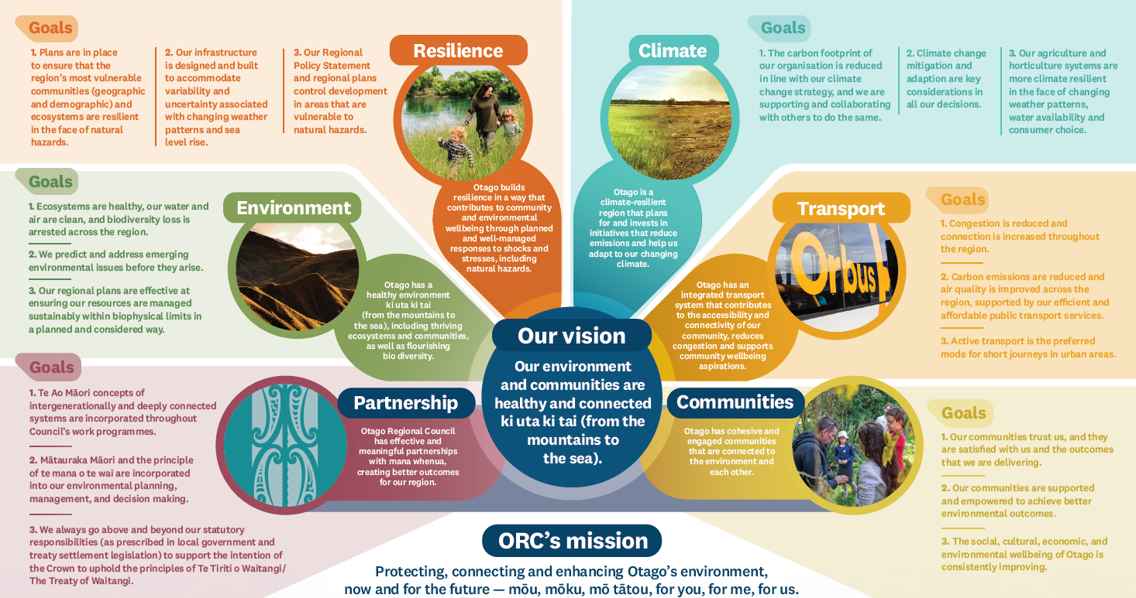
Introduction
We want to focus the kōrero today on outcomes, but we have provided a lot of information to help you understand the relative benefits/impacts/trade-offs of each option.
We encourage you to:
Get excited about the big picture – a shared idea of the future, values to protect, how to deliver outcomes for our communities.
Identify what should we focus on to make the most progress; how to get most impact from our spending (more bang for buck).
Think about ‘what does good look like’?
If we get stuck in the detail, help us to zoom out a bit.

Slide 6
Process to Date (and future)
Sept ‘23
ESP Workshop
Dec ‘23
ESP Workshop
Dec ‘24
Further engagement with Aukaha & TAMI
5 Feb ‘25
Councillor Reference Group
20 Feb ‘25
ESP Committee Workshop: seek feedback on level of ambition
5 March ‘25
Councillor Reference Group
Aug/Sept ‘24
Public and Stakeholder Engagement
19 March ’25
Council Meeting: seek decision on level of ambition
Aug ’25
Council Meeting: endorsement of draft Strategy & proposed Plan
Aug/Sept ’25
Public engagement draft Strategy
Public Notification of proposed Plan
Apr-Jul ’25
Cl.3 & Cl.4A consultation
Apr-Jul ’25
Councillor Reference Group as needed
June ’25
ESP Committee Workshop: discuss draft provisions of Strategy & Plan
Notes:
Workshop 13 September 2023: The Science Team presented the scientific data we have on air quality and sought Council’s input on issues in Otago.
ESP Committee Workshop and Meeting on December 13, 2023: The ESP Committee considered a high-level Issues and Options paper by the Policy and Planning team and confirmed the list of issues for public engagement.
ESP Committee Workshop 27 June 2024: The Science Team provided a briefing on the most up to date air quality science for Otago.
Council Meeting 23 October 2024: Staff updated Council on progress for developing an Air Quality Strategy and Air Plan, including key future milestone points. Council approved establishing a Councillor Reference Group, noted ORC’s joint approach to the strategy and plan, and approved the Terms of Reference for the Reference Group.

Slide 7
Management Options

Slide 8
Home heating & outdoor burning
Option 1:
Status Quo
18% improvement in ambient air quality by 2040
Health cost $106M
Option 2:
NESAQ PM₁₀
42% improvement in ambient air quality by 2040
Health cost $73M
Option 3:
WHO PM_{2.5}
49% improvement in ambient air quality by 2040
Health cost $58M

Slide 9
Option 1: Status Quo
Modelling suggests the current air management measures will result in: 18% improvement in air quality in monitored towns
Health cost of $106M in monitored towns
Won’t meet NESAQ or WHO by 2040
Domestic heating
Outdoor burning
No burning rule 16.6.3.1 materials
Alexandra, Arrowtown, Clyde, Cromwell: Permitted burners must meet an emission rate below 0.7g/kg and a thermal efficiency above 65%
All other urban areas + properties <2ha in the rest of Otago: Permitted burners must meet an emission rate below 1.5g/kg and a thermal efficiency above 65%
Education programme – Burn Dry Breathe Easy
Air Zones 1 and 2: only burn dry organic material, setbacks
Air Zone 3: only burn dry organic material (except on production land)
Agricultural wrap burning permitted on production land in Air Zone 3
Permitted region wide
Notes:
Domestic heating - Alexandra, Arrowtown, Clyde Cromwell
Permitted burners must have emission rate less than 0.7g/kg and thermal efficiency less than 65%
Modelled as ULEB
Domestic Heating –
All other urban areas + properties <2ha in the rest of Otago
Permitted burners must have emission rate less than 1.5g/kg and thermal efficiency less than 65%
Modelled as MfE burner

Slide 10
Option 2: NESAQ (PM10)
42% improvement in air quality by 2040 in monitored towns
Health cost $73M in monitored towns
(Savings of $33M compared to status quo)
Alexandra
Phase out non-ULEB over 20 years
Arrowtown, Clyde, Cromwell, Milton, Mosgiel
Phase out non-ULEB over 20 years
Outdoor burning controls
All other urban areas
Only ULEB for new installs
Financial assistance
Outdoor burning controls
Behaviour change programme
Financial assistance
Only ULEB for new installs
Only ULEB for new installs

Slide 11
Option 3: WHO (PM2.5)
49% improvement in air quality by 2040 in monitored towns
Health cost $58M in monitored towns
(Savings of $48M compared to status quo)
Alexandra
Phase out all burners over 20 years
Clyde, Cromwell
Phase out non-ULEB over 20 years
Financial assistance
Arrowtown, Milton, Mosgiel
Phase out non-ULEB over 20 years
Other urban areas
Outdoor burning controls
Behaviour change programme
Financial assistance
Only ULEB for new installs
Financial assistance

Slide 12
Questions – home heating
What is Council’s level of ambition regarding air quality and associated health outcomes?
Should we prioritise regulatory compliance (NESAQ) or better human health outcomes (WHO)?
Or, are you happy with the status quo?

Slide 13
Outdoor burning
Option 1 – Status quo
Option 2 – Increased regulation (some or all)
2A: Urban outdoor burning restrictions
2B: Winter outdoor burning restrictions
2C: Ban agricultural wrap burning
2D: Require good practice region wide
Option 3 – Non-regulatory approach
Notes:
For outdoor burning, we are concerned about how it can affect ambient air quality, but also about the more localised adverse effects it can have, because for larger-scale activities, those effects can be pretty significant.
We considered both of those things and have come up with three broad approaches for how we could manage outdoor burning.
One is the status quo - what we are doing now.
Option 2 covers four ways ORC could increase regulation of outdoor burning.
Option 3 is taking a non-regulatory approach to managing outdoor burning.
And Council could choose to mix and match the different regulatory and non-regulatory options, depending on what your desired outcome for outdoor burning is.
Examples of localised effects: smoke impacts on amenity and visibility, localised health impacts from lots of smoke or from noxious or dangerous discharges.

Slide 14
Outdoor burning (Option 1)
Option 1: Status quo
Permitted
No burning rule 16.6.3.1 materials
Air Zones 1 and 2: only burn dry organic material, setbacks
Air Zone 3: only burn dry organic material (except on production land)
Agricultural wrap burning permitted on production land in Air Zone 3
Notes:
As part of the status quo, we do a few non-regulatory things. The Air Plan contains a guide to good practice for outdoor burning, and that information is available on the ORC website, along with a summary of the rules. And we have shared that information brochures in the past. But apart from that, the status is quo is really just the current Air Plan rules.
Currently, outdoor burning is permitted region wide, provided you don’t burn any of the materials in rule 16.3.3.1 (which lists things that it’s generally prohibited to burn) and there’s also a general requirement to avoid offensive or objectionable discharges beyond your property boundary.
Then there are rules apply to diferent parts of Otago.
The strictest rules apply in Air Zones 1 and 2 (which are urban areas). In these areas, you have to comply with setbacks and there are requirements to only burn dry vegetation, paper, cardboar or untreated wood.
In Air Zone 3, which is most of Otago, there are fewer restrictions:
On Air Zone 3 land that isn’t production land, you still have to burn only dry organic material but there aren’t any setbacks to comply with.
On production land in Air Zone 3, there are no setbacks or restrictions on what can be burned, except for the rule prohibiting burning of various materials. That rule prohibits burning of most plastics, but there is an exemption for polyethylene, allowing agricultural wrap to be burned on production land in Air Zone 3.

Slide 15
Outdoor burning (Option 2)
Option 2A – Urban restrictions
Further restrictions on larger-scale outdoor burning in urban areas.
Option 2B – Winter restrictions
Buffer zones around urban areas where larger-scale outdoor burning over winter requires resource consent.
Notes:
Science work has recommended these two options as regulatory measures that could improve ambient air quality in the six priority areas, and potentially in other urban areas.
Both options are about controlling larger-scale outdoor burning, so there could be exemptions for the small-scale or infrequent activities that the current Air Plan permits – such as fires for cooking.
Option 2A is about controlling outdoor burning within urban areas. We already have pretty strong restrictions on this in the urban areas that are in Air Zones 1 and 2, with the Air Plan setbacks effectively setting a 1 ha minimum site size. But this still allows outdoor burning to occur, which can be issue for places that aren’t meeting the national air quality standards. Also, thinking about more the localised adverse effects, there are many cases where you have properties larger than 1 ha near denser residential areas. So there are opportunities to further restrict outdoor burning in urban areas, for instance by setting a larger minimum site size, or just not permitting those larger scale activities in specified areas.
Option 2B is about controlling outdoor burning that happens outside urban areas, to try and reduce the amount of particulate matter travelling from rural land into urban areas. The idea of restrictions being in winter is that that’s when some urban areas already have poor air quality you’re most likely to get the stable conditions that allow smoke plumes to travel large distances. Winter restrictions would involve defining a buffer zone around certain urban areas, and within that buffer zone outdoor burning would not be a permitted activity over winter.

Slide 16
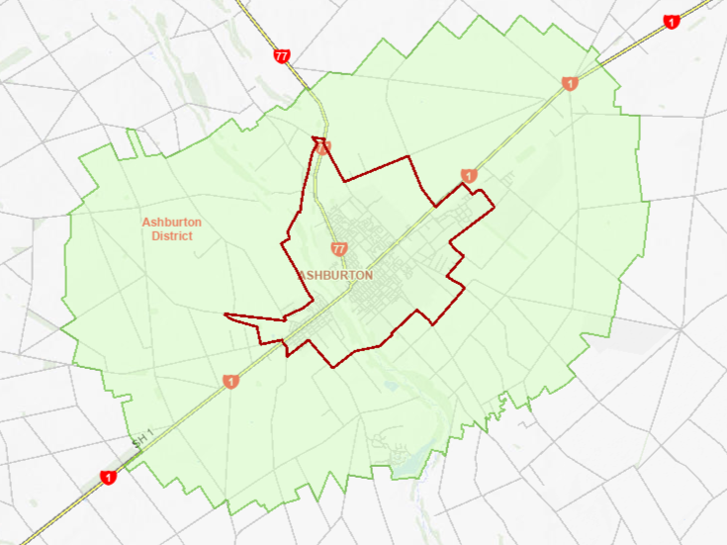
Outdoor burning (Option 2B)
Winter restrictions – buffer zone approach
Air Zone
(urban area where most Air Plan rules apply)
Buffer Zone
(rural land where winter restrictions apply, surrounds urban area)
Notes:
Winter restrictions would involve defining a buffer zone around certain urban areas, and within that area outdoor burning would not be a permitted activity over winter.
This map, which is from the Canterbury Air Plan, illustrates how that would work.
The smaller area outlined in red is the Air Zone where most rules apply. This where you would introduce additional restrictions for outdoor burning within urban areas.
The green is the buffer zone where winter restrictions would apply, so it would be for rural land near urban areas. Beyond that, there would not be restrictions.

Slide 17
Outdoor burning (Option 2)
Option 2C – Ban burning agricultural wrap
Recycling now more feasible.
Remove exemption allowing outdoor burning of polyethylene.
Option 2D – Require good practice
Make good practice into region-wide permitted activity conditions.
E.g. setbacks, burning dry material.
Notes:
These two options are primarily about reducing the more localised adverse effects of outdoor burning, rather than improving ambient air quality.
Option 2C is pretty self-explanatory: now that alternatives to burning agricultural wrap are more feasible, we could remove the exemption allowing it to be burned outdoors on Air Zone 3 production land. Which has already happened in other regions.
Option 2D is about addressing the current lack of restrictions on outdoor burning outside Air Zones 1 and 2. Things like setbacks from neighbouring dwellings and only burning dry material are generally accepted as good practice. However, a lot of Otago doesn’t have any restrictions beyond not burning certain materials.
So, requiring good practice would do two things:
It would mean that no matter where burning occurs, there are some clear rules protecting things like amenity on neighbouring properties and visibility on roads.
It would help to manage outdoor burning occurring at the rural/urban interface.
Urban/rural: burning green material can create more smoke, which can be a particular problem when it’s occurring near a built-up area. You can’t do that in Air Zones 1 and 2, but you can on production land in Air Zone 3, even if you’re right beside Air Zone 1.

Slide 18
Outdoor burning (Option 3)
Option 3 – Non-regulatory approach
Leave the current Air Plan rules as they are and use non-regulatory measures to reduce adverse effects from outdoor burning.
E.g. education, community-led guidelines. similar outcomes.
Notes:
Finally, ORC could also take a non-regulatory approach to managing outdoor burning, which could involve things like education programmes, and working with rural communities to develop outdoor burning guidelines, which might achieve more buy-in than using rules.
This could take a couple of forms:
We could leave all the existing Air Plan rules as they are, and try and achieve any changes to outdoor burning that Council wants to see using non-regulatory measures.
Or we could introduce new rules for some things and use non-regulatory measures to address others.
Example: we could introduce urban outdoor burning restrictions and require good practice, but take a non-regulatory approach to agricultural wrap burning and and outdoor burning over winter.

Slide 19
Questions
Urban outdoor burning
Winter outdoor burning
Agricultural wrap burning
Good practice region wide
What aspects of outdoor burning should be managed using increased regulation?
What aspects of outdoor burning should be managed using non-regulatory measures?
Or, are you happy with the status quo?
Notes:
Four key areas where we could change what we’re doing.

Slide 20
Farming - odour
Option 1: Updated status quo
Discharges to air from intensive farming permitted within stocking thresholds.
Discharges to air from farm waste management permitted subject to setbacks.
Option 2: Increased management of air discharges from intensive farming.
Notes:
When it comes to the air plan, the farming chapter is concerned with activities that cause odour, where that could impact the amenity of surrounding properties. This covers activities such as intensive farming and farm waste management.
Option 1 is an updated status quo. In the current plan, air discharges from intensive farming are permitted as long as the operation does not exceed 2000 pigs or 100,000 poultry. The odour from farm waste is managed through the waste plan, and is a permitted activity subject to setbacks, and an offensive or objectional test. The updated status quo would look at bringing the farm waste management rules over from the regional waste plan and align setbacks with other regional plans.
Option 2 would look at more stringent permitted thresholds. The current intensive farming rules are less stringent than in other regions and less stringent than rules in Otago’s territorial authority plans. Although odour from farming does not appear to be a big problem in Otago, this may be because Otago’s territorial authorities have more stringent thresholds which is managing the activity. However discharges to air are a regional council responsibility, and option 2 would investigate the situation further.
_______________________________________________________________________________
Additional detail:
Updating a Regional baseline – ours is so high compared to other TAs and other regions.
Option 2 could include:
- Changing the default activity status so consent is required
- Odour management plans
- Lowering the stocking threshold for permitted activities
- Introducing setbacks
Explanation between ORC role v TAs if required:
Territorial authorities manage land use and therefore the potential for conflicts between land uses through land use zoning in district plans.
Regional Councils are responsible for discharges to air, with one potential impact being odour impacts on amenity.
pORPS:
AIR-M3 Territorial authorities must prepare or amend and maintain their district plans to include provisions that direct an urban form that assists in achieving good air quality...
AIR-M2 regional plans must manage the adverse effects of discharges to air by ... ensuring discharges to air do not cause offensive or objectionable effects...

Slide 21
Questions
Are you comfortable with the status quo updated to reflect other Otago regional plans?
Or, do you want greater protections for odour?
Notes:
The question for discussion is are you comfortable with the status quo with updates from the other regional plans or do you want us to investigate how farming activities are being managed and what the appropriate thresholds and conditions should be?

Slide 22
Agrichemicals & fertilisers
Option 1: Status quo
Discharges to air from agrichemical use permitted, rules based on land use type.
Discharges to air from fertiliser use permitted.
Option 2: Improved management
Controls on larger-scale agrichemical spraying on private property.
Fertiliser application setback from sensitive uses.
Notes:
The agrichemical and fertiliser provisions of the air plan cover the effects of spray drift and dust that can cause localised impacts on amenity, human health and vegetation.
Option 1 is the status quo.
Discharges from agrichemical applications are permitted with conditions and rules are organised based on land use type. There are more conditions required for spraying on public land, but less on private land where the main condition requiring no noxious or dangerous effects beyond the boundary of the property.
For fertilisers, all applications are permitted, provided the discharge has no noxious, dangerous, offensive or objectionable effects at or beyond the boundary of the property.
Option 2 would look at:
incorporating best practice from the New Zealand Standard for management of agrichemicals, particularly focussing on conditions for larger scale agrichemical spraying on private property, which is the main gap in the current rules.
Providing setbacks for fertiliser application, unless neighbours agree otherwise.
____________________________________________________________________________________________________
Additional information:
The current rules only require best practice standards for public places, so there is a risk of inadequate control of effects of large-scale spraying on private property. The current main condition requiring that there is no noxious or dangerous effects beyond the boundary.
Best practice could include:
Qualifications for operators
Appropriate signage
Notification to neighbours
Re-arranging by application type: the main factors that could cause spray drift are the weather conditions, expertise of the operator and application method – therefore grouping rules based on application method could be clearer and allow targeted and appropriate conditions for each application method. This is the approach in other regions, and how the NZ standard lays out it’s rules.
For fertilisers: rule adopted in both Southland and Nelson is to require a 30 m setback from a neighbouring dwelling, unless the occupier gives their permission.
Community consultation summary example helicopter spraying.

Slide 23
Questions
Are you comfortable with the status quo?
Or, do you want more controls around agrichemicals and fertiliser?
Notes:
The question for discussion is are you comfortable with the status quo or do you want greater protections to manage spray drift and dust from agrichemical spraying and fertiliser application?

Slide 24
Trade and Industrial
Option 1: Status quo
Permitted low risk activities
Discretionary consents required for high risk or large-scale activities
Notes:
Make notes about what is managed in the NESAQ – burning of tyres, bitumen, coated wire

Slide 25
Question
Are you comfortable with an approach of just updating these rules to reflect current planning practices?
Or, do you want greater controls for trade and industrial air discharges?

Slide 26
Next Steps
5 March ‘25
Councillor Reference Group
19 March ’25
Council Meeting: seek decision on level of ambition
Aug ’25
Council Meeting: endorsement of draft Strategy & proposed Plan
Aug/Sept ’25
Public engagement draft Strategy
Public Notification of proposed Plan
Apr-Jul ’25
Cl.3 & Cl.4A consultation
Apr-Jul ’25
Councillor Reference Group as needed
June ’25
ESP Committee Workshop: discuss draft provisions for Strategy and Plan

Slide 27
Closing questions and comments
Is there anything further you’d like to discuss?
Notes:
The question for discussion is are you comfortable with the status quo or do you want greater protections to manage spray drift and dust?

Slide 28
END

