Slide 1
Council Workshop 27 August 2026
Infrastructure Strategy Review
Longer-term investment for reliable, affordable and resilient schemes in a changing climate
Flood Protection, Land Drainage and River Management
Notes:
Kia ora koutou, thank you for having me.
Today is the first of two workshops as we review the Infrastructure Strategy ahead of the 2027-2037 Long-term Plan.
Nothing today needs a decision.
We want to reset the basics, show you the assets behind the Strategy, and test whether the newly developed problem statements still hold true.

Slide 2
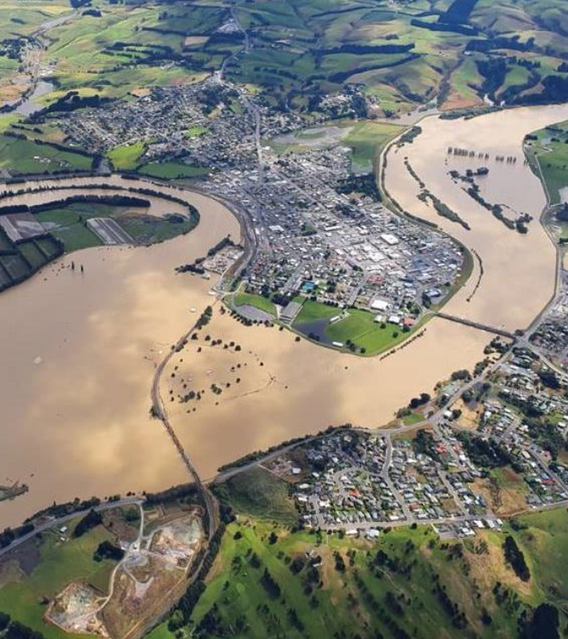
43,000
hectares
of urban and rural land across Otago protected by our flood and drainage schemes
Balclutha, February 2020
Notes:
The image shown depicts Balclutha in Feb 2020 during the Clutha flood.
Across Otago, around 43k hectares of urban and rural land sits behind our flood protection and drainage infrastructure. That is what the Infrastructure Strategy is about: keeping this protection working for the next 30 years and beyond.

Slide 3
Why we are here today
First of two Council workshops informing the Infrastructure Strategy (IS) review
1
The review is underway
The next IS will be adopted with the 2027-2037 Long-term Plan.
2
Today covers the basics
What the ‘IS’ is, why we prepare one, and the assets it covers.
3
We want your input
Do the updated problem statements ring true? Your direction shapes the October draft.
Notes:
3 things today. First, the review of the current IS is underway, and the next Strategy will be adopted with the 2027-2037 Long-term Plan.
Second, the basics: what an Infrastructure Strategy is, why we prepare one, and the flood protection, land drainage and river management infrastructure it covers.
Third, and most importantly, your direction: we have run an Investment Logic Mapping workshop, and the 7 significant issues from the current infra strategy now sit inside 3 draft problem statements. So we want to know from you, do those statements ring true?
What you tell us today shapes the draft IS we bring back in October.

Slide 4
What is an Infrastructure Strategy?
Required by law
Section 101B of the Local Government Act 2002.
30
year minimum planning horizon
Adopted as part of every Long-term Plan
A clear purpose
Identify the significant infrastructure issues, the principal options, and implications.
Our scope
Flood protection, land drainage and river management across Otago.
Gives effect to the Soil Conservation and Rivers Control Act 1941 and Land Drainage Act 1908.
Notes:
The Strategy is a requirement of Section 101B of the LGA 2002. Every council must prepare and adopt one as part of its Long-term Plan, covering at least 30 consecutive financial years.
Its purpose is to identify the significant infrastructure issues we face over that period, the principal options for managing them, and the implications of each option.
For us that simply means flood protection, land drainage and river management, and it helps give effect to our responsibilities under the Soil Conservation and Rivers Control Act 1941 and the Land Drainage Act 1908.

Slide 5
What the Infrastructure Strategy must set out
Minimum content set by the Local Government Act 2002
1
Renew and replace
2
Respond to demand
3
Levels of service
How existing assets will be renewed or replaced as they age.
How we respond to growth or decline in demand for services.
Planned increases or decreases in levels of service.
4
Health and environment
5
Resilience
6
Most likely scenario
Public health and environmental outcomes maintained or improved.
Natural hazard risks identified and managed, with financial provision.
Indicative 30 year costs, significant decisions and assumptions.
Notes:
The Act also sets minimum content an IS must contain:
-The Strategy must outline how we renew or replace assets as they age
-How we respond to growth or decline in demand for services,
-Any planned increases or decreases in levels of service
-How public health and environmental outcomes are maintained or improved and adverse effects mitigated
-How we manage natural hazard risk, with appropriate financial provision.
-It must also present the most likely scenario: so indicative capital and operating expenditure over 30 years, the significant decisions and their timing, and the assumptions behind them, including where they are uncertain.

Slide 6
Where the Infrastructure Strategy fits
ORC Strategic Directions
Vision and goals
Infrastructure Strategy
Issues, options, investment direction
Asset Management Plan
Detailed tactical plan
Operations and works
Maintenance and day to day delivery
Feeds the Long-term Plan
With the Financial Strategy, this framework provides direction for the 2027-2037 Long-term Plan.
AMP timing
Updated in parallel. Finalised once the IS is adopted and before the final Long-term Plan is adopted.
“Strategy without tactics is the slowest route to victory. Tactics without strategy is the noise heard before defeat ”_Sun Tzu
Notes:
The Strategy sits between our Strategic Directions and the Asset Management Plan.
Strategic Directions set the vision.
The Strategy turns that into significant issues, options and investment direction.
The Asset Management Plan is more granular plan that delivers it.
Together with the Financial Strategy, this framework provides direction for the Long-term Plan.
Side note: the AMP is being updated in parallel, and will be finalised once the Strategy is adopted and before the final Long-term Plan is adopted, therefore all three plans stay aligned.

Slide 7
Asset management planning
Every asset, managed across its whole life
Dispose
Plan
Structured Asset Management gives effect to the IS
Knowing what we own, its condition, and when to intervene.
Asset
lifecycle
Key AM improvements into the future:
AM Policy development, cyclic condition data collection across the asset portfolio
Renew
Create
A refreshed asset information system, enabling an integrated approach to asset and financial management
The result Strategic direction, confident lifecycle forecasts, optimised work programmes.
Maintain
Operate
Notes:
Asset management is the discipline underneath all of this: knowing what we own, what condition it is in, and when to intervene, so every dollar does the most work.
Each asset moves through the same lifecycle. We plan it, create it, operate and maintain it, renew it and eventually dispose of it.
And we will keep lifting our practice into the future: In development is an Asset Management Policy, planning for a cyclic asset data and condition collection regime, a refreshed asset management information system which will enable stronger link between asset and financial management.
The result is defined strategic direction, lifecycle costs we can forecast with more certainty, and optimised forward works programmes.

Slide 8
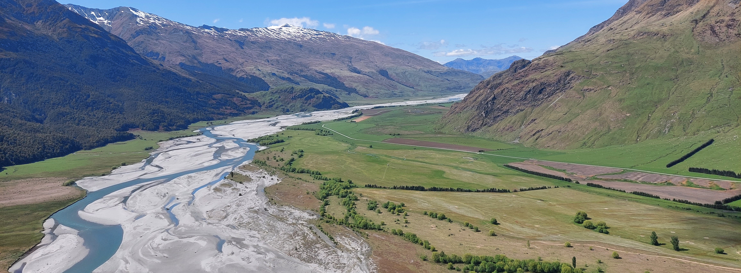
Our infrastructure
What the IS covers, and where
Matukituki River Braiding, Apline Headwaters
Notes:
Next, a quick tour of the infrastructure itself.

Slide 9
What the Infrastructure Strategy covers
Three types of infrastructure, working together
Flood protection
Mitigates floods
Land drainage
Drains low-lying land
River management
Aids channel management
Floodbanks
Pump stations
Gates and locks
Spillways
Ponding and floodways
Culverts and bridges
Flood walls
Rock work
Debris traps
Trees
Pump stations
Gravity outfalls
Open drains
Culverts and bridges
Rock buttresses
Training lines
Groynes
Trees
Notes:
Three types of infrastructure work together. Flood protection mitigates the impact of floods: floodbanks, pump stations, gravity gates and locks, spillways, ponding areas and floodways, culverts and bridges, flood walls, rock work, debris traps and trees.
Land drainage keeps low-lying land usable: pump stations, gravity outfalls, open drains, culverts and bridges.
River management aids channel management within river systems: rock buttresses, training lines, groynes and trees.

Slide 10
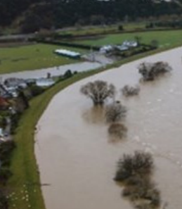
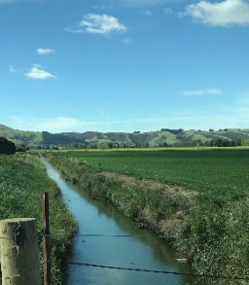
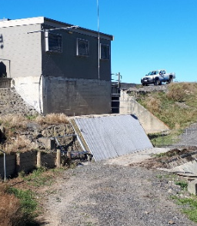
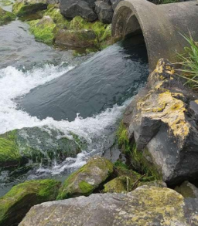
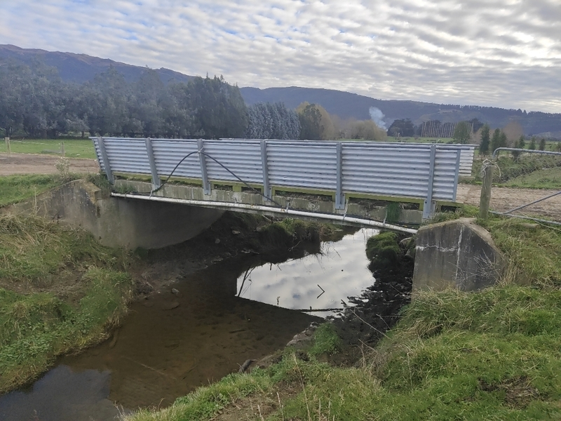
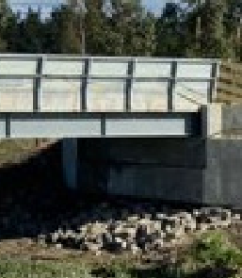
The asset portfolio at a glance
218 km
Floodbanks
535 km
Open drains
14
Pump stations
369
Culverts
42
Bridges
Plus gates, spillways, weirs, groynes, training lines, flood walls, rock work, debris traps and trees
Key infrastructure. Not exhaustive.
Notes:
Some scale for context. 218 kilometres of floodbanks, 535 kilometres of open drains, fourteen pump stations, 369 culverts and 42 bridges, plus gates, spillways, weirs, groynes, training lines and more.
Much of this was built by earlier generations.
Our job is to keep it serving the next ones.

Slide 11
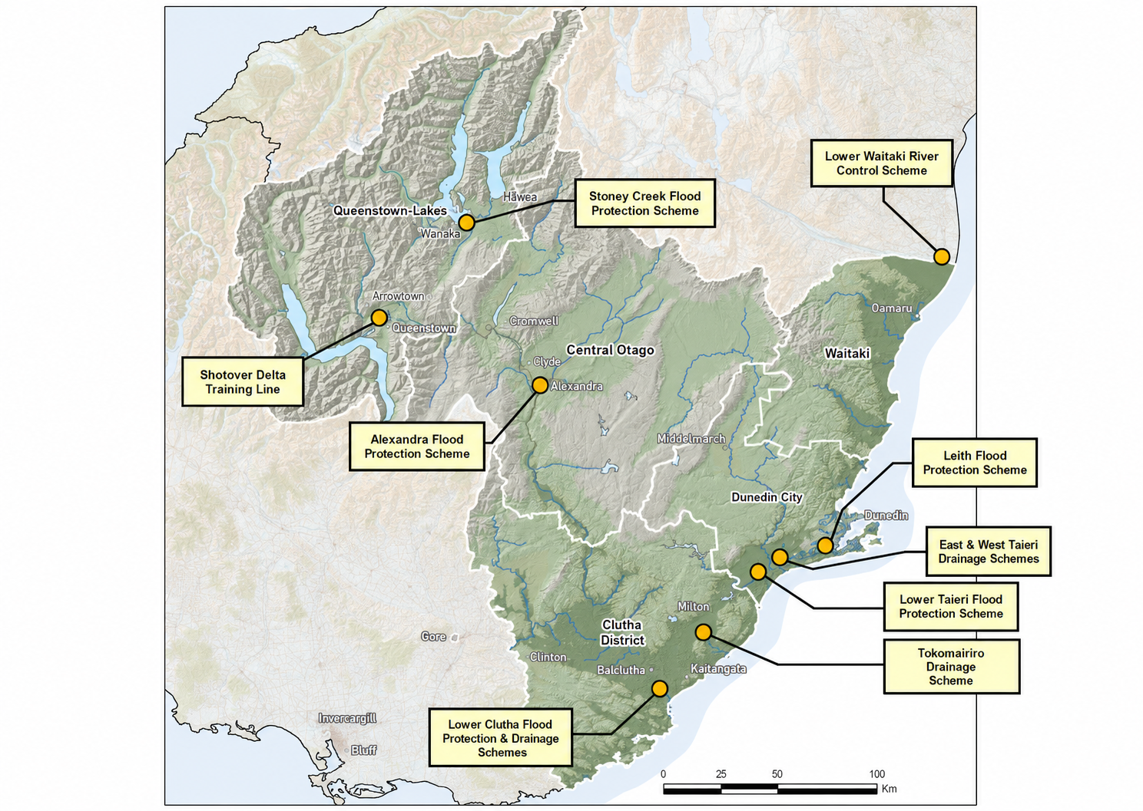
Where the schemes are
9
flood protection, drainage & river control schemes
Territorial authorities also own flood infrastructure.
Notes:
9 flood protection, drainage and river control schemes across the region: Alexandra, the Leith in Dunedin, Lower Clutha, Lower Taieri, West and East Taieri, Tokomairiro, Lower Waitaki and Stoney Creek near Wanaka.
River management infrastructure sits across wider areas, from the Shotover and Matukituki training lines through to the Lower Waitaki floodways.
Worth noting that territorial authorities and other parties also own flood infrastructure in Otago.

Slide 12
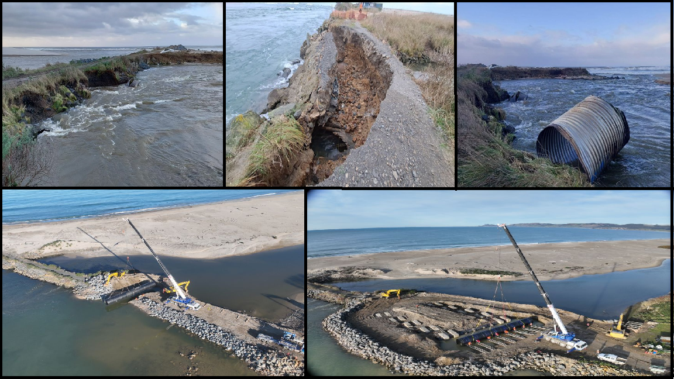
Significant Issues and Problem Statements
The seven issues in the current IS, and the draft problem statements they now inform
Notes:
Now the significant issues, and how we test them.

Slide 13
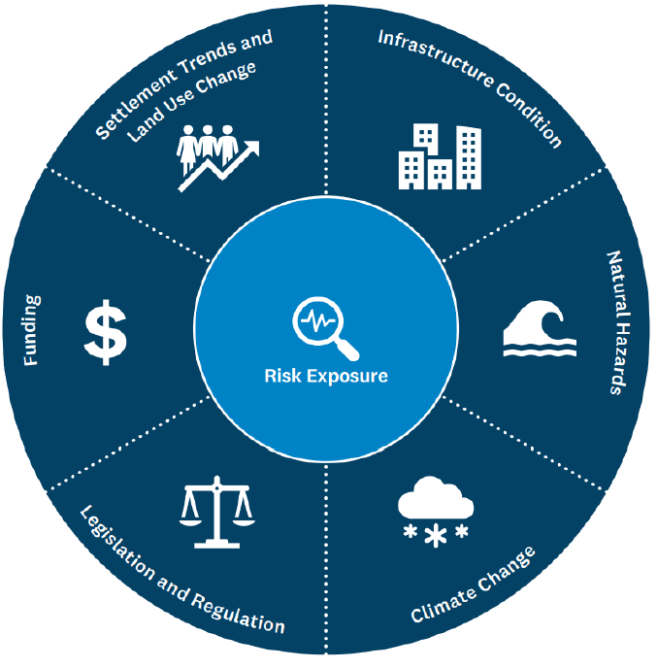
Seven closely linked issues in the current Infrastructure Strategy
Risk exposure is the common denominator.
Each issue changes the risk our schemes and communities carry.
Through Investment Logic Mapping, these seven are now the contributing factors behind three draft problem statements.
Notes:
The current Strategy identifies 7 encompassing significant issues which are closely linked.
XXX
Risk exposure is the common denominator: every one of the other six changes the risk our schemes are exposed to, and the risk our communities carry.
These issues have not gone away. Through the Investment Logic Mapping work they have become the contributing factors behind three draft problem statements, which I will come to shortly.

Slide 14
From issues to an investment story
Investment Logic Mapping workshop, 28 July 2026
A facilitated workshop under the Treasury’s Better Business Case approach, with an independent accredited facilitator.
Natural Hazards and Engineering in the room together: Assets and Delivery, Planning and Partnerships, Rivers, and Operations and Maintenance.
50+
issues raised
13
themes
Cause
and effect
3
problem statements, weighted
4
benefits defined
The seven significant issues are not lost. They are the contributing factors to the three draft problem statements.
Notes:
We have taken a big step to improve the way we collaborate across teams and strategize. On 28 July we ran a facilitated Investment Logic Mapping workshop under the Treasury's Better Business Case approach, with an independent accredited facilitator.
Natural Hazards and Engineering were in the room together: Assets and Delivery, Planning and Partnerships, Rivers, and Operations and Maintenance. We started with more than fifty raw issues, grouped them into 13 themes, worked each theme through cause and effect, and landed on 3 weighted problem statements and 4 benefits.
Again, the 7 significant issues captured in the current Strategy have not gone anywhere. They are the contributing factors inside these three statements. The next slide is the resulting map on a single page.

Slide 15
The draft Investment Logic Map
Otago flood protection, drainage and river management
Long-term investment for reliable, affordable and resilient schemes in a changing climate
Problem Statements
Benefit Statements
Changing land use and unclear council, agency and landowner roles leave communities unclear on risk and scheme limits.
45%
Reliable scheme performance at efficient whole-of-life cost
45%
25%
Lower long-term risk exposure, greater resilience
Legacy assets and gaps in whole-of-life planning undermine affordability and shift costs and risk to future generations.
Response and solution: next stage
35%
15%
Communities understand risks, limits and responsibilities
Asset condition and hazard information gaps limit confidence in decisions about scheme performance and risk.
20%
Improved environmental condition and river function
15%
Notes:
This is the draft Investment Logic Map on a single page.
The left column holds the three problem statements with their weightings, exactly as agreed at the workshop. The right column holds the four benefits future investment should deliver, abridged here and shown in full later in this section.
The response and solution stages have not been done yet. That is the next piece of work, and your direction on the problem statements shapes it.

Slide 16
Draft problem statement 1
45%
Changing land use and unclear council, agency and landowner roles leave communities unclear on risk and scheme limits.
How we got here
Draws on the significant issues
■ Settlement trends and land use
■ Legislation and regulatory
■ Risk exposure
Development and land use change are adding pressure, while ORC has limited control over where growth occurs.
The Council, territorial authorities, agencies and landowners share responsibility for flood risk, and the split is not always clear. Communities do not consistently understand the residual risk they carry or the protection the schemes are designed to provide.
Weighted highest: these pressures raise both the demand on schemes and the consequences of underperformance.
Evidence raised: stormwater pressure at Outram and Mosgiel, growth behind schemes, ongoing planning interfaces with councils.
Notes:
The first draft problem statement, weighted at 45%: changing land use and unclear council, agency and landowner roles leave communities unclear on risk and scheme limits.
This brought together the workshop's strongest themes. Land use is changing and responsibility for flood risk is shared between ORC, other councils, agencies and landowners. The split isn't always clear, even to the parties themselves. It shows up on three fronts - Who influences where growth goes. Who owns and maintains which assets. And who carries the risk that's left once a scheme reaches its limits.
And Communities do not consistently understand the residual risk they carry or the protection the schemes are designed to provide.
Evidence the workshop pointed to included urban growth adding stormwater pressure around Mosgiel and Outram; There are more people and more property relying on the schemes than there used to be. And ongoing planning interfaces which are important because the decisions about where growth goes typically sit with the territorial authorities, while our scheme infrastructure carry the outcome.
It was weighted highest because these pressures increase the demand on the schemes, and they increase the consequences if a scheme underperforms.

Slide 17
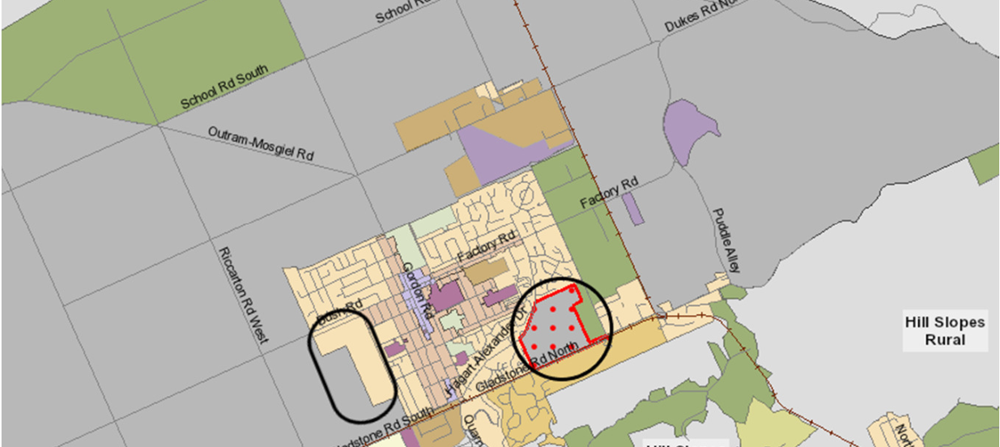
The issues in brief · Problem statement 1
Settlement trends & land use
Development increases the people and property relying on the schemes for protection, and changes runoff patterns.
Approach Work with territorial authorities through their planning processes, so new development does not rely on the schemes beyond what they are designed to provide.
Where risk remains, choose the right response for each place: protect, avoid, retreat or accommodate (PARA).
Deferred residential zoning, Dunedin 2GP
Notes:
Settlement trends and land use change: development can increase dependency on the schemes and change runoff patterns. The map shows Dunedin’s 2nd generation district plan with deferred residential zoning around Mosgiel.
The current approach is to work proactively with territorial authorities to ensure that new development does not rely on the schemes beyond what they are designed to provide, Where risk remains, we choose the right response through application of the PARA framework: protect, avoid, retreat, accommodate.

Slide 18
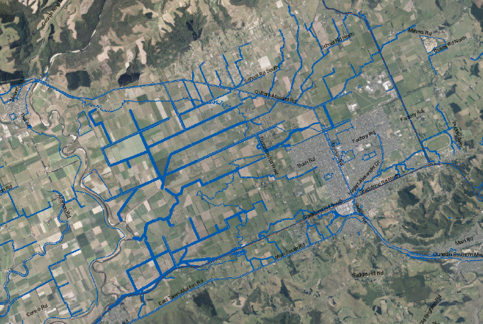
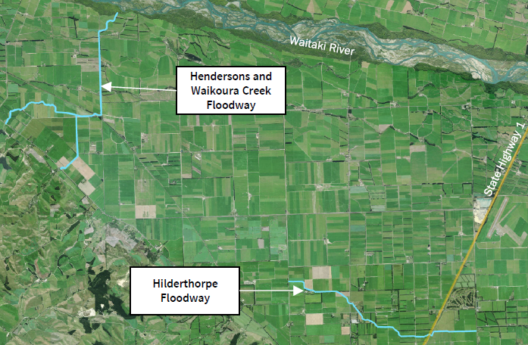
The issues in brief · Problem statement 1
Legislation and regulatory
Schemes reflect the values of their era. Standards keep moving. Central government and community expectations are evolving. On the brink of major reform.
Approach Seek improved environmental performance and co-benefits through nature based solutions where possible. Proactively engage TA’s and central government early on policy and plan changes.
DCC 2nd Generation Plan (2GP) - Designations Layer
• Flood protection and drainage
• Telecommunications, rail, electricity, state highways
Waitaki District Council Designations - Lower Waitaki
Flood Control Scheme
Notes:
Legislation and regulatory: the schemes reflect the values of the era they were built in, and standards, central govt and community expectations continuously evolve, with a major reform ongoing.
The current approach engage proactively wit TA’s and central government on policy and plan changes ,and where appropriate, seek enhanced environmental performance and co-benefits through nature based solutions.

Slide 19
Draft problem statement 2
35%
Legacy assets and gaps in whole-of-life planning undermine affordability and shift costs and risk to future generations.
How we got here
Draws on the significant issues
■ Infrastructure condition
■ Funding
■ Risk exposure
Ageing assets, historic design and funding decisions, and renewals that are hard to plan across long lives.
Delaying investment or relying on reactive funding transfers cost and unresolved risk to future ratepayers.
An asset management challenge, and a question of long-term affordability and intergenerational fairness.
Evidence raised: 150 years of assets, major renewals ahead, uninsurable floodbanks, recovery displacing planned work.
Notes:
The second PS, at 35 %: legacy assets and gaps in whole-of-life planning undermine affordability and shift costs and risk to future generations.
This reflects ageing infrastructure, historic design and funding decisions, and how hard it is to plan large renewals across very long asset lives.
Delaying investment or relying on reactive funding transfers cost and unresolved risk to future ratepayers.
The evidence included assets built over about 150 years, significant renewals ahead, uninsurable floodbanks, finite scheme reserves, and recovery work displacing planned programmes.
Infrastructure condition and funding sit at its core, with risk exposure running through it.

Slide 20
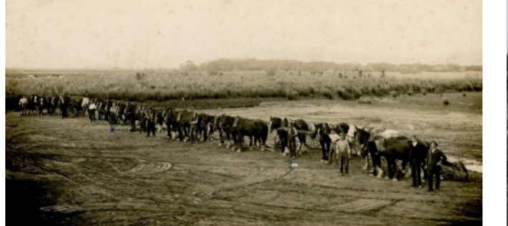
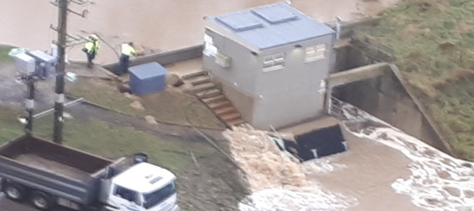
The issues in brief · Problem statements 2 and 3
Infrastructure condition
Built over 150 years. Condition degrades, older records are patchy.
Approach Protecting what we own through prioritised risk based renewals, backed by robust inspection and condition data.
Contour Channel under construction, early 1900s
Mill Creek Pump Station, East Taieri, 2017 flood
Notes:
Infrastructure condition. These assets have been built over 150 years. The photo is the Contour Channel under construction in the early 1900s. Condition degrades, records for older assets are patchy, and floodbanks have several potential failure modes.
Our current approach is risk based prioritisation of renewals, informed by robust inspection, condition programmes and end of life deterioration forecasts.

Slide 21
The issues in brief · Problem statement 2
Funding
General ageing infrastructure and funding pressures.
Rating impacts and pressure on communities.
There is an expectation to do more with less or same level of funding.
Recovery from the 2020 to 2023 floods often displaced planned work.
Approach Maintain current levels of service and continue to pursue central government co-investment, plan with and without it.
Notes:
Funding: flood recovery is costly and unpredictable, and recovery from the 2020 to 2023 events often came at the expense of planned work.
We will keep pursuing central government co-investment and plan for scenarios with and without it. We’ve had recent successes securing funding through Regional Infrastructure Fund climate resilience programme and will continue to pursue similar avenues

Slide 22
Draft problem statement 3
20%
Asset condition and hazard information gaps limit confidence in decisions about scheme performance and risk.
How we got here
Draws on the significant issues
■ Infrastructure condition
■ Natural hazards
■ Climate change
■ Risk exposure
Missing records, incomplete condition information, and limited understanding of how schemes function.
Schemes are rarely tested at full design standard, yet must perform when significant events arrive.
An enabling problem: it shapes how well we prioritise investment and understand the risk communities carry.
Evidence raised: incomplete historic records, condition data being formalised, evolving hazard and climate knowledge.
Notes:
The third, at 20 %: asset condition and hazard information gaps limit confidence in decisions about scheme performance and risk.
This PS revolves around missing or inaccessible asset data records, incomplete condition information, limited understanding of how schemes function, and evolving climate, flood, seismic and coastal hazard knowledge.
These assets are rarely tested at their full design standard, yet they must perform when it matters.
It is framed as an enabling problem, but it directly affects how well we prioritise investment and understand the risk communities carry.
Infrastructure condition, natural hazards and climate change are the current significant issues that feed it.

Slide 23
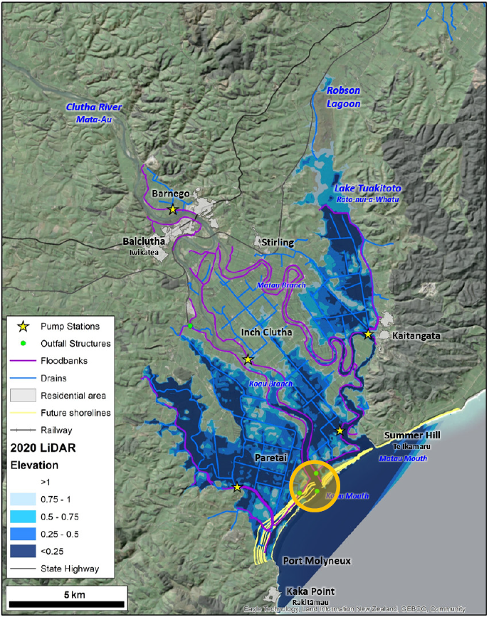
The issues in brief · Problem statement 3
Natural hazards
Floods, landslides, earthquakes, tsunamis, coastal erosion and storm surge can damage the scheme infrastructure.
Approach Maintain and improve practices relating to hazard readiness, response and recovery. Increased efforts to raise awareness and educate communities around natural hazards they may be at risk from.
Lower Clutha Delta
Notes:
Natural hazards: flooding, landslides, earthquakes, coastal erosion, tsunami, storm surge and wind can all damage the very scheme infrastructure built to protect against them. Mill Creek pump station that was damaged in 2017 is a good example.
The image shows the lower clutha delta with land elevation relative to sea level (blue) and projected shoreline retreat (yellow lines)
We will keep improving readiness, response and recovery, applying lessons from events here and around the country. We will continue to increase efforts to raise awareness and educate communities around natural hazards that pose a risk to them.

Slide 24
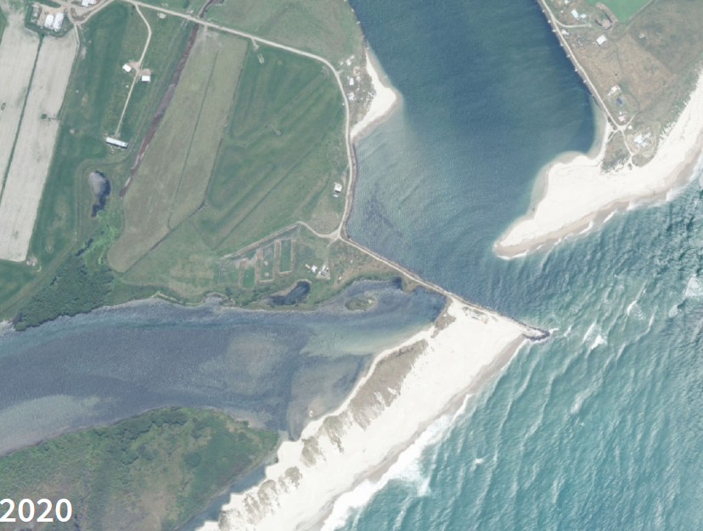
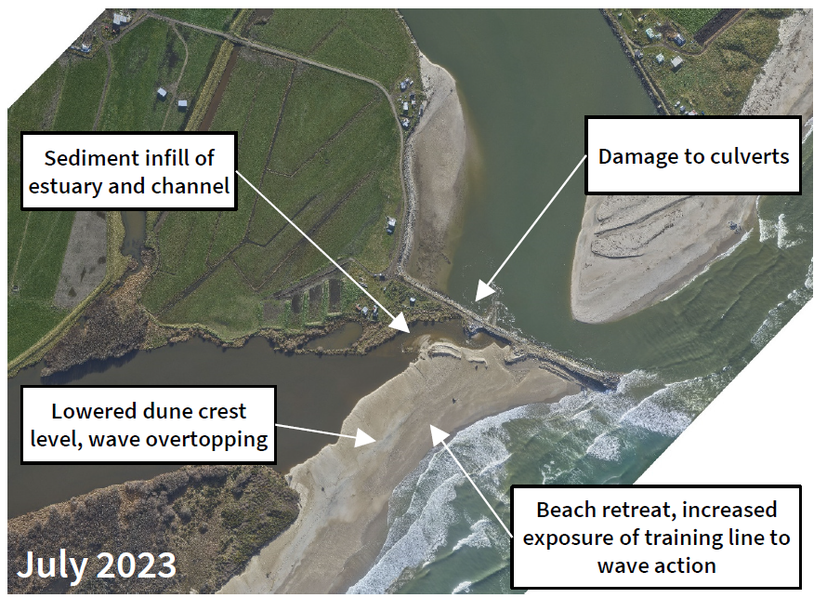
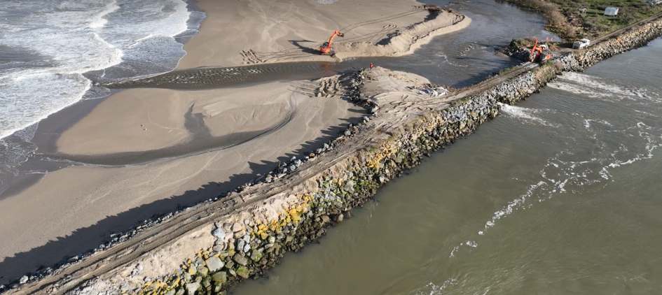
The issues in brief · Problem statement 3
Climate change
The National Institute of Water and Atmospheric Research (NIWA) projects larger floods and intensity, rising seas and higher water tables.
Approach Understand each scheme's exposure, build it into adaptation planning.
Puerua Outfall, Lower Clutha, 2020
Puerua Outfall, Lower Clutha, July 2023
Puerua Outfall, Lower Clutha, August 2023
Notes:
Climate change: NIWA's projections for Otago point to larger floods, higher average flows, sea level rise and higher water tables. The Puerua Outfall repairs in 2023 show what that pressure looks like on the ground. Our approach is to continue to improve our understanding of the effects on each scheme and build that knowledge into adaptation planning with communities.

Slide 25
The benefits sought
What success looks like if the problems are addressed
45%
Reliable scheme performance at an efficient whole-of-life cost.
Draft Measure: schemes verified capable of meeting agreed levels of service.
25%
Lower long-term risk exposure and greater resilience to changing hazards and climate.
Draft Measure : change in quantified residual risk to people, property and critical services.
15%
Communities understand scheme risks, limits and responsibilities and can participate in informed decisions.
Draft Measure : affected communities understanding scheme risk, limits and responsibilities.
15%
Improved environmental condition and natural river function.
Draft Measure : monitored sites with maintained or improved ecological condition.
Response and Solution stages follow.
Notes:
The workshop also defined the value we expect if these problems are addressed.
Reliable scheme performance at an efficient whole-of-life cost carries the greatest weight at 45 %.
Then lower long-term risk exposure and greater resilience at 25%,
communities understanding scheme risks, limits and responsibilities at 15,
and improved environmental condition and natural river function at 15.
Each has a measure of success attached.
The response and solution stages of the ILM come next, and they will shape the options we bring back in October.

Slide 26
Planning through reform
For Engineering, it is business as usual
Reform brings uncertainty
Water services, resource management and the shape of local government are all moving.
The rivers keep flowing and the schemes keep running, whatever the structure.
The IS records what we own, the risks we carry and the investment needed.
That evidence base makes any transition smoother, for Council and for communities.
Notes:
A word on reform. Water services, resource management and the shape of local government are all moving. For Engineering at ORC, it is business as usual. The rivers keep flowing and the schemes keep running, whatever structure the sector lands on. Our infrastructure strategy and asset plan records what we own, the risks we carry and the investment the schemes need, enabling a smoother transition for Council and communities.

Slide 27
Testing the problem statements
For context: Since the IS was adopted
October 2024
Flooding across Dunedin, coastal Clutha and North Otago, with local emergencies declared.
October 2025
Major wind event affecting several parts of Otago.
January 2026
The National Policy Statement for Infrastructure came into force, enabling operation, maintenance and upgrade.
July 2026
Flooding across Dunedin, coastal Clutha and North Otago, with local emergencies declared.
Ongoing
Resource management transition continues; On the brink of major local government reform.
What we are asking today
1 Do the three problem statements ring true?
2 Are the weightings about right?
3 Are there any additional issues we should consider?
4 Early views on the benefits sought?
Notes:
Now over to you, and this is the direction we are seeking today.
Do the three draft problem statements ring true?
Are the weightings about right?
Looking back at the seven significant issues, is anything missing or lost in translation?
And any early views on the benefits sought?
For context, since the current Strategy was adopted we have had the October 2024 flooding, the October 2025 wind event, the National Policy Statement for Infrastructure in force from January 2026, the July 2026 flooding, and the resource management transition continuing alongside local government reform.

Slide 28
Next steps and timing
27 August 2026
August to October
(14-tbc) October 2026
By December 2026
Workshop 1: purpose, assets, testing the problem statements
Problem statements refined, responses and solutions developed, draft prepared
Workshop 2: direction, options, draft Infrastructure Strategy
IS adopted December 2026
In parallel the Asset Management Plan is updated alongside the Strategy, finalised between Strategy adoption and Long-term Plan adoption.
Notes:
Where to from here.
Today's direction goes straight into refining the problem statements. The response and solution stages of the ILM follow through August to October.
Workshop 2 on 14 October brings back the direction, the options and a draft Strategy.
It is then finalised for adoption in December 2027.
In parallel, the Asset Management Plan is being updated, and will be finalised once the Strategy is adopted and before the Long-term Plan is adopted.

Slide 29
Thank you
Questions and discussion
Notes:
Thank you. Over to questions and discussion.

